Slide 1
Hormones
5.1.4 a & B

Slide 2
Starter : Key terms: What do they mean?
Hormone
Endocrine gland
Exocrine gland
Target cells

Slide 3
Key terms: What do they mean?
Hormone
Molecules released by endocrine glands directly into blood. Act as messengers carrying signal from endocrine gland to target tissue
Endocrine gland
Secretes hormones directly into the blood eg pancreas
Exocrine gland
Secretes molecules into a duct which carries them to where they are used eg salivary gland
Target cells
Possess specific receptor on their plasma membrane. Shape of receptor is complementary to the shape of the hormone molecule.

Slide 4
Success Criteria
(a) endocrine communication by hormones
To include secretion of hormones into the blood, transport by the blood, and detection by target cells or tissues.
(b) the structure and functions of the adrenal glands
Adrenal glands as an example of endocrine glands, to include the hormones secreted by the cortex and medulla and their functions.

Slide 5
Endocrine Communication by Hormones
Hormones are secreted into the blood
By endocrine (ductless) glands, a group of cells make the hormone and release it into capillaries running through the gland
Transported by the blood
Detected by target cells/tissues
Target cells can be grouped together or more widespread throughout the body
Have a receptor with a specific shape, complementary to the shape of the hormone

Slide 6
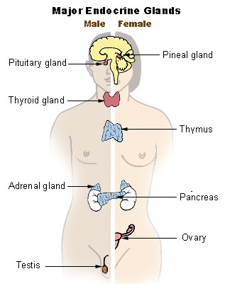
Major endocrine glands
Endocrine gland | Hormone
Pituitary | Growth
Thyroid | Thyroxin
Adrenal | Adrenalin
Pancreas | Insulin Glucagon
Ovary | Oestrogen
Testes | Testosterone

Slide 7
Hormones
There are 2 types
Protein and peptide hormones and derivatives of amino acids eg adrenalin and insulin
Not soluble in the phospholipid membrane and do not enter the cell
Steroid hormones eg sex hormones
Can pass through the membrane and enter the cell

Slide 8
First and Second Messenger systems
Non-steroid hormones are first messengers (they do not enter the cell)
They bind to receptors on the outside of the cell and initiate effects inside.
They cause the release of secondary messengers which in turn stimulate a change in the activity of the cell
Notes:
Use diagram from book p23

Slide 9
Second Messenger System
First messenger binds to receptor
G protein activated
This activates adenyl cyclase
This converts inactive ATP into cyclic AMP (cAMP). This is the secondary messenger
cAMP may act directly on another protein or initiates a cascade of enzymes controlled reactions

Slide 10
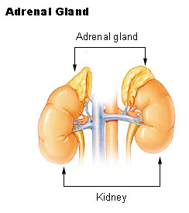
Adrenal Gland structure

Slide 11
Adrenal Cortex
Zona glomerulosa
Secretes mineralocorticoids
E.g. aldosterone
Zona fasciculata
Secretes glucocorticoids
E.g. cortisol
Zona reticularis
Secretes precursor molecules used to make sex hormones

Slide 12
Adrenal Medulla
Not differentiated into regions
Consists of chromaffin cells
Extension of the sympathetic nervous system
Secretes adrenaline and noradrenaline

Slide 13
Function of Adrenal Glands
Adrenal Medulla
Responds to stress e.g. pain or shock
Widespread effect as most cells have receptors for adrenaline
Adrenal Cortex
Makes steroid hormones
FLIP Learning Task: use p66-67 (p23 old book) to add more detail to the roles of AM & AC

Slide 14
Plenary
Adrenaline affects a range of target tissues in the body. Suggest how the adrenaline molecule can cause different effects in different target tissues. (2)
Outline how adrenaline activates enzymes within the target cell [5]

Slide 15
Plenary
Adrenaline affects a range of target tissues in the body. Suggest how the adrenaline molecule can cause different effects in different target tissues. (2)

Slide 16
Plenary
2. Outline how adrenaline activates enzymes within the target cell [5]
Adrenaline can’t enter the cell
Adrenaline binds to receptor on target cell
Complementary shape
Adrenaline first messenger
G protein activated
Activates adenyl cyclase
Changes ATP into cAMP
cAMP second messenger
cAMP activates enzyme in the cell

