Slide 1
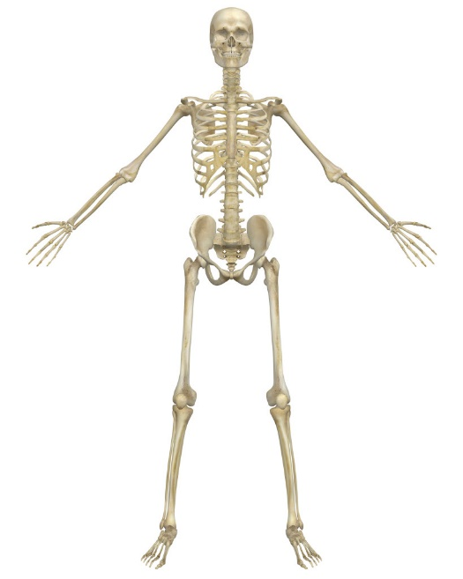
B5a skeletons
Advantages of internal skeleton
Framework
Grow with the body
Attach muscles
Flexible
Structure of long bone
Head covered with cartilage
Shaft containing bone marrow with blood vessels
Hollow to be stronger and weigh less

Slide 2
B5a Skeletons
Cartilage and bone are living
Can get infected
Can grow and repair themselves
Skeleton starts off as cartilage
Undergoes ossification
Add calcium and phosphorus
More cartilage = younger
Osteoporosis
Weak/softer bones
Prone to fractures

Slide 3
B5a Skeletons
Synovial joints
Synovial fluid (lubricates)
Synovial membrane (keeps fluid within joint)
Ligaments (join bones)
Cartilage (cushions)
Types of joint
Ball and socket
Hinge
Arm
Antagonistic muscles (bicep and tricep)
Example of a level

Slide 4
B5 Question 1
Which 2 elements are added in ossification?

Slide 5
B5 Question 1
Which 2 elements are added in ossification?
CALCIUM & PHOSPHORUS

Slide 6
B5 Question 2
Name the antagonistic muscles that bend and straighten the arm

Slide 7
B5 Question 2
Name the antagonistic muscles that bend and straighten the arm
BICEP & TRICEP

Slide 8
B5b Circulatory systems
Single
One circuit from the heart e.g. Fish
Two chambers
Double
Two circuits from the heart e.g. Mammal
Four chambers
Higher pressure so transport is quicker
Galen
Importance of pulse & heart is a pump
Harvery
Circulation e.g. Valves, capillaries

Slide 9
B5b Circulatory systems
Cardiac Cycle
Systole (contract)
Diastole (relax
Atria contract forcing open AV valves
Ventricles contract forcing shut AV valves and open semi lunar valves
Adrenaline
Hormone that increases heart rate
Echocardiogram
Ultrasound of heart to see it beating

Slide 10
B5b Circulatory Systems
Heart muscle contraction
Controlled by groups of cells that produce small electric current (pacemaker/SAN)
SAN impulse causes the atria to contract and stimulates the AVN
AVN causes the ventricles to contract
Artificial Pacemakers
Used to control heart beat
ECG
Looks at electrical current of the heart

Slide 11
B5 Question 3
How many chambers does the heart have?

Slide 12
B5 Question 3
How many chambers does the heart have?
FOUR

Slide 13
B5 Question 4
What is the name of the pacemaker cells in the heart?

Slide 14
B5 Question 4
What is the name of the pacemaker cells in the heart?
SINO ATRIAL NODE

Slide 18
B5c running repairs
Hole in the heart
Blood can directly move between sides of the heart
Less oxygen in the blood, as oxygenated and deoxygenated blood mix
Corrected by surgery
Unborn babies naturally have a hole in the heart that closes soon after birth

Slide 19
B5c Running repairs
Weak/Damaged Valves
Reduce effective blood circulation
Can be replaced by artificial valves
Blocked coronary artery
Reduces blood flow to muscles, so less oxygen
Can be treated with bypass surgery
Treatment for heart problems
Heart assist devices used before transplants
Heart transplant: risk of rejection and have to take immuno-suppressants

Slide 20
B5c Running Repairs
Blood donation
Blood Transfusion
Unsuccessful = agglutination (blood clumping)
Agglutinins determine how blood types react
E.g. Type A
Antigen A
Antibody Anti-B
Blood clotting
Platelets meet damaged blood vessels, causes a series of reactions forming a mesh of fibrin fibres
Haemophilia is inherited condition where blood doesn’t clot
Control clotting: warfarin, heparin, aspirin

Slide 21
B5 Question 5
What is the standard treatment for a blocked coronary artery?

Slide 22
B5 Question 5
What is the standard treatment for a blocked coronary artery?
BYPASS SURGERY

Slide 23
B5 Question 6
What is agglutination?

Slide 24
B5 Question 6
What is agglutination?
BLOOD CLUMPING CAUSED BY MIXING BLOOD TYPES

Slide 25
B5d Respiratory system
Gas exchange systems restrict animals to their habitats
Amphibians need moisture (permeable skin makes them susceptible to water loss)
Fish gills only work in water (work by forcing water across the filaments)
Gas exchange systems adaptations
Permeable
Moist
Large surface area (alveoli)
Good blood supply
Lining one cell thick

Slide 26
B5D respiratory systems
Breathing
Inhalation: increase volume = decrease pressure
Exhalation: decrease volume = increase pressure
Tidal Air
Amount of air in a normal breath
Vital Capacity
Total amount of air can breathe out
Residual Air
Amount of air left in the lungs

Slide 27
B5d respiratory systems
Protects against disease
Mucus wafted by ciliated cells
Lung diseases
Asbestosis
Industrial cause
Inflammation and scarring limits gas exchange
Cystic Fibrosis
Genetic cause
Too much mucus in bronchioles
Lung Cancer
Lifestyle cause
Cells grow rapidly reducing surface area
Asthma
Symptoms: difficulty breathing, wheezing, tightness
Treatment: Inhaler
Asthma attack: Lining becomes inflamed, fluid builds up in air ways, muscles contract and constrict bronchioles

Slide 28
B5 Question 7
What does the term ‘residual air’ mean?

Slide 29
B5 Question 7
What does the term ‘residual air’ mean?
AIR LEFT IN THE LUNGS WHEN YOU BREATHE OUT DEEPLY

Slide 30
B5 Question 8
What two muscles are involved in breathing in and out?

Slide 31
B5 Question 8
What two muscles are involved in breathing in and out?
DIAPHRAGM & INTERCOSTAL

Slide 32
B5 Question 9
Give an example of an industrial lung disease

Slide 33
B5 Question 9
Give an example of an industrial lung disease
ASBESTOSIS

Slide 34
B5 Question 10
Give an example of a lifestyle lung disease

Slide 35
B5 Question 10
Give an example of a lifestyle lung disease
LUNG CANCER

Slide 38
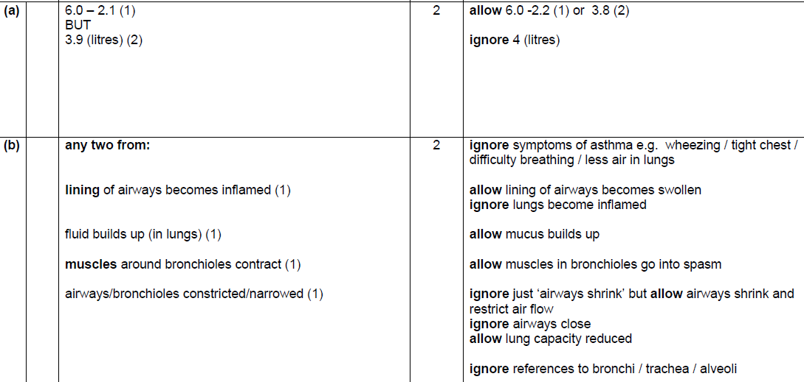

Slide 39
B5E Digestion
Physical digestion
Food passes more easily through digestive system
Provides larger surface area
Enzymes
Carbohydrase = starch → sugar
Protease = protein → amino acids
Lipase = fat → fatty acids + glycerol
Enzyme and pH
Stomach acid aids protease function
Mouth and small intestine are alkaline

Slide 40
B5e Digestion
Bile
Made in gall bladder
Increases surface area of fats to improve digestion
Starch digestion
Amylase breaks starch → maltose
Maltase breaks maltose → glucose
Small intestine
Absorbs small molecules into the blood plasma by diffusion
Large surface area due to villi

Slide 41
B5 Question 11
What is the role of bile salts in digestion?

Slide 42
B5 Question 11
What is the role of bile salts in digestion?
EMULSIFY FATS
CREATE LARGER SURFACE AREA FOR LIPASE TO WORK

Slide 43
B5 Question 12
What two enzymes are involved in starch digestion?

Slide 44
B5 Question 12
What two enzymes are involved in starch digestion?
AMYLASE & MALTASE

Slide 45
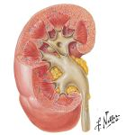
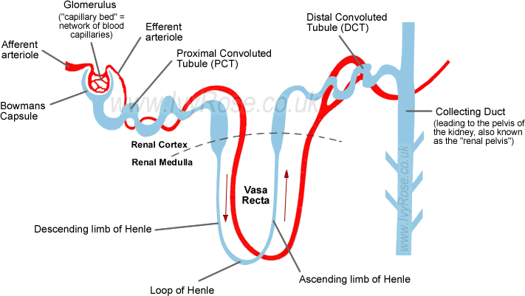
B5f Waste Disposal
Blood plasma
Needs constant water concentration
Gross structure of kidney
Cortex
Medulla
Ureter
Renal artery and Renal vein
Kidney Tubule
Filter unit (glomerulus and capsule)
Area of selective reabsorption
Area of salt and water regulation

Slide 46
B5f Waste Disposal
Urea
Made in liver from excess amino acids
Removed from blood by the kidney
Urine
Amount made depends on heat & exercise (sweating) and water intake
ADH
Anti-diuretic hormone
Released by pituitary gland
Controls water levels in urine
Increases permeability of kidney tubules so more water is reabsorbed in to the blood
Controlled by negative feedback

Slide 47
B5f Waste Disposal
Carbon dioxide
High levels must be removed from the body
Turns blood acidic
Detected by the brain
Results in increased breathing

Slide 48
B5 Question 13
Name the 4 main excretory organs

Slide 49
B5 Question 13
Name the 4 main excretory organs
SKIN
LIVER
KIDNEYS
LUNGS

Slide 50
B5 Question 14
How do the kidneys work?

Slide 51
B5 Question 14
How do the kidneys work?
FILTER AT HIGH PRESSURE
REABSORB WATER & USEFUL SUBSTANCES

Slide 52
B5 Question 15
Which hormone controls urine concentration?

Slide 53
B5 Question 15
Which hormone controls urine concentration?
ADH: Anti-Diuretic Hormone

Slide 56
B5g Life Goes On
Menstrual Cycle
Oestrogen repairs uterus wall
Progesterone maintains uterus wall
FSH stimulates egg to develop
LH causes ovulation
Pituitary gland releases FSH and LH
Controlled by negative feedback
Foetal screening
Amniocentesis
Chromosomal analysis
Test for e.g. Down’s syndrome
Raises ethical issues: miscarriage, abortion, quality of life

Slide 57
B5g Life Goes On
Treatments for infertility
Artificial Insemination
FSH
In vitro fertilisation (IVF) (outside the body)
Egg donation
Surrogacy
Ovary Transplant
Ethical issues
If baby genetically theirs?
Benefits: allows infertile couples to have a baby

Slide 58
B5g Life Goes On
Uses of hormones
Contraceptive pill
Mimic pregnancy by inhibiting FSH
Fertility drugs
FSH to make more eggs

Slide 59
B5 Question 16
What are the 3 main stages of the menstrual cycle?

Slide 60
B5 Question 16
What are the 3 main stages of the menstrual cycle?
EGG MATURATION
OVULATION
MENSTRUATION

Slide 61
B5 Question 17
Which 4 hormones are involved in the menstrual cycle?

Slide 62
B5 Question 17
Which 4 hormones are involved in the menstrual cycle?
OESTROGEN
PROGESTERONE
FSH: FOLLICLE STIMULATING HORMONE
LH: LUTENISING HORMONE

Slide 63
B5H Growth and Repair
Extremes in height
Causes by genes or hormone imbalance
Human growth hormone is produced by pituitary and causes growth in long bones
Factors that influence growth
Diet
Exercise
Monitoring babies
Measure length, mass and head size
Provide early warning of growth problems
Use average growth charts

Slide 64
B5H Growth and Repair
Increased life expectancy
Less industrial disease
Healthier lifestyle
Healthier diet
Modern treatments and cures
Better housing
Consequences: aging population, country can’t afford health care, pensions
Mechanical replacements for organs, problems:
Size
Power supply
Materials used
Body reactions

Slide 65
B5H Growth and Repair
Shortage of donor organs
Tissue match (NOT blood match)
Size and age
Problems with transplants
Rejection
Need to take immuno-suppressive drugs
Living donors
Kidney
Dead donor
Need to have died in a way not to damage organs
Donor registry
Does it increase donor numbers?

Slide 66
B5 Question 18
Give 3 examples of body parts that can be mechanically replaced

Slide 67
B5 Question 18
Give 3 examples of body parts that can be mechanically replaced
KNEE & HIP JOINTS
KIDNEY
LENS
HEART

Slide 68
B5 Question 19
Give one problem with transplants

Slide 69
B5 Question 19
Give one problem with transplants
REJECTION
IMMUNOSUPRESSANTS

Slide 70
B5 Question 20
What causes extremes in height?

Slide 71
B5 Question 20
What causes extremes in height?
GENES
HORMONE IMBALANCE

