Slide 1
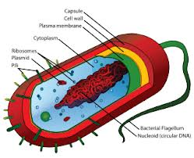
B6a Microbes: BACTERIA
Bacterial Cell
Flagellum (movement)
Cell wall (maintain shape)
DNA (control cells activities)
Main shapes of Bacteria
Spherical
Rod
Spiral
Curved Rod
Bacterial Asexual Reproduction
Binary Fission
Aseptic Techniques
Sterilise equipment
Reduce risk of disease/contamination
Bacteria are everywhere because...
Can use wide range of energy sources
Some can make their own food
Can exploit wide range of habitats

Slide 2
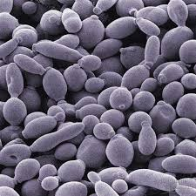
B6a Microbes: YEAST
Yeast growth rate can be increased by
Removal of products
Increase food
Optimum temperature
Optimum pH
Yeast growth rate doubles every 10ºC increase in temperature until the optimum is reached

Slide 3
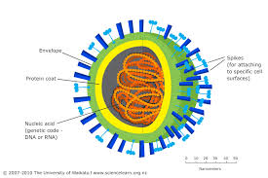
B6a Microbes: Viruses
Structure of a Virus
Protein coat surrounding a strand of DNA
Viruses
Only reproduce in other living cells
Only attack specific cells
Can attack plant, bacteria and animal cells
Reproduction
Attack to host cell
Inject DNA
Use the cell to make new components
Host cell splits open releasing more viruses

Slide 4
Question 1
What are the 4 main shapes of bacteria?
Spherical
Rod
Spiral
Curved Rod

Slide 5
Question 2
State 2 factors that effect yeast growth
Food availability
Temperature
pH
Removal of products

Slide 6
Question 3
What do viruses need to reproduce?
Living cells

Slide 9
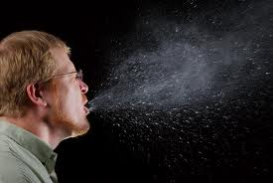
B6B Disease
Transmission | How to prevent spread
Food | Don’t mix raw and cooked meat
Water | Don’t drink the water
Contact | Condoms
Airborne droplets | Alcohol hand gels, tissues
Stages of an infectious disease
Enter body
Incubation period (pathogen reproduces)
Produces toxins
Symptoms

Slide 10
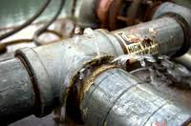
B6B Disease
Natural disasters increase spread of disease
Damage sewage and water pipes
Damage electrical supplies (can’t preserve food)
Displaces people
Disrupts health services
Antibiotics
Don’t work on viruses
Kill bacteria within the body
Some bacteria becoming resistant
Reduce this by only prescribing antibiotics when necessary and completing the course
Antiseptics
Kill bacteria outside the body

Slide 11
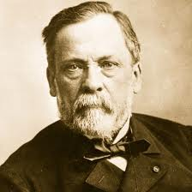
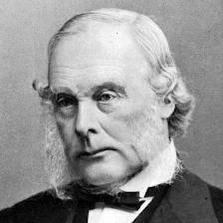
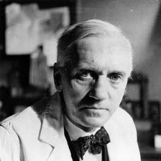
B6B Disease
Pioneers
Pasteur
Germ theory of disease
Lister
Developed antiseptics
Fleming
Discovered penicillin

Slide 12
Question 4
What is the incubation period?
Time it takes for pathogen to reproduce, before symptoms

Slide 13
Question 5
How can we stop the spread of antibiotic resistance in bacteria?
Complete the course
Only prescribe antibiotics when necessary

Slide 14
Question 6
What role did Pasteur have in treatment of disease?
Germ Theory of Disease

Slide 15
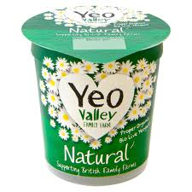
B6C Using Microorganisms
Yoghurt Making
Sterilise equipment
Pasteurise milk
Incubate culture of Lactobacillis
Breaks down lactose to make lactic acid
Sample
Add flavours/colours/packaging

Slide 16
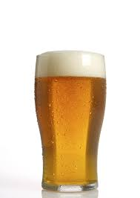
B6C Using Microorganisms
Fermentation (anaerobic respiration in yeast)
Glucose → Ethanol + Carbon dioxide
C₆H₁₂O₆ → 2C₂H₅OH + 2CO₂
Yeast can also do aerobic respiration
Stages of brewing
Extract sugar
Add yeast
Prevent entry of air and microorganisms
Clarify (clear)
Pasteurising (heat to 70ºC to kill microorganisms)
Bottle

Slide 17
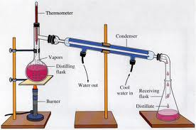
B6C Using Microorganisms
Distillation
Increases the alcohol concentration
To do this commercially you need a license
Yeast & alcohol
Yeast will stop working if alcohol level gets to high
Different strains can tolerate different levels

Slide 18
Question 7
Write the word equation for the action of Lactobacillus
Lactose → Lactic acid

Slide 19
Question 8
What is the balanced symbol equation for fermentation?
C₆H₁₂O₆ → 2C₂H₅OH + 2CO₂

Slide 20
Question 9
How can you increase the concentration of alcohol in drinks?
Distillation

Slide 21
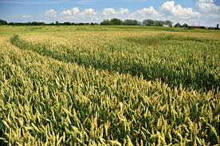
B6D Biofuels
Ways to transfer energy from biomass
Burn trees
Ferment
Burning biofuels causes no net increase in carbon dioxide
Burnt at same rate they are made
Area of land not cleared of other vegetation to grow biofuels
This can also lead to habitat loss and extinction of species
Advantages of biofuels
Alternative to fossil fuels
No net increase in greenhouse gases
No particulates

Slide 22
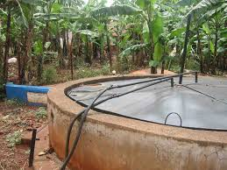
B6D Biofuels
Biogas
Mainly methane
Needs to be more than 50% to be burnt in a controlled way
Less than 10% is explosive
Some carbon dioxide
Traces of hydrogen, nitrogen and hydrogen sulphide
Made by a digester
Continuous flow method
Provide organic waste and remove the gas and remaining solids
Biogas is a cleaner fuel than petrol
But does not contain as much energy as natural gas
Biogas production is effected by temperature due to enzymes in microorganisms

Slide 23
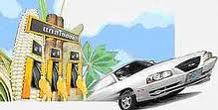
B6D Biofuels
Uses of biogas
Burned to make electricity
Burned to make steam for heating systems
Fuel for vehicles
Gasohol
Mixture of petrol and alcohol
Used for cars e.g. In Brazil
More economically viable as Brazil has large amounts of sugar cane and small oil reserves

Slide 24
Question 10
State 2 advantages of biofuels
Alternative to fossil fuels
No net increase in greenhouse gases
No particulates

Slide 25
Question 11
How is biogas made?
Ferment organic waste in a digester

Slide 26
Question 12
What is gasohol?
Petrol and alcohol

Slide 29
B6E Soil
Particle size
Sandy soil has large particles
Clay soil has small particles
The larger the particle size the more air content and permeability of soil
Loam
Mixture of clay and sand
Humus
Mostly decomposed dead material

Slide 30
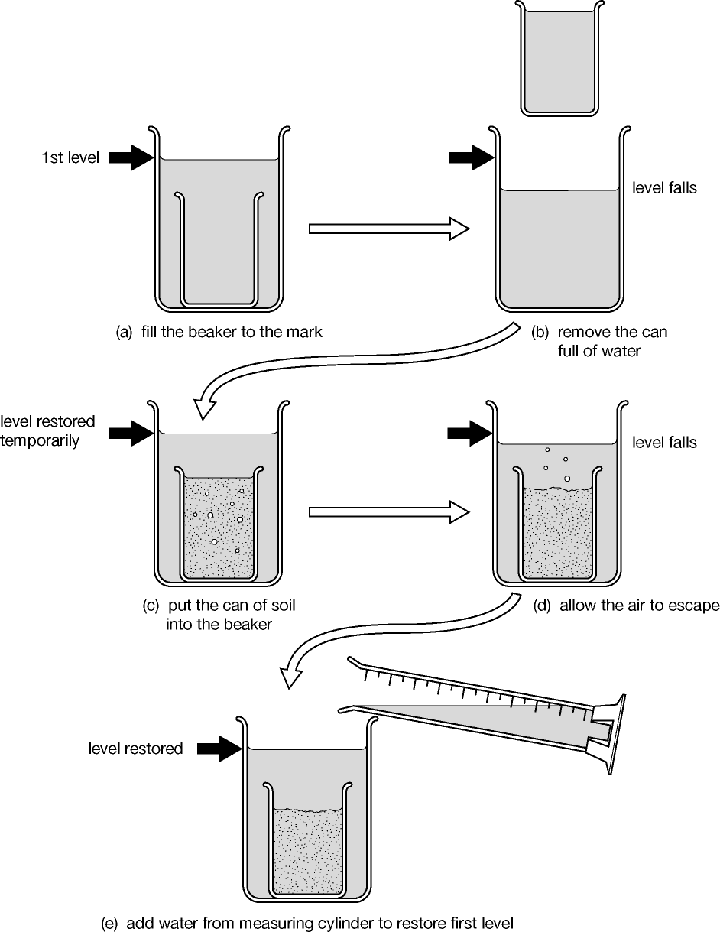
B6E Soil
Experiment to investigate air content in soil

Slide 31
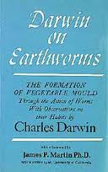
B6E Soil
Some soil life needs air oxygen and water
This is why aerating and draining improves soils
Humus is important
Decomposes to release minerals
Increases air content
Earthworms are important to soil structure and fertility
Bury organic matter
Aerate and drain soil (increase decomposition)
Mix up soil layers (increase fertility)
Neutralise acidic soils
Darwin discovered the importance of earthworms doing experiments in his garden

Slide 32
Question 13
What sized particles are in sandy soils?
Large

Slide 33
Question 14
What is loam?
Contains mixture of sand and clay

Slide 34
Question 15
Bury organic matter
Aerate soil
Mix up layers
Neutralise acidic soils
State 2 benefits of earthworms to soil fertility

Slide 37
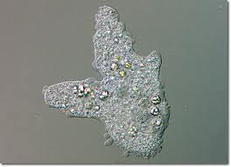
B6F WATER
Advantages of life in water
No dehydration
Less variation in temperature
More support
Easy disposal of waste products
Disadvantages of life in water
Regulating water control
Resistance to movement
Amoebas regulate water using contractile vacuoles
Take in water into vacuoles and release outside cell

Slide 38
B6F WATER
Factors that effect photosynthesis in water
Light
Temperature
Minerals
Grazing food webs in oceans
Food chains rely on marine snow and bacteria

Slide 39
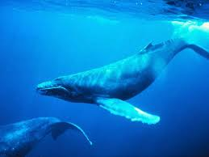
B6F WATER
Fertiliser run off causes eutrophication
Rapid growth of algae
Results in death and decay
Bacteria use up oxygen
Fish die
Biological indicators
Species can be used to indicate pH and oxygen levels in water
Bioaccumulation
PCBs and DDT build up in the food chain and kill whales

Slide 40
Question 16
State 1 disadvantage of life in water
Regulating water content
Difficult to move

Slide 41
Question 17
State one factor that effects photosynthesis in phytoplankton
Light
Temperature
Minerals

Slide 42
Question 18
What causes the lack of oxygen in the eutrophication process?
Bacteria decaying dead algae

Slide 45
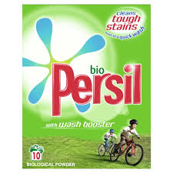
B6G Using Enzymes
Biological washing powder
Contains enzymes
Amylase = breaks down starch
Lipase = breaks down fat
Protease = breaks down protein
Makes soluble products so they wash out
Effected by pH of tap water and temperature of washing machine

Slide 46
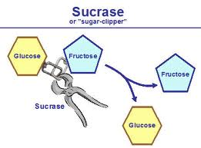
B6G Using Enzymes
Sweetening foods with Invertase/Sucrase
Sucrose → Fructose + Glucose
Product is much sweeter than sucrose so need to use less (low calorie foods)

Slide 47
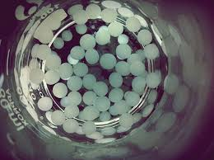
B6G Using Enzymes
Immobilising enzymes
Mix enzyme with alginate
Drop mixture into calcium chloride
Advantages
Product not contaminated with the enzyme
Continuous flow
Lactose Intolerance
Can’t produce enzyme lactase
Bacteria in gut ferment lactose
Causes diarrhoea and wind
Making lactose free milk with immobilised lactase
Lactose → glucose + galactose
Simple sugars can be absorbed by lactose intolerant person

Slide 48
Question 19
What does amylase break down?
Starch

Slide 49
Question 20
What does invertase break sucrose down into?
Glucose and Fructose

Slide 50
Question 21
What does lactase break down lactose into?
Glucose and galactose

Slide 51
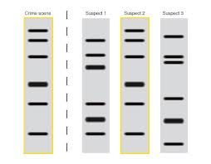
B6H Gene Technology
DNA Fingerprinting
Extract DNA from sample
Fragment DNA with restriction enzyme
Separate using electrophoresis
Visualise pattern using radioactive probe

Slide 52
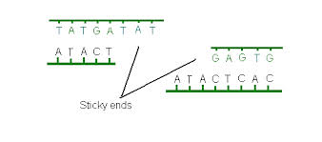
B6H Gene Technology
Transgenic organism
Made by genetic engineering
This is possible because all organisms have the same DNA (A,T,C and G bases)
Main stages of Genetic Engineering
Identify desired gene
Remove gene using restriction enzyme (cuts leaving sticky ends)
Cut open other organism’s DNA using restriction enzyme
Insert new gene using ligase enzyme (sticks the sticky ends together)
Gene works in new organism
Clone transgenic organism

Slide 53
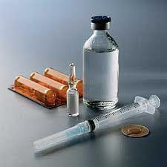
B6H Gene Technology
Example of Genetic Engineering
Bacteria make human insulin
Bacterial plasmid cut open and gene inserted
Plasmid is a vector for genetic engineering because bacteria can take them up from their surroundings
Assaying technique
Used to check the new gene has been correctly transferred

Slide 54
Question 22
What process is used to separate the DNA fragments in DNA fingerprinting
Electrophoresis

Slide 55
Question 23
What are the names and roles of the 2 enzymes in GE?
Restriction – cut sticky ends
Ligase – stick sticky ends

Slide 56
Question 24
What is the vector in GE bacteria to make human insulin
Plasmid

Slide 57
Question 25
What technique is used to check the gene has been correctly transferred
Assaying

