Slide 1
Biological Molecules
Carbohydrates, Lipids, Water, Nucleotides

Slide 2
Glossary
Metabolism
The sum total of all biochemical reactions taking place in the cells of an organism
DNA
A polynucleotide, usually double stranded, made up of nucleotides containing bases adenine, thymine, cytosine and guanine
RNA
A polynucleotide, usually single stranded, made up of nucleotides containing bases adenine, uracil, cytosine and guanine
Gene
A sequence of DNA nucleotides that codes for a polypeptide

Slide 3
State the functions of biological molecules in organisms

Slide 4
Monomers & Polymers
 | Carbohydrate | Protein | Nucleic Acid
Monomer
Polymer

Slide 5
General Features
Condensation | Hydrolysis

Slide 6
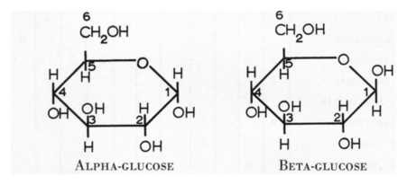
Structural Difference
Alpha Glucose | Beta Glucose

Slide 7
Making a disaccharide: formation & breakage of a glycosidic bond

Slide 8
Alpha Glucose: a monosaccharide
Properties

Slide 9
Making a polysaccharide: formation & breakage of a glycosidic bond

Slide 10
Compare and Contrast structure of starch and cellulose
Starch (Amylose) | Cellulose

Slide 11
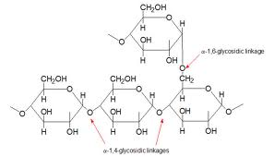
Glycogen Structure

Slide 12
How their structures relate to their functions
Starch
Glycogen
Cellulose

Slide 13
Compare and Contrast function of starch and cellulose
Starch (Amylose) | Cellulose

Slide 14
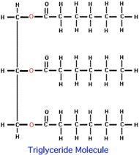
Lipids
Lipids (fats and oils) are a range of biological molecules e.g. Triglycerides (NOT polymers)

Slide 15
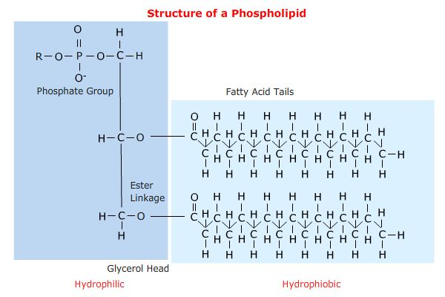
Compare and Contrast structure of triglycerides and phospholipids
Triglycerides | Phospholipids

Slide 16
How their structures relate to their functions
Triglyceride
Phospholipid
Cholesterol

Slide 17
Describe hydrogen bonding between water molecules

Slide 18
Relate properties of water to its role
Property | Role

Slide 19
Food Tests
 | Test | Result
Protein
Carbohydrate (reducing)
Carbohydrate (non-reducing)
Lipid

Slide 20
Describe how the concentration of glucose can be estimated using colour comparisons

Slide 21
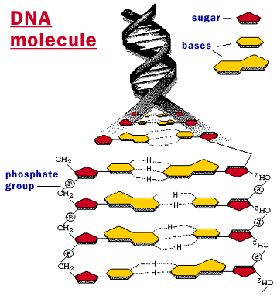
Structure of DNA Molecule
Formed by hydrogen bonding between complementary base pairs on two antiparallel DNA strands

Slide 22
How is double helix shape produced?
Antiparallel strands twist

Slide 23
Semi-Conservative Replication (include DNA polymerase)

Slide 24
How their structures relate to their functions
DNA
RNA

