Slide 1
Watch the video
http://www.youtube.com/watch?v=2Jp1D1dzxj8

Slide 2
Print and cut out the following slides
Rearrange in your book to show HOW carbon is moved from one living thing to another and back into the environment
BBC bitesize may help

Slide 3
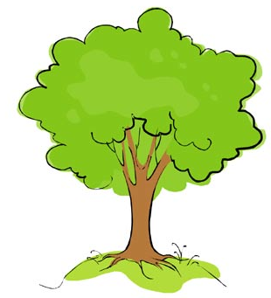
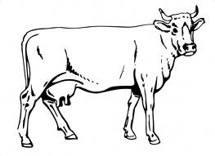
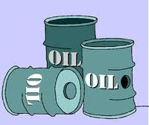
Organic compounds in green plants
Organic compounds in consumers
CO₂ in the air and dissolved in water, particularly oceans
Organic compounds in dead organisms
Organic compounds in fossil fuels
The Carbon Cycle

Slide 4
Death
Feeding
Photosynthesis
Respiration
Death
Combustion
Respiration
Decay and decomposition

Slide 5
Fossilization

Slide 6
Print and Fill in the next slide – use p63 and Bitesize

Slide 7
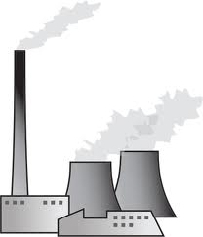
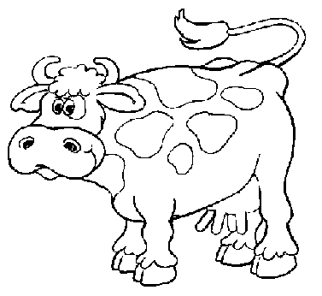
Nutrient Cycling & The Carbon Cycle
LO:
What happens to dead plants & animals?
How is carbon cycled
What is the equation for respiration?
What is the equation for photosynthesis?
Which process takes carbon from the air & which puts it back into the air?
Nutrient cycling
What happens to dead animals & plants?
What microorganisms carry out decomposition?
How can animals obtain the nutrients in the remains dead organisms?
What is detritus?
What do detritivores do?
What conditions do you think decomposers work best in?
The Carbon Cycle
Name the processes represented by each arrow
CO₂ in atmosphere
Carbon-compound in plants = ……………
Carbon-compounds in animals
Fossil fuels-oil, coal, peat, gas

Slide 8
How is Carbon recycled in the sea? – re-order the sentences using p63
Carbon dioxide reacts with rain to form carbonic acid.
The acid rain weathers the rock and carbon dioxide is released.
When these organisms die, their shells collect on the sea floor
Carbon dioxide can be held by the oceans in a carbon dioxide sink. It can also be released by volcanoes and forest fires
Limestone is soft and attacked by acid rain.
The shells of marine organisms contain carbonates
Over millions of years they form a type of sedimentary rock called limestone
Other marine animals such as corals also cover themselves with calcium carbonate

Slide 9
Name 3 things needed for decay | What organisms remove carbon dioxide from the atmosphere? | What element is used in making Fats and Proteins in plants and animals? | What process in plants and animals produces carbon dioxide?
Decay releases substances that plants need to… | Name 2 groups of microbes that carry out decay | Carbon is recycled in a process called… | How do herbivores get the carbon they need in their diet?
If oxygen, warmth and moisture are in good supply, decay will… | Microbes decay dead material by a process called… | 2 ways humans use the carbon cycle to our advantage is… | The scientific name for the amount of material in a living thing is…
Humans release carbon dioxide from wood and fossil fuels by… | How is carbon transferred from one animal to the next in a food chain? | What process do plants use carbon dioxide for? | What substance do plants make in photosynthesis that contains carbon?

Slide 10
Answers.....
digestion | eating | biomass | fungi & bacteria
photosynthesis | respire | carbon cycle | compost & sewage
glucose C₆H₁₂O₆ | oxygen, warmth & moisture | green plants | eat plants
burning | grow | carbon | speed up

Slide 11
Now close your books and....
...try to complete the worksheet!

Slide 12
If you are not sure.....
Revisit bitesize and revise the topic again
BBC bitesize may help
Then carry out the test.

