Slide 1
Do Now – mark enzyme temp Qs
Explain why the starch was made up with a buffer solution
Buffer helps to maintain the pH of a solution as it resists changes in pH. The starch is made up with a buffer solution to maintain the pH of the solution, so that any changes in rate are only due to the changes in temperature
2. Why were all the boiling and test tubes left in the water bath for five minutes before mixing the enzyme with the starch
To ensure that all components were at the same temperature
3. Describe and explain, using your biological knowledge, all the results you have obtained at different temperatures
Hand this part of the questions in for me to mark and give brief feedback on

Slide 2
Hand in your pH graphs and question answers for me to review and feedback on
Then find your Qs on temperature and enzymes from p.110 that you did on Friday as cover work

Slide 3
The molecules have less kinetic energy, so move more slowly. This means there are fewer collisions, and few ES complexes are made
Cooling the enzyme slows the rate of reaction but does not permanently alter the molecular structure. So, on warming to 40⁰C, enzyme molecules gain kinetic energy and can move again – they therefore catalyse the reaction. Enzymes that have been boiled are denatured and this involves an irreversible change to the shape of the active site
Because high temperatures cause hydrogen and ionic bonds to break within the protein molecule, altering the shape of the active site, so that it is no longer complementary to the shape of the substrate molecule
There may be differences in enzyme concentrations in different types of living tissues/in tissues of different ages/in different extracts of enzymes
a) IV = the factor you change, DV is the thing that changes as a result of the IV (the thing that you measure) b) So that all the reactant molecules are at the specified temperature / have the same level of kinetic energy at the same temperature c) So that the reaction does not start before you start timing it

Slide 4
Describe and explain the effects of substrate concentration on enzyme activity
Low substrate concentration = low production formation per unit of time
Higher substrate concentration = higher production formation per unit of time
Q. Does continually increasing substrate concentration continually increase the product formation?
Why does it not?
In this case, substrate concentration is the limiting factor

Slide 6
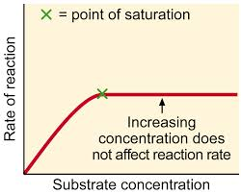
Describe and explain the effects of substrate concentration on enzyme activity
As the substrate concentration increases, there are more successful collisions, and more enzyme substrate complexes are formed
At the point of saturation, any more increases in substrate concentration will have no effect. All of the active sites are occupied
The substrate molecules are having to ‘wait’ for empty active sites

Slide 7
Describe and explain the effects of substrate concentration on enzyme activity
Initially, as substrate concentration increases, so does the rate of reaction. Why?
More enzyme-substrate complexes can form.
At this point, substrate concentration is the limiting factor.
As substrate concentration rises further, the reaction will reach its maximum rate.
As mentioned earlier, the point of saturation is reached as all active sites are occupied.
What is now the limiting factor?
Enzyme concentration.

Slide 8
Rate of reaction experiment
An investigation...

Slide 9
Cofactors, prosthetic groups and coenzymes
Cofactors are just ‘enzyme helpers’ that are required to help some enzymes catalyse reactions.
There are different types:
Prosthetic groups – permanently bound
Metal ions – not permanently bound
Coenzymes – temporarily bound
enzyme
active site
substrate
cofactor

Slide 10
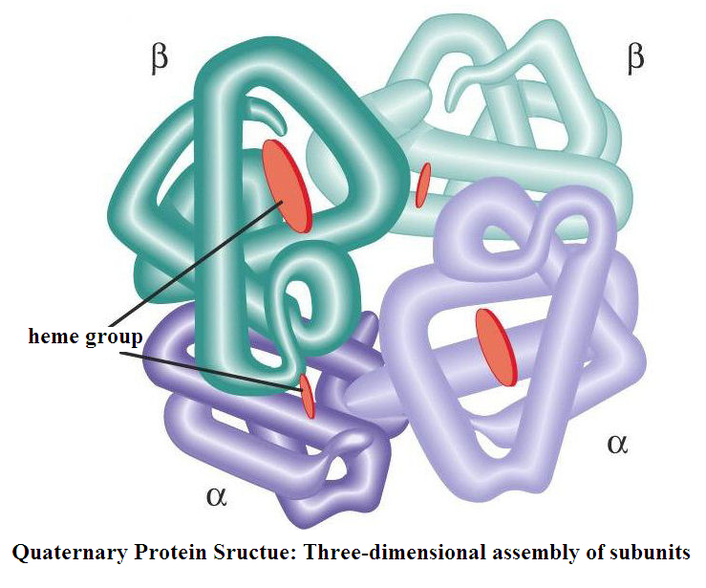
Prosthetic groups
This is a cofactor that is permanently bound to the enzyme
These bind tightly to the active site of the molecule, and help to form the enzyme-substrate complex
This is haemoglobin.
It has 4 haem groups, containing iron ions.
These help the binding of oxygen.

Slide 11
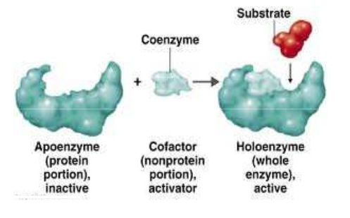
Metal Ions as Cofactors
These are not permanently bound, but will help to form the enzyme-substrate complex, therefore increasing the rate of the reactions
Examples include cosubstrates which actually bind to the substrate, helping it form the correct shape to bind to the enzyme, forming the enzyme-substrate complex.

Slide 12
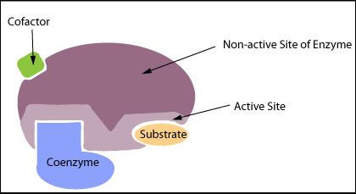
Coenzymes
These are organic molecules that temporarily bind to the active site of enzymes
Coenzymes are changed during the reaction, and so need to be recycled to their original form, or need a source of more co-enzymes
https://www.youtube.com/watch?v=flFtSU8E9zw

