Slide 1
Module 5
Respiration
5.2.2g Electron transport chain

Slide 2
Learning Outcomes
Describe the process and site of oxidative phosphorylation
Explain the chemiosmotic theory
Explain the role of the electron transport chain, proton gradients and ATP synthase

Slide 3
Identify where substrate level phosphorylation takes place within the first three stages of respiration
Substrate level phosphorylation – when phosphate groups are transferred from donor molecules to ADP to make ATP
Glycolysis – at the end when enzyme controlled reactions covert 3C triose phosphates into 2x 3C pyruvate (2 molecules of ATP are regenerated from ADP)
Krebs cycle - 1 molecule of ATP is regenerated from ADP

Slide 4
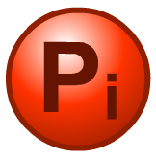

Phosphorylation of ADP
The addition of an inorganic phosphate group (P_{i}) to a molecule like ADP is called phosphorylation. ADP is phosphorylated during respiration.
Two types of phosphorylation occur during respiration:
1. Substrate-level: glycolysis & Krebs cycle
A single reaction involving the direct transfer of a phosphate group from a donor molecule to ADP.
2. Oxidative: electron transport chain
A series of oxidation reactions that produce sufficient energy to form ATP from ADP and phosphate.
Notes:
Boardworks A2 Biology
Respiration

Slide 5
Starter
How many of each one is produced during the following stages of Aerobic Respiration?
 | GLYCOLYSIS | LINK REACTION | KREBS CYCLE
ATP | 2 | 0 | 2
Carbon Dioxide | 0 | 2 | 4
Reduced NAD | 2 | 2 | 6
Reduced FAD | 0 | 0 | 2
Notes:
Glycolysis = 2x ATP, zero carbon dioxide, 2x reduced NAD, zero reduced FAD
Link Reaction = zero ATP, 2x carbon dioxide, 2x reduced NAD, zero reduced FAD
Krebs cycle = 2x ATP, 4x carbon dioxide, 6x reduced NAD, 2x reduced FAD

Slide 6
Glycolysis
Link Reaction
Key
Cytoplasm
Mitochondria
Krebs Cycle
Electron Transport Chain

Slide 7
Summary so far!
Anaerobic respiration makes 2 ATP per glucose.
Aerobic respiration makes 32 ATP per glucose
Anaerobic respiration only completes glycolysis which makes 2 ATP, hence this is why Anaerobic respiration only makes 2 ATP per glucose molecule.
Aerobic respiration makes 32 ATP because 2 ATP come from glycolysis, 2 ATP from Krebs Cycle (as it happens twice per glucose)....

Slide 8
So where does the rest of the energy come from?
Where does the remaining 28 ATP come from?
The Electron Transport Chain.
Producing ATP from coenzymes is known as
  oxidative phosphorylation
ATP is made due to the electrons from the reduced NAD and reduced FAD made in the earlier stages.
Each reduced NAD will generate 2.5ATP
Each reduced FAD will generate 1.5ATP
On whiteboards (using the table we constructed at the start of the lesson) calculate how much ATP each coenzyme will produce.

Slide 9
Where they come from and how many?
Reduced FAD
2 (from Krebs)
2 x1.5 = 3
Reduced NAD
2 (from Glycolysis)
2 (from 2x link reaction)
6 (from 2x Krebs)
2.5 x 10 = 25
Add this to the 4 ATP made directly in glycolysis and Krebs by substrate level phosphorylation and you have 32 ATP altogether!
However why is this not always the case?
Proton leak across mitochondrial space
ATP produced may actively transport pyruvate into mitochondria
Moves reduced NAD from cytoplasm made during Glycolysis into mitochondria

Slide 10
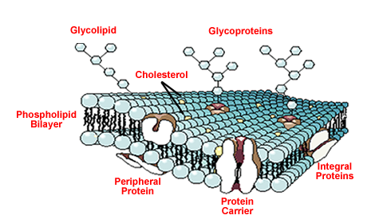
H
H⁺
e⁻
H₂
1. Which are the same?
2. What are the others called?
Proton
Electron
H⁺
H⁺
H⁺
H⁺
H⁺
3. What would happen and why ?
H⁺

Slide 11
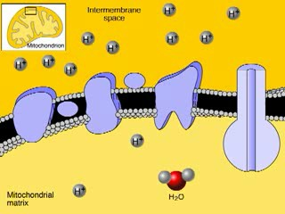
The Electron Transport Chain
The final stage of aerobic respiration is known as oxidative phosphorylation (in the presence of oxygen, energy is released to allow phosphorylation of ADP).
This occurs in the electron transport chain. This process requires:
Oxygen (to accept the electrons and hydrogen at the end)
Reduced NAD and FAD which are carrying protons (H+)
Electron carriers (cytochromes)

Slide 12
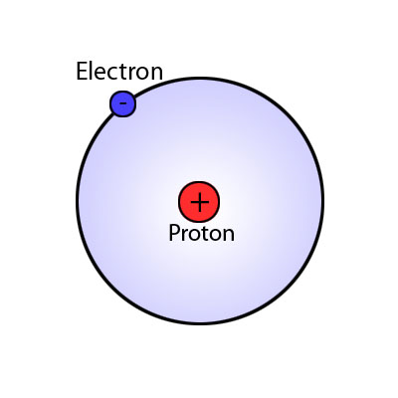
Some points to note
NADH = Reduced NAD
Cytochrome = Electron carrier
H H⁺ + e⁻
(hydrogen atoms are split into protons and electrons)

Slide 13
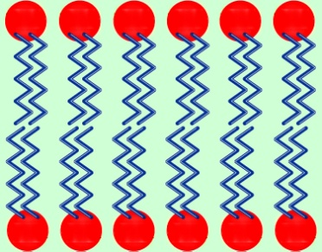
NAD
H
Matrix
O
O
FAD
H⁺
NAD
H
H
P_{i}
H⁺
H⁺
H⁺
e⁻
ADP
H⁺
e⁻
Inter membrane space
Electron carriers
ATP Synthase
H⁺
H⁺
H⁺
H⁺

Slide 14
NAD
H
Matrix
O
O
H⁺
P_{i}
H⁺
H⁺
H⁺
e⁻
ADP
H⁺
e⁻
Inter membrane space
H⁺
H⁺
H⁺
H⁺

Slide 15
NAD
H
Matrix
O
O
H⁺
P_{i}
H⁺
H
H
ADP
O
e⁻
e⁻
Note: As oxygen is found as O₂,
technically only ½ oxygen molecule is needed in the creation of 1 water molecule
Inter membrane space
H⁺
H⁺
H⁺
H⁺
H⁺
H⁺
H⁺

Slide 16
NAD
H
Matrix
P_{i}
ATP
H
H
ADP
O
Inter membrane space
H⁺
H⁺
H⁺
H⁺
H⁺
H⁺
H⁺

Slide 17
http://vcell.ndsu.nodak.edu/animations/etc/movie-flash.htmIn groups
– Model the process of ETC using playdoh, using information from animation and page 90/91 in book
A single H atom is made up of 1 proton (H+) and 1 electron (e-)

Slide 18
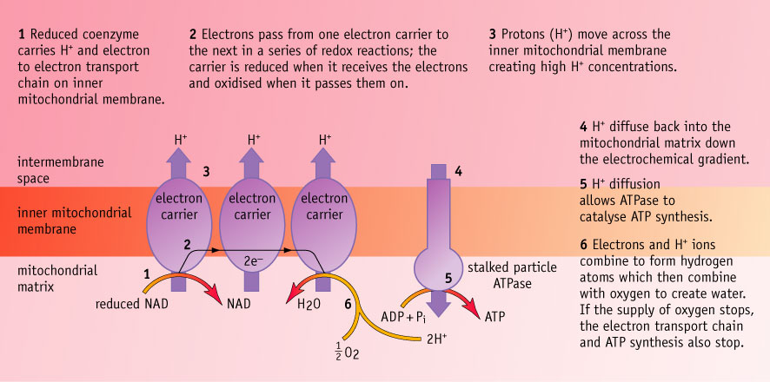
ETC and Chemiosmosis Summary
Oxidative Phosphorylation – Formation of ATP by adding a phosphate group to ADP, in the presence of oxygen, which is the final electron acceptor.
Protons flow through ATPsynthase driving the rotation of part of the enzyme to join ADP and Pi to form ATP. Electrons are passed along to last electron carrier, to oxygen.
Notes:
STUDENT HANDOUT

Slide 19
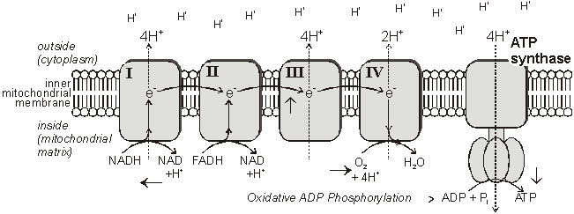
Electron Transport Chain Details
tons (H+) and electrons (e-).
The oxidised NAD molecules return to the Krebs Cycle to collect more hydrogen.
FADH binds to complex II rather than complex I to release its hydrogen.
The electrons are passed down the chain of protein complexes from I to IV, each complex binding electrons more tightly than the previous one.
In complexes I, II and IV the electrons give up some of their energy, which is then used to pump protons across the inner mitochondrial membrane by active transport through the complexes.
Altogether 10 protons are pumped across the membrane for every hydrogen from NADH (or 6 protons for FADH).

Slide 20
Chemiosmosis Details
In complex IV the electrons are combined with protons and molecular oxygen to form water. The oxygen diffuses in from the tissue fluid.
Oxygen is only involved at the very last stage of respiration as the final electron acceptor.
The energy of the electrons is now stored in the form of a proton gradient across the inner mitochondrial membrane.
The ATP synthase enzyme has a proton channel through it, and as the protons “fall down” this channel their energy is used to make ATP, It takes 4 protons to synthesise 1 ATP molecule.
This method of storing energy by creating a proton gradient across a membrane is called chemiosmosis.
Notes:
Some poisons act by making proton channels in mitochondrial membranes, so giving an alternative route for protons and stopping the synthesis of ATP

Slide 21

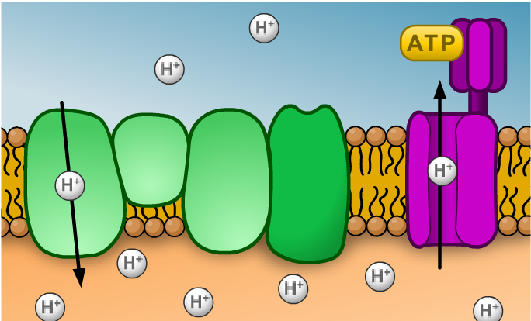
Evidence for chemiosmosis
The theory of chemiosmosis states that the energy in a chemical gradient established by electron movement is used to generate ATP.
matrix
Evidence includes:
The proton gradient across the inner membrane can be measured as it corresponds to a pH gradient.
Isolated ATP synthase enzymes can produce ATP using a proton gradient even if no electron transport is occurring.
Chemicals that block the ETC inhibit the formation of a proton gradient and prevent ATP synthesis.
Notes:
Teacher notes
The theory of chemiosmosis was proposed by Peter Mitchell in 1961. It was not well accepted by the scientific community at the time who believed that there was a stable intermediate compound that stored the energy from the electron transfer chain: no such intermediate has ever been found. In 1978, Peter Mitchell was awarded the Nobel Prize in Chemistry. The theory of chemiosmosis is now widely accepted.
Boardworks A2 Biology
Respiration

Slide 22



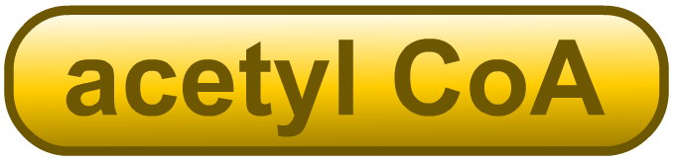

Keeping track of the products
For each molecule of glucose, glycolysis produces:
2 ×
2 ×
2 ×
For each molecule of glucose, the link reaction produces:
2 ×
2 ×
2 ×
Notes:
Boardworks A2 Biology
Respiration

Slide 23

Keeping track of the products
For each molecule of glucose, Krebs cycle generates:
4 × produced by decarboxylation
6 × produced by redox reactions
2 × produced by redox reactions
2 × produced by substrate-level phosphorylation
The NADH and FADH₂ contain the potential energy originally locked in glucose. This energy is now transferred to ATP by oxidative phosphorylation in the electron transport chain.

Slide 24
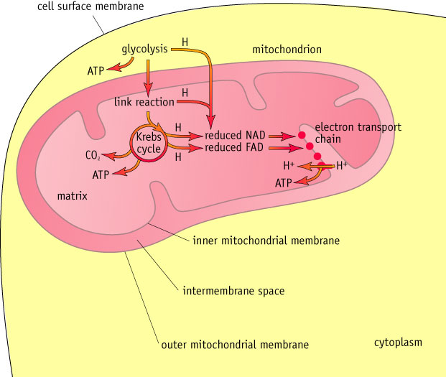
Aerobic Respiration Overview
Notes:
STUDENT HANDOUT

Slide 25
Answers to handout Q
1.
(a) pyruvate; 1
(b) Krebs cycle; 1
(c) ATP formed as electrons pass along transport chain;
oxygen is terminal electron acceptor / accepts electrons from electron transport chain;
electrons cannot be passed along electron transport chain if no O₂ to accept them;
forms H₂O / accepts H⁺ from reduced NAD/FAD / oxidises reduced NAD/FAD;
3 max

Slide 26
(a) Electrons transferred down electron transport chain;
Provide energy to take protons/H⁺ into space between membranes;
Protons/H⁺ pass back, through membrane/into matrix/through
ATPase;
Energy used to combine ADP and phosphate/to produce ATP;
Accept: alternatives for electron transport chain. 3 max
(b) (i) Prevent damage to mitochondria caused by water/osmosis/ differences in water potential;
Accept: other terms that imply damage e.g. shrink/burst 1
(ii) Glucose is used/broken down during glycolysis;
Breakdown of glucose/glycolysis in cytoplasm/not in mitochondria;
Accept: ‘glucose is converted to pyruvate’ for description of breakdown
Glucose cannot cross mitochondrial membrane/does not
enter mitochondria;
Accept: only pyruvate can 2 max
(iii) Terminal/final acceptor (in electron transport chain)/used to
make water; Could be shown by symbols 1 [7}

Slide 27
Class and Homework Tasks
Complete the questions on page 91 then self-assess your answers
Complete the exam style question on aerobic respiration

Slide 28
Practice exam question mark scheme
2. (a)
Statement | Glycolysis | Krebs cycle | Light-dependent reaction of photosynthesis
NAD is reduced | YES | YES | NO
NADP is reduced | NO | NO | YES
ATP is produced | YES | YES | YES
ATP is required | YES | NO | NO
4
(b) (i) pyruvate/succinate/any suitable Krebs cycle substrate; 1
(ii) ADP and phosphate forms ATP;
oxygen used to form water / as the terminal acceptor; 2
(iii) Y X W Z;
order of carriers linked to sequence of reduction / reduced
carriers cannot pass on electrons when inhibited; 2
[9]

Slide 29
Respiration Quiz!!!

Slide 30
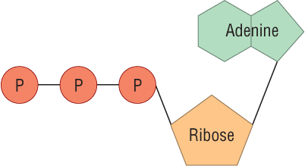
Q1. Which molecule is this?
ATP

Slide 31
30.7 kJ
Q2. How much energy is released when ATP is broken down into ADP?

Slide 32
anabolic
Q3. What name is given to a metabolic reaction where smaller molecules are built up into larger ones?

Slide 33
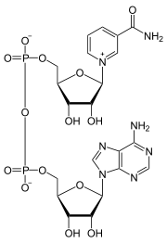
two, joined by phosphate
groups.
Q4. How many nucleotides are in NAD?

Slide 34
Glucose (6C)
ATP
ADP
Phosphorylation!
Glucose-6-phosphate
Glycolysis
Fructose-6-phosphate
ATP
ADP
Phosphorylation!
Q5. Which molecule is missing in the stages of glycolysis?
Hexose 1,6 bisphosphate
?
2 x Triose phosphate (3C)
2x triose phosphate
x2
ADP
ATP
Reduced NAD
x2
2 x Intermediate (3C)
ADP
ATP
x2
2 x Pyruvate (3C)

Slide 35
2
Q6. How many molecules of NAD are reduced during the link reaction?

Slide 36


CoA
Acetyl CoA
Oxaloacetate (4C)
?
Citrate
Reduced NAD
Citrate (6C)
NAD
Q7+8. What are the names of the missing molecules?
?
CO₂
NAD
CO₂
Reduced NAD
5C Compound
NAD
FAD
Reduced NAD
Reduced FAD
ADP
4C Compound
?
CO₂
CO₂
ATP

Slide 37
cytochromes
Q9. What are the proteins in the electron transport chain known as?

Slide 38
Into the intermembrane space
Q10. Where are hydrogen ions pumped to as a result of the electron transport chain?

Slide 39
Homework
Complete the sheet on Chemiosmotic theory
p116 Biozone

Slide 40
Learning Outcomes
Describe the process and site of oxidative phosphorylation
Explain the chemiosmotic theory
Explain the role of the electron transport chain, proton gradients and ATP synthase

