Slide 1
Practice Exam Questions – PEER ASSESS
A) Active site
B) Molecule A - Non-competitive inhibitor. Binds at allosteric site and changes the shape of the active site, preventing enzyme-substrate from forming.
Molecule B – Competitive inhibitor. Binds to the active site, blocking it. Prevents the enzyme-substrate complex from forming.
C) Non-competitive inhibition.
Ensures that an appropriate amount of the product is formed.
Increases the efficiency of metabolic reactions as large amounts of product are not formed.

Slide 2
STAR Time and Feedback on Homework
I have marked and given feedback to respond to for you temperature enzyme question – anything highlighted yellow needs addressing
I have only marked the graph of your enzyme pH as I’ve not seen your graph skills thus far. Again, anything in yellow needs addressing
I have marked and given feedback to the cofactor questions – save this STAR time until last as the next slide shows the answers to that we can go through it and you can purple pen it

Slide 3
1. The NAD is recycled/regenerated after it has been changed during an enzyme-catalysed reaction in which it is
used as a coenzyme.
2. They may bind to the active site of the enzyme, together with the substrate molecule, acting as co-substrates and
making the shape of the substrate complementary to the shape of the enzyme’s active site; or they may change
the charge distribution on the surface of the enzyme’s active site or on the surface of the substrate molecule,
enabling ES complexes to form more easily.
3. Similar: Both form temporary bonds with enzyme; both are non-protein
Different: metallic cofactors are inorganic; coenzymes are organic.
4. Metallic cofactors bond temporarily, whereas prosthetic groups are permanently bound to the enzyme’s active
site/are part of the enzyme structure.
5. (a) Covalent
(b) Ionic
(c) Ionic or hydrogen

Slide 4
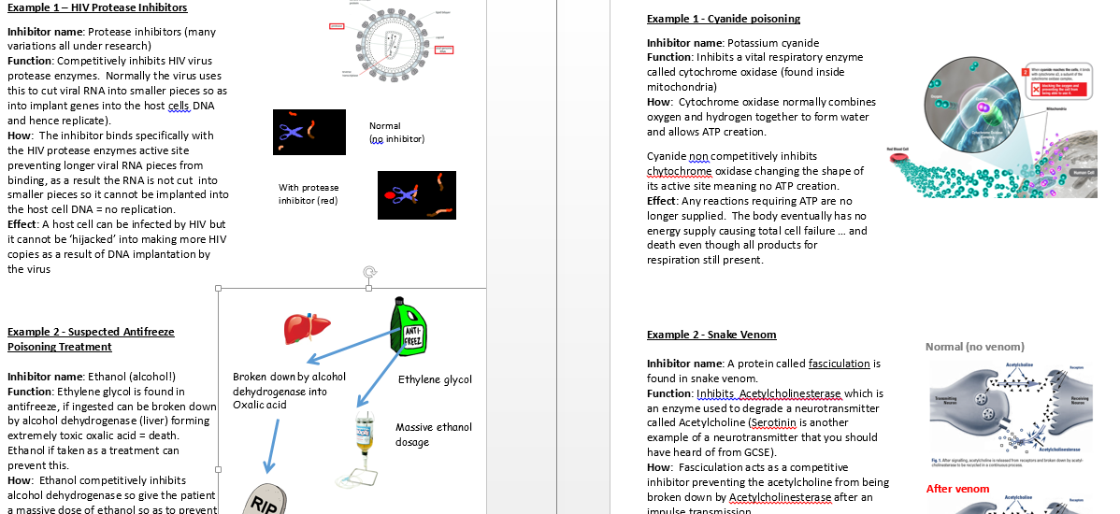
Enzyme Inhibitors and Their Uses
TASK : Use the info sheets provided to find out about the uses of inhibitors, in nature as poisons, as well as medically. Work as a group to find the information required to fill in the task sheet

Slide 5
Homework – Flipped Learning
I will e-mail you (and put on Weebly) a copy of the ‘Enzyme Concentration Flipped Learning’ PowerPoint. Use this, along with the textbook and any supplementary notes you make, to answer the following exam question
“Explain the effects of enzyme concentration, substrate concentration and competitive inhibitors on the rate of an enzyme-controlled reaction. (9 marks)”

Slide 6
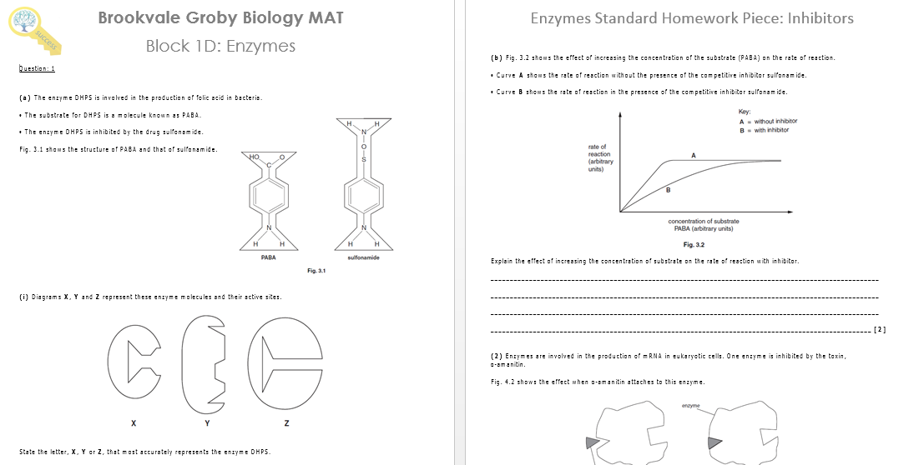
Enzymes MAT
Complete the following MAT on Enzymes and Inhibitors – anything that you’ve not finished should be taken home and completed

