Slide 1
Enzymes and Concentration
Lesson 16

Slide 2
Success Criteria
Describe and explain the effect of enzyme concentration and substrate concentration on enzyme activity

Slide 3
Starter
Think, pair, share
Effect of enzyme concentration on enzymes
Effect of substrate concentration on enzymes

Slide 4
The Effect Of Substrate Concentration
On The Rate Of Enzyme - Catalysed Reactions
Low Substrate
Concentration
Low product
concentration per
unit time
Increased Substrate
Concentration
More product
formation;
increased reaction rate

Slide 5
The Effect Of Substrate Concentration
On The Rate Of Enzyme - Catalysed Reactions
Further increase
in substrate
concentration
Maximum product
formation; maximum
rate of reaction
Excess substrate
concentration
No further increase
in product formation;
maximum reaction rate
maintained
Enzyme
concentration
is the LIMITING FACTOR

Slide 6
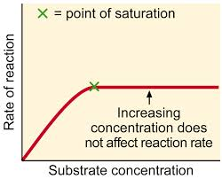
Enzymes and Substrate Concentration
As SC increases there are more collisions and more enzyme substrate complexes form
Point of saturation: further SC has no effect, as all the active sites are occupied, forming enzyme substrate complexes as fast as possible

Slide 7
The Effect Of Enzyme Concentration
On The Rate Of Enzyme - Catalysed Reactions
Rate of
reaction
The rate of reaction
is directly proportional to the
enzyme concentration
As enzyme concentration
increases, the rate of reaction
increases
In living cells, enzyme
concentrations are usually
much lower than substrate
concentrations
Substrate concentration is
rarely a limiting factor
Increasing concentration of enzyme

Slide 8
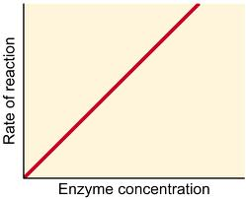
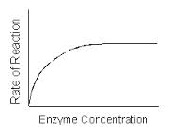
Enzymes and Enzyme Concentration
As EC increases, more active sites become available so more enzyme substrate complexes form
With a fixed concentration of substrate: A point will be reached when all the substrates are occupying active sites

Slide 9
Practical Task
Investigate the effect of substrate concentration on catalase activity [Activity 28]
Practical Skills: Qualitative
Drawing Results Table

Slide 10
Peer Assess Results Table
Mark | Complete?
Appropriate column and row headings
Ruled rows and columns
Separate conclusions and observation columns
All tests and results recorded
Correct conclusions for all test results

Slide 12
Success Criteria
Describe and explain the effect of enzyme concentration and substrate concentration on enzyme activity

Slide 13
Plenary
Answer questions 1-5 on worksheet
Practical Skills: Evaluative
Analysing experiment

Slide 14
Homework
Complete Evaluative Practice Homework ppt
Practical Skills: Evaluative
Analysing experiment

