Slide 1
Enzyme & Inhibitors

Slide 2
Success criteria
The effects of inhibitors on the rate of enzyme-controlled reactions.
To include competitive and non-competitive and reversible and non-reversible inhibitors with reference to the action of metabolic poisons and some medicinal drugs, and the role of product inhibition
AND
inactive precursors in metabolic pathways (covered at A level only).

Slide 3
Starter
Although you have spent the time since last lesson researching enzyme inhibition using the resources provided, here is an animation to recap...

Slide 4
summary

Slide 5
Competitive Inhibitors
Have a similar shape to that of the substrate molecule.
This means that they occupy the active site, forming enzyme-inhibitor complexes.
These complexes do not lead to the formation of products because the inhibitor is not identical to the substrate.
The level of inhibition depends on the concentrations of inhibitor and substrate.
Where the number of substrate molecules is increased, the level of inhibition decreases because a substrate molecule is more likely than an inhibitor molecule to collide with the active site.
Most competitive inhibitors do not bind permanently to the active site. They bind for a short period of time and then leave. Their action is described as reversible, as the removal of the inhibitor form the reaction mixture leaves the enzyme molecule unaffected.

Slide 6
Non-competitive inhibitors
Do not compete with substrate molecules for a place in the active site. Instead, they attach to the enzyme, molecule in a region away from the active site.
The attachment of non competitive inhibitors distorts the tertiary structure of the enzyme molecule, leading to the shape of the active site changing.
This means that they substrate no longer fits into the active site so the enzyme-substrate complexes cannot form and the reaction rate decreases.
The level of inhibition depends on the number of inhibitor molecules present. If there are enough inhibitor molecules to bind to all of the enzyme molecules present, then the enzyme controlled reaction will stop.
Changing the substrate concentration will have no effect on this form of inhibition
Most non-competitive inhibitors bind permanently to the enzyme molecule. The inhibition is irreversible, and any enzyme molecule bound by inhibitor molecules are effectively deactivated.

Slide 7
Card Sort
Put the two sets of cards in order.

Slide 8
Exam Questions
Work through the 3 exam questions using the information you have learnt since last lesson.
You may use your textbook to help you.

Slide 9
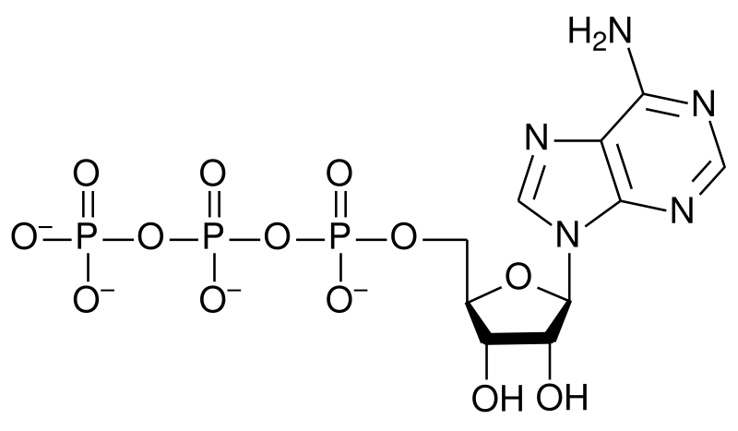
End-product inhibition
Enzyme inhibition is important in regulating metabolic pathways. The final (end) product often acts as a regulator of the pathway in a process called end-product inhibition.
When the amount of end product is high, it binds non-competitively to an enzyme in the pathway, blocking further production of itself.
When the amount of end product falls, inhibition ends and the pathway restarts.
The synthesis of ATP is regulated in this way, with ATP acting as the inhibitor.
Notes:
Teacher notes
End-product inhibition is an example of negative feedback.

Slide 10
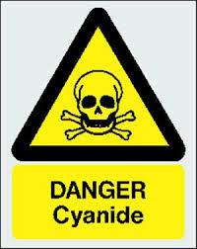
Metabolic poisons
Many natural poisons are enzyme inhibitors.
Many toxins exert their effects because they inhibit or inactivate enzymes
Cyanide is an irreversible inhibitor of an enzyme involved in aerobic respiration.
Cyanide binds to an enzyme found in mitochondria. This enzyme is involved in the final stages of respiration and it’s inhibition prevents the earlier stages from occurring and hence prevents cells from producing ATP.
Notes:
Photo credit: Dr Paddy Ryan / Ryan Photographic
A green mamba (Dendroaspis angusticeps), whose venom contains fasciculin, a potent inhibitor of acetylcholinesterase. www.ryanphotographic.com
Teacher notes
Toxin: a poisonous substance produced by a living organism. Many toxins are not enzyme inhibitors but work by interfering with cell receptors and ion channels.
Venom: a toxin produced by an animal that is injected into its prey to cause paralysis and/or death. Used as a defence mechanism or for predation. Venom can contain many different types of toxin.
Poisonous organism: an organism that is harmful if eaten or touched (distinct from a venomous organism).
Glycoalkaloids are acetycholinesterases produced by some members of the Solanaceae family of flowering plants (includes the deadly nightshade, potatoes and tomatoes).

Slide 11
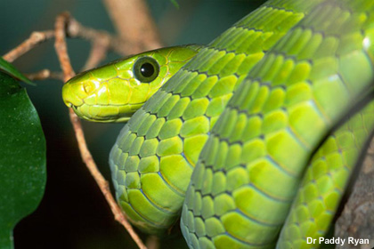
Uses of inhibitors: natural poisons
Many natural poisons are enzyme inhibitors.
Inhibitors in toxins/venom can irreversibly block enzymes such as acetylcholinesterase, causing paralysis and death.
Acetylcholinesterase breaks down acetylcholine a neurotransmitter. If acetylcholine is not broken down it stays attached to receptors on the muscle membrane and keeps the muscle contracted.
This causes paralysis, if the muscles involved in breathing are affected, then the victim dies of suffocation
Notes:
Photo credit: Dr Paddy Ryan / Ryan Photographic
A green mamba (Dendroaspis angusticeps), whose venom contains fasciculin, a potent inhibitor of acetylcholinesterase. www.ryanphotographic.com
Teacher notes
Toxin: a poisonous substance produced by a living organism. Many toxins are not enzyme inhibitors but work by interfering with cell receptors and ion channels.
Venom: a toxin produced by an animal that is injected into its prey to cause paralysis and/or death. Used as a defence mechanism or for predation. Venom can contain many different types of toxin.
Poisonous organism: an organism that is harmful if eaten or touched (distinct from a venomous organism).
Glycoalkaloids are acetycholinesterases produced by some members of the Solanaceae family of flowering plants (includes the deadly nightshade, potatoes and tomatoes).

Slide 12
Medicinal drugs acting by enzyme inhibition
Make you own brief notes on the following
Asprin
ATPase inhibitors
ACEase inhibitors
Protease inhibitors
Nucleoside reverse transcriptase inhibitors

Slide 13
Medicinal drugs acting by enzyme inhibition
Aspirin – prevents the formation of prostaglindins (cell-signalling molecules produces when tissues are infected or damaged). Prostaglandins make nerve cells more sensitive to pain and increase swelling during inflammation.
- also reduces the risk of blood clots
ATPase inhibitors – used to treat heart failure or abnormal heart beat. Eg foxgloves contain digitalis a chemical that inhibits the sodium-potassium pump in the cell membranes of heart muscle cells and allows more calcium ions to enter. Calcium ions increase muscle contractions and strengthens heart beat.

Slide 14
Medicinal drugs acting by enzyme inhibition
ACE inhibitors – ACE (angiotensin converting enzymes) normally increase blood pressure. Ace inhibitors are used to lower BP, treat heart failure and minimise risk of second heart attack.
Protease inhibitors – used to treat viral infections. They prevent the replication of virus particles within host cells by inhibiting (competitive inhibition) protease enzymes so the viral coats cannot be made.
Nucleoside reverse transcriptase inhibitors – inhibit enzymes involved in making DNA using the viral RNA as a template.

