Slide 2
Notes:
Teacher notes
In ‘Slide Show’ mode, click the name of a section to jump straight to that slide.

Slide 3



What is cloning?
Cloning is the production of identical copies of organisms, cells or DNA.
A clone is a genetically identical organism or a group of genetically identical cells derived from a single parent.
Cloning occurs in nature as part of growth and reproduction. This natural process can be manipulated to produce clones of organisms artificially.
Notes:
Photo credit: Jerome Wexler / Science Photo Library
Teacher notes
Strawberry plants use vegetative propagation to produce new plants, which are clones. The plants have adapted specialized stems or runners that grow along the ground from the parent plant. The cells in the tip of the runner can then divide and differentiate forming the roots and shoots of the new strawberry plant.

Slide 4
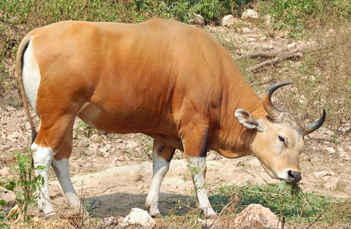
Why clone organisms?
Scientists can use genetic technologies to clone whole organisms; this is known as reproductive cloning.
Farm animals or crop plants with desirable features can be cloned, ensuring a constant food supply and high productivity.
It is thought that reproductive cloning could also help to increase numbers of rare or endangered species.
Notes:
Photo credit: © Shutterstock 2009, Robert Adrian Hillman
Teacher notes
In 2003, scientists at Advanced Cell Technology, Massachusetts, successfully produced a cloned banteng (Bos javanicus). Banteng are a type of wild cattle found in south-east Asia, that are classed as severely threatened, according to the IUCN (International Union for the Conservation of Nature). The DNA from a male banteng that died nearly 20 years early was inserted into an egg from a dairy cow using somatic cell nuclear transfer. Out of 30 embryos created, two calves were born. Due to abnormalities, one calf was put down, however, the other survived but has not yet produced offspring.

Slide 5

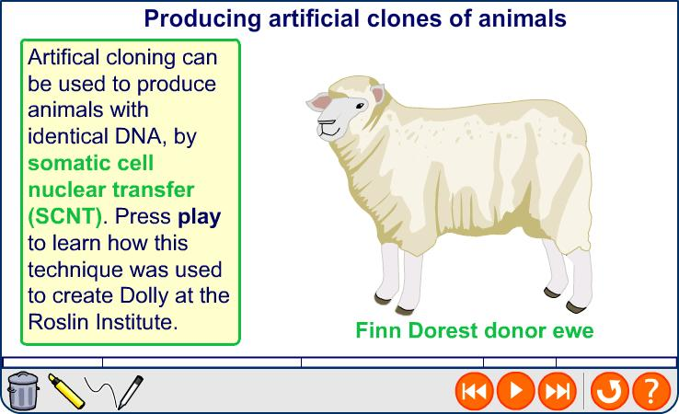
Producing animal clones

Slide 6
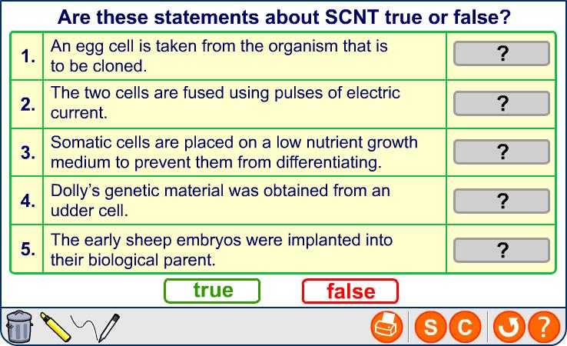
Somatic cell nuclear transfer

Slide 7

Natural clones in plants
Some plants are able to naturally produce genetically identical offspring. Adult plant cells are totipotent, meaning that each cell has the capacity to regenerate the entire plant.
The English elm can reproduce by vegetative propagation – asexual reproduction that involves producing new plants from existing vegetative structures. Root suckers or basal sprouts can form from the roots of elm trees, when they are under stress.
If the tree cannot withstand its current environmental conditions it still has a chance of survival, because the basal sprouts can allow the organism to regrow metres from the original tree.
Notes:
Photo credit: © Shutterstock 2009, Joe Gough

Slide 8
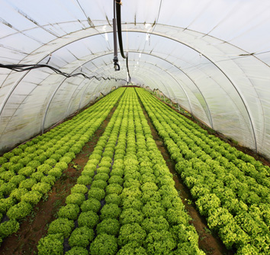
Large scale cloning of plants
A plant with highly desirable characteristics, e.g. a high yield crop plant, can be used to produce many more plants with exactly the same genetic composition.
A large number of cloned crop plants can be propagated easily, as clones require the same conditions, grow at the same rate and will therefore be ready for harvest at the same time, reducing costs.
The production of plant clones can occur at any time of the year.
Notes:
Photo credit: © Shutterstock 2009, Sven Hoppe

Slide 9
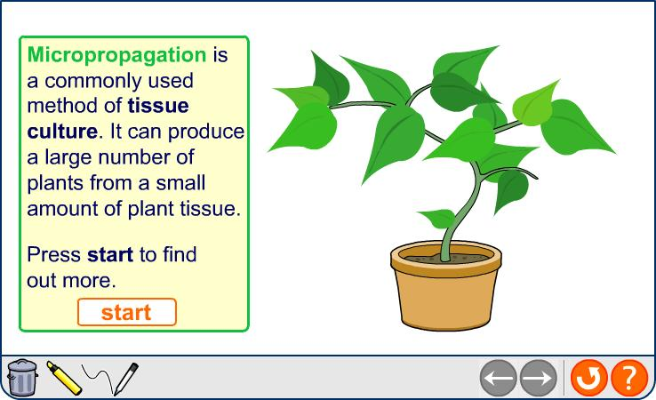
Tissue culture

Slide 10
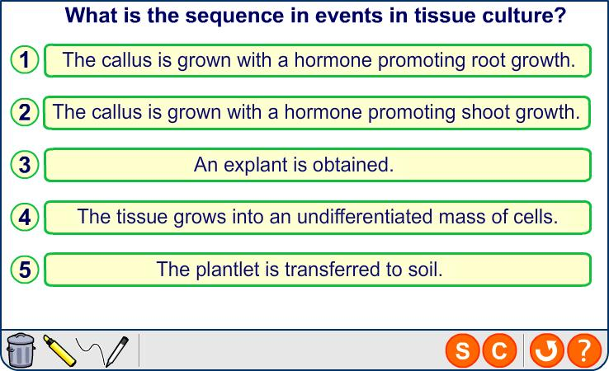
Producing plant clones

Slide 11

Disadvantages of reproductive cloning
A population of cloned individuals will have a very low genetic diversity. This reduces the ability of the population to adapt.
Clones will be equally vulnerable to a disease or pests, causing diseases to spread fast, affecting the whole population.
A good example of this is Dutch
elm disease. Accidently spread throughout Europe the disease devastated native elm populations.
It is thought that these were natural clones from only a few individuals.
Notes:
Photo credit: © Shutterstock 2009, Povl E. Petersen
Teacher notes
Dutch elm disease is a fungal disease that is spread by the elm bark beetle. The disease is thought to have originated in Asia. It is named Dutch elm disease because it was first identified in the Netherlands.

Slide 12
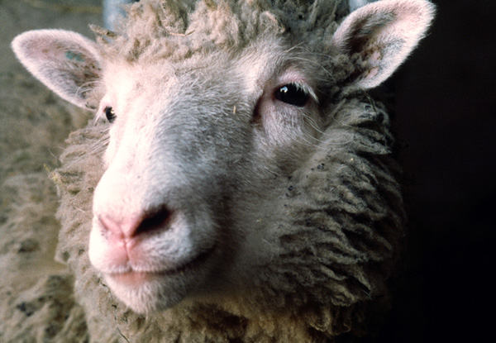
Disadvantages of reproductive cloning
The first cloned mammal, Dolly the sheep, died prematurely due to lung disease. This raised concerns about the health and life expectancy of cloned animals.
It is thought that some cloned mammals will have shorter telomeres than other animals of the same again. Telomeres are pieces of non-coding DNA that prevent the chromosome from degrading. They shorten as cells divide and are therefore considered a measure of ageing in cells.
Notes:
Photo credit: PH. Plailly / Eurelios / Science Photo Library

Slide 13
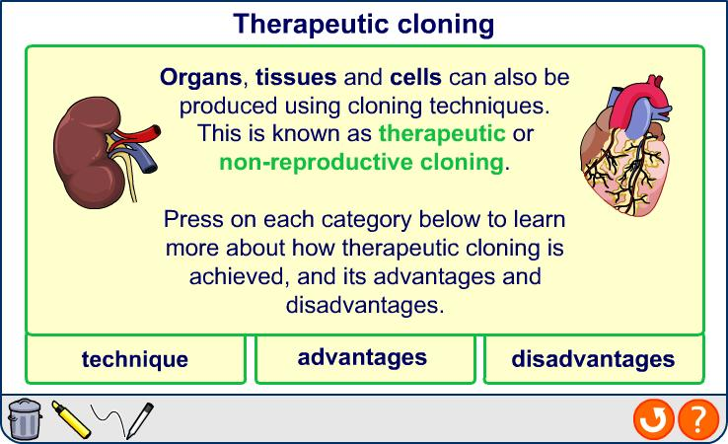
Therapeutic cloning
Notes:
Photo credit (nuclear transfer): Jenny Nichols, Wellcome Images
Cloning by nuclear transfer. The nucleus for transfer has been picked up into the transfer pipette. It is about to be injected in to a recipient egg whose own nucleus has previously been removed.
Photo credit (embryo): © Shutterstock 2009, herbap
Teacher notes
Another problem surrounding therapeutic cloning research is the lack of human egg donors. Unfertilized egg cells are needed; however, the egg-donation procedure is uncomfortable and potential painful, and carries some medical risks.

Slide 14
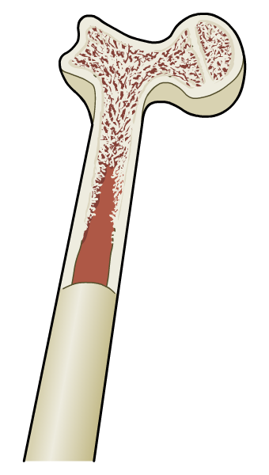
Adult stem cells
In mature animals only a few stem cells remain. These are multipotent. They have the capacity to differentiate into only a few specific cell types. They maintain and repair specific tissues in the body.
Adult stem cells do not provide the same flexibility as embryonic stem cells. However, adult stem cells can be used to produce a limited range of tissues for transplantation.
For example, adult haematopoietic stem cells from bone marrow have been used in transplants for 40 years. These stem cells form all the blood cell types in the body.
Notes:
Teacher notes
See the Boardworks AS Biology ‘Cell Division’ presentation for more information about stem cells.

Slide 15
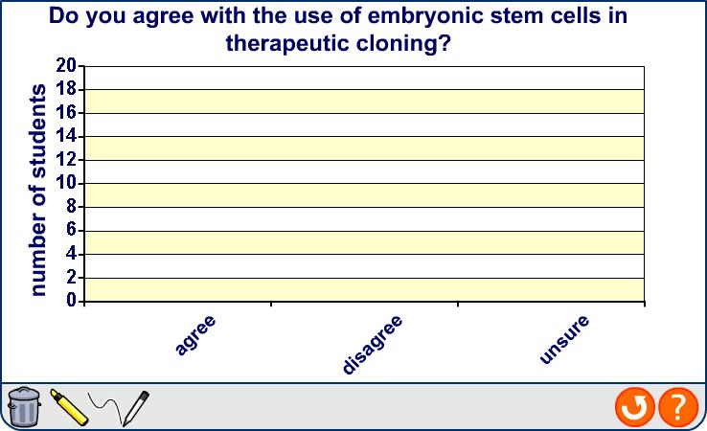
Take a vote: therapeutic cloning

Slide 16
Notes:
Teacher notes
In ‘Slide Show’ mode, click the name of a section to jump straight to that slide.

Slide 17
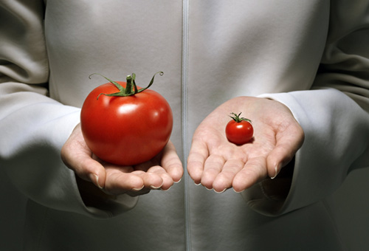
How is genetic engineering useful?
Genetic engineering involves inserting a foreign gene into an organism’s genome, resulting in the expression of the new gene.
This method can be used to engineer recombinant organisms that synthesize useful products, e.g. hormones.
It is also used to improve a feature of the recipient organisms, e.g. producing herbicide resistant in crop plants.
Genetic engineering technologies aid the understanding of how organisms function by allowing scientists to study and alter gene function.
Notes:
Photo credit: Coneyl Jay / Science Photo Library

Slide 18
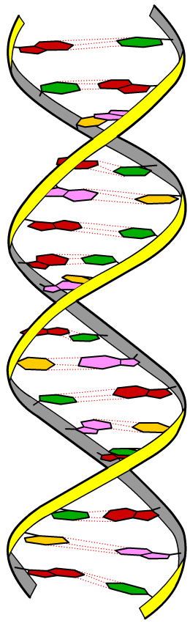
Recombinant technology
Once the gene for the desired protein has been identified, the following steps are carried out:
1. Multiple copies of the desired gene are produced.
2. The gene is inserted into a vector and transferred into host cells.
3. The host cells that have successfully taken up the gene are identified using a marker.
4. The host cells are allowed
to multiply or are cloned.
Notes:
Teacher notes
See the ‘Studying Genomes’ presentation for more information about identifying genes.

Slide 19
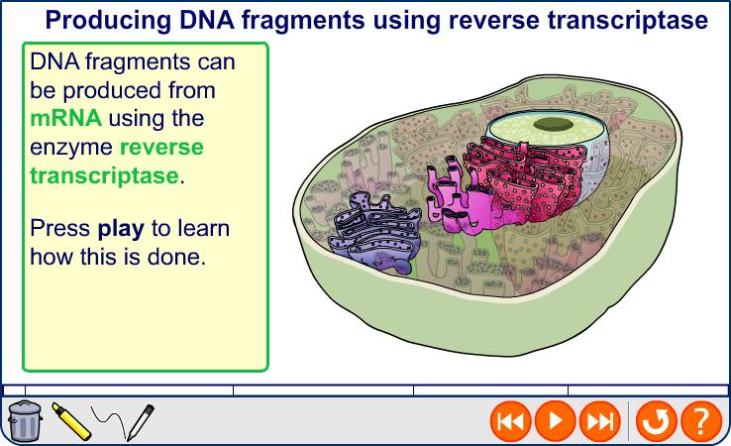
Producing DNA copies from mRNA
Notes:
Teacher notes
See the Boardworks AS Biology ‘Infectious Diseases’ presentation for more information about how HIV uses reverse transcriptase to replicate its viral components in a host’s cell.

Slide 20
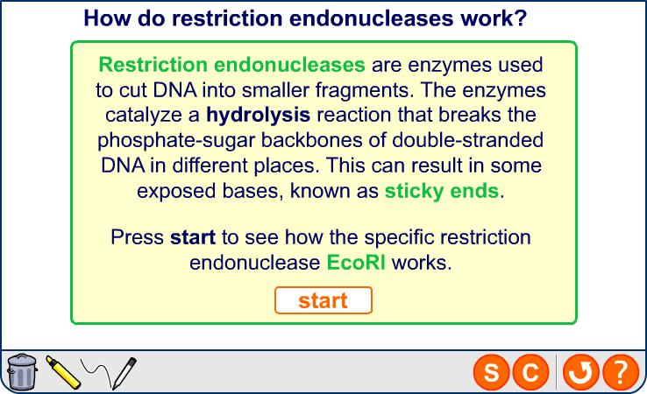
Producing DNA copies by cutting DNA
Notes:
Teacher notes
Restriction endonucleases produced in bacteria are thought to have evolved as a defensive mechanism, to protect against invading viruses. The enzyme could cut the viruses’ genetic material into fragments preventing it from replicating. The host’s DNA is methylated by another enzyme in order to protect it from the activities of the restriction endonuclease.
Certain sequences of DNA are the same whether they are read 5' to 3' or 3' to 5'. These sequences are called palindromic.

Slide 21
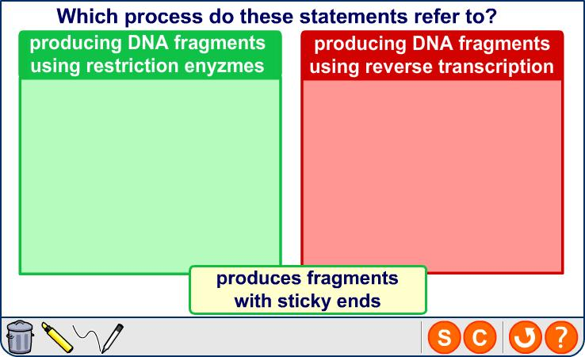
Which process?

Slide 22
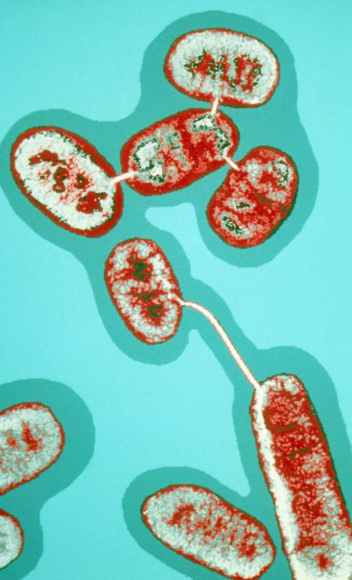
Bacterial conjugation
Microorganisms can naturally exchange genetic material in a process called conjugation. Genetic material in the form of plasmids can be copied and passed between bacteria.
Some plasmids contain genes associated with antibiotic resistance. The movement of plasmids between individuals of the same and different species speeds up the spread of antibiotic resistance.
Notes:
Photo credit: Dr Linda Stannard, UCT / Science Photo Library
Teacher notes
See the Boardworks AS Biology ‘Infectious Diseases’ presentation for more information about antibiotic resistance.

Slide 23
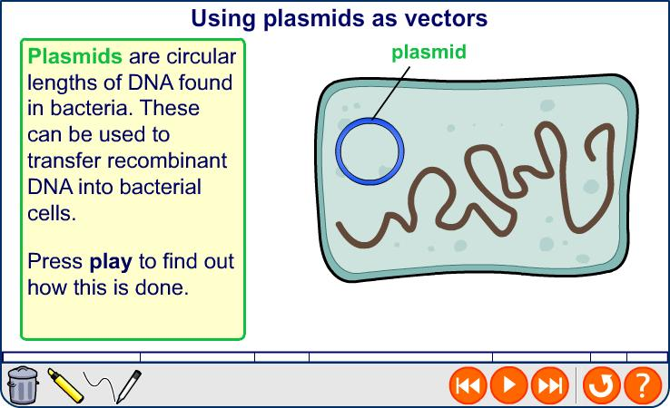
Recombinant bacteria
Notes:
Teacher notes
The uptake of plasmids by bacteria is aided by the presence of calcium ions in the medium and changes in temperature. These make the bacteria more permeable, allowing the plasmids to pass through the cell membrane. This is a very inefficient process - less than 1% of bacterial cells will take up a plasmid.

Slide 24
Other genetic markers
Fluorescent markers and enzymes markers are also techniques to identify cells that have taken up the desired gene.
A gene from a jellyfish that produces a protein called green fluorescent protein (GFP) can be used. The desired gene is transplanted into the centre of the GFP gene. The cells that have not taken up the desired gene will fluoresce.
Using enzyme markers involves transplanting the desired gene into the centre of a gene coding for lactase. Lactase will turn a particular colourless substrate blue, therefore cells that have taken up the desired gene will not turn this substance blue.

Slide 25
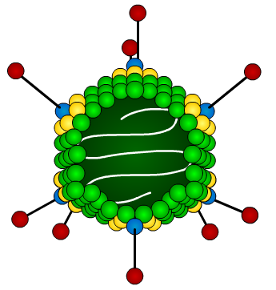
Viruses as vectors
Viruses naturally transfer their genetic material into their host’s cells, as they need the host to produce viral proteins to allow them to replicate. Scientist use viruses, such as the adenovirus, as vectors in DNA technology.
viral genome
The genetic material that causes virulence must first be removed from the virus. The desired gene can be added to the viral genome.
The virus infects the target cells, inserting its genome
so that the target cells then express the new sequence.
adenovirus
Notes:
Teacher notes
Non-biological vectors include:
Ballistic impregnation – DNA coated with tungsten or gold particles is fired into plant cells. This has been used in the modification of several crop plants, including wheat.
Electroporation – temporary pores are created in cells using bursts of electricity. These allow DNA to enter the cell.
Micro-injection – DNA is injected into the nucleus using a very fine pipette.
Liposome transfer – the DNA is coated by a liposome, which enables it to move through the cell membrane.

Slide 26
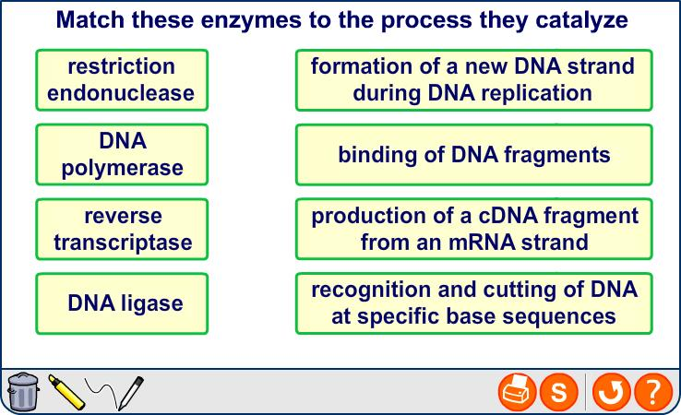
Enzymes in genetic technology

Slide 27
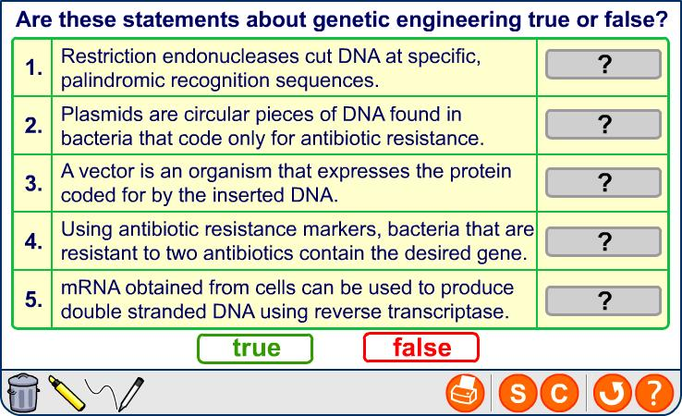
Genetic engineering: true or false?

Slide 28
Notes:
Teacher notes
In ‘Slide Show’ mode, click the name of a section to jump straight to that slide.

Slide 29
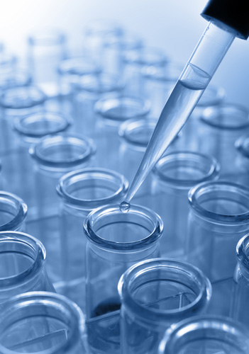
Using technology to modify organisms
Crop plants and domestic animals have been modified over generations using selective breeding, to produce organisms with desirable characteristics.
Recombinant DNA technology can now be used to alter the genetic make-up of organisms much more quickly.
Some genetically modified organisms are already being produced. In 2006, 252 million acres of transgenic crops were grown globally.
Notes:
Photo credit: © Shutterstock 2009, Alexander Raths

Slide 30
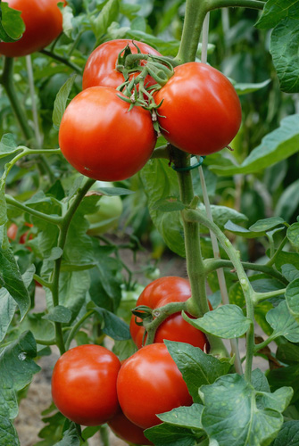
Types of GM crops
Several different type of genetically-modified crops are currently being grown throughout the world. These include:
herbicide-resistant crops
pest-resistant crops – these include insect-resistant crops that have been engineered to produce a bacterial toxin that kills a specific pest.
disease-resistant crops
crops with increased nutritional value – these include Golden Rice.
Notes:
Photo credit: © Shutterstock 2009, Fotokostic

Slide 31
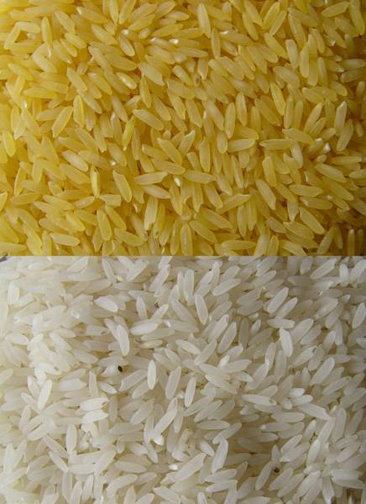
Golden Rice
Rice that has been engineered to contain beta-carotene is known as Golden RiceTM.
Beta carotene is converted
into vitamin A when digested.
Golden Rice is thought to have potential benefits, as vitamin A deficiency currently affects a large number of people in economically less developed countries.
Notes:
Photo credit: Golden Rice Humanitarian Board (www.goldenrice.org)
Teacher notes
When the original strain of Golden Rice was released in 2000 there were concerns that it did not contain enough beta-carotene. It was thought that children would not be able to obtain the recommended daily requirement from eating normal quantities of the rice. However, in 2005 a new strain was released that contains 20 times as much beta-carotene as the original strain.
There are also concerns that genetically-modified crops will be forced upon developing countries. Some people argue that malnutrition is caused by poverty and a lack of a balanced diet rather than vitamin deficiencies of a specific crop.

Slide 32
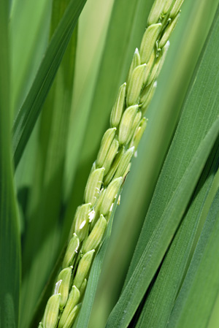
The production of Golden Rice
Rice plants naturally contain the gene for beta-carotene. This gene is expressed in the photosynthesizing parts of the plants. However, it is not expressed in the endosperm (grain).
The production of beta-carotene relies on the presence of several enzymes. Not all of the enzymes are naturally available in the endosperm.
In order to complete the biosynthetic pathway to restore the production
of beta-carotene, scientists inserted two genes from other organisms into the rice genome, to complete the biosynthetic pathway.
Notes:
Photo credit: © Shutterstock 2009, SuthinSoonthorn
Teacher notes
These genes are phytoene synthase, extracted from daffodil plants, and crt1 enzyme taken from soil bacteria.
More information about the production of golden rice can be found here: http://www.goldenrice.org/Content2-How/how1_sci.html

Slide 33
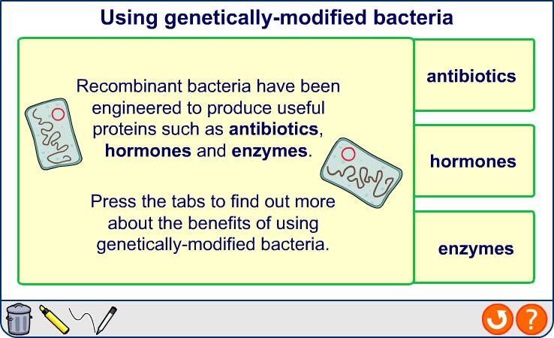
Using genetically modified bacteria
Notes:
Photo credit (insulin): © Shutterstock 2009, Rob Byron
Photo credit (antibiotics): © Shutterstock 2009, Tatiana Popova
Photo credit (cheese production): © Shutterstock 2009, Kheng Guan Toh
Teacher notes
Other hormones such as testosterone, oestrogen, cortisone and human growth hormone can be produced by genetically-modified bacteria.

Slide 34
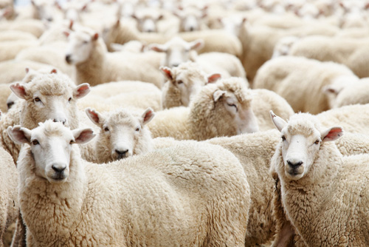
Production of drugs
Transgenic animals and plants can be modified to produce useful pharmaceuticals. This is known as pharming.
For example, alpha-1-antitrypsin protects the lungs from damage during infection. Transgenic sheep can be produced that contain the gene for this protein.
The gene can be pre-programmed to be expressed only in the mammary gland cells and secreted in milk. It can be extracted, purified and used for treating emphysema sufferers.
Notes:
Photo credit: © Shutterstock 2009, Pichugin Dmitry
Teacher notes
This technique can also be used to produce cows that secrete lactoferrin; a protein with antibacterial activity. Goats that secrete the enzyme tPA in their milk can also be engineered. This enzyme is used to help dissolve blood clots. Pharming can also be used to produce organisms that secrete specific vaccines, such as the hepatitis B vaccine. Plants that secrete antigen against common pathogenic organisms are also being developed.
It is thought that certain drugs can be produced by transgenic organism at a significantly reduced cost compared to current production methods

Slide 35
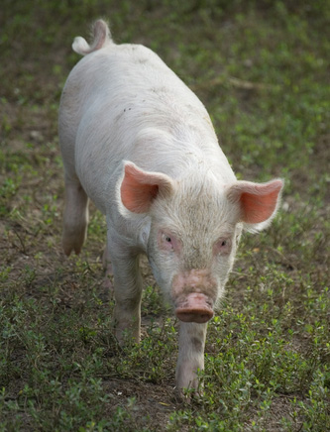
Xenotransplantation
Xenotransplantation is the transfer of organs or tissues into humans from other species, including pigs.
Transplanted organs are often rejected by the new host’s immune system, as antigens on the cells’ surface will be recognized as foreign.
Recombinant DNA technology has been used to engineer pigs that lack an enzyme that is thought to contribute to transplant rejection.
It is thought that with future developments xenotransplantation
may be able to provide a large number of organ transplants.
Notes:
Photo credit: © Shutterstock 2009, Igorsky

Slide 36
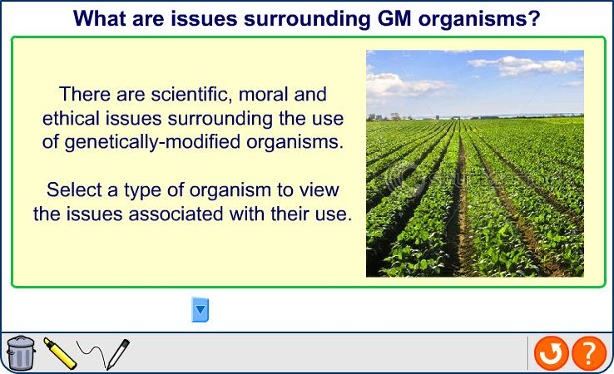
The GM debate
Notes:
Photo credit: © Shutterstock 2009, Elena Elisseeva

Slide 37
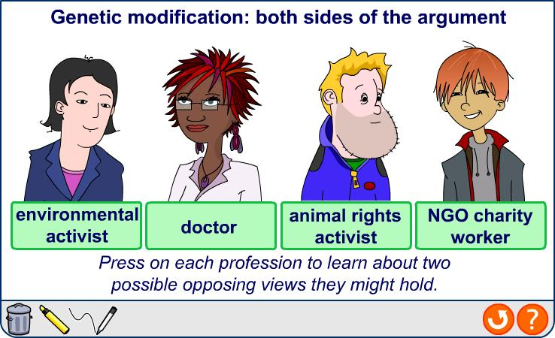
Opinions on GM organisms

Slide 38
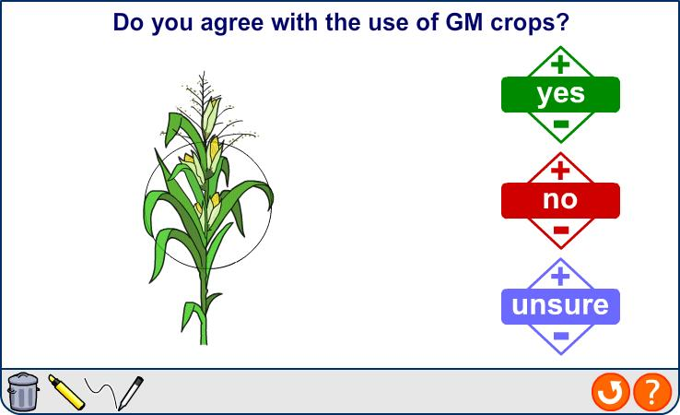
Genetic modification: you vote

Slide 39
Notes:
Teacher notes
In ‘Slide Show’ mode, click the name of a section to jump straight to that slide.

Slide 40
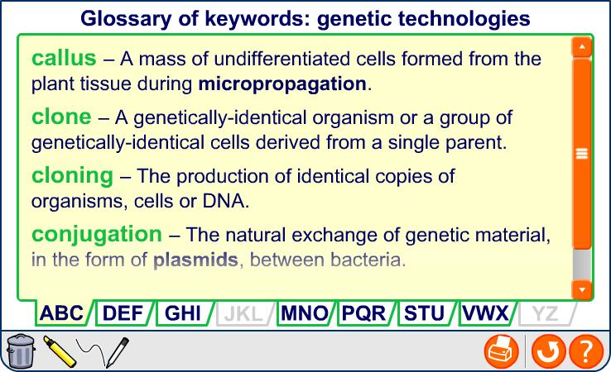
Glossary

Slide 41

What’s the keyword?

Slide 42
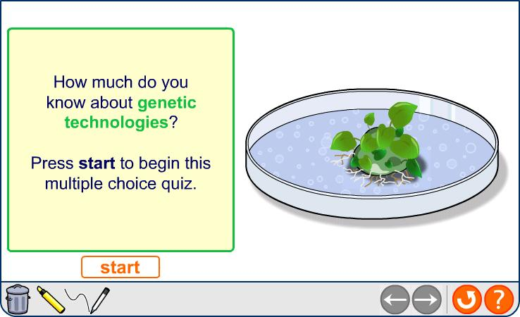
Multiple-choice quiz

