Slide 1
Haemoglobin

Slide 2
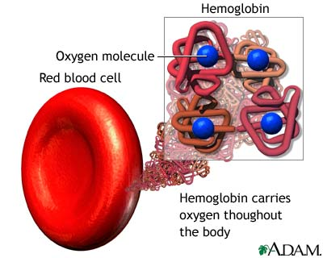
Haemoglobin has ONE job – to carry oxygen around the body
It is a large protein with a quaternary structure

Slide 4
What are proteins?
Proteins are made up of C, H, O, N and some S and P
Transport proteins such as haemoglobin carry oxygen.
The monomer molecules making up proteins are called amino acids.
There are 20 different naturally occurring amino acids.
All amino acids have the same general structure:
A carboxyl group (-COOH)
An amino group (-NH2) attached to a C atom
A variable group called R

Slide 5
Haemoglobin
Haemoglobin is a globular protein.
It’s structure is curled up so that hydrophilic side chains face outwards and hydrophobic side chains face inwards.
This makes haemoglobin soluble and therefore good for transport in the blood.

Slide 6
Quaternary = four parts

Slide 7
1 haemoglobin can carry 4O₂ It’s quite tricky for the first oxygen molecule to bind, but once it has bound the haemoglobin undergoes a conformational change of shape. This makes it much easier for the 2 subsequent oxygen molecules to bind. The last (fourth) oxygen molecule does not bind as easily. This is because the haemoglobin is saturated with oxygen molecules.

Slide 8
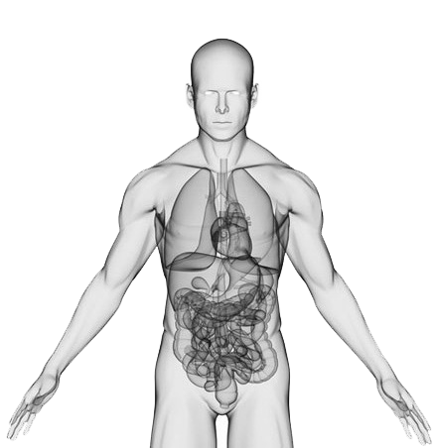
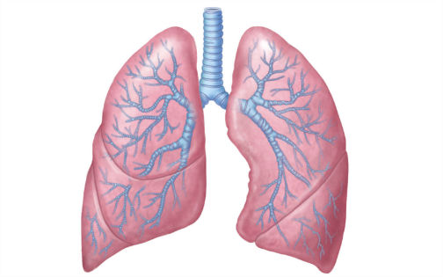
association OR loading
Hb + 4O₂ ⇌ HbO₈
dissociation OR unloading
Haemoglobin + Oxygen ⇌ Oxyhaemoglobin

Slide 9
Haemoglobin reversibly binds with oxygen so is a good transporter of oxygen:
At the gas exchange surface e.g. lungs:
Haemoglobin has a high affinity for O2 so O2 binds
At the respiring tissues:
Haemoglobin has a low affinity for oxygen. The high conc. of CO2 causes haemoglobin to change shape, releasing oxygen.

Slide 10
Key terms for your glossary
Affinity
Saturation
Partial pressure
Loading / association
Unloading / dissociation

Slide 11
Partial Pressure of O₂: The partial pressure of oxygen (pO₂) is a measure of oxygen concentration. pO₂ will be high in the lungs, and lower in body tissues such as muscle.
Haemoglobin's affinity for oxygen depends on the pO₂. Oxygen combines with haemoglobin to form oxyhaemoglobin where there's a high pO₂, and oxyhaemoglobin breaks down to haemoglobin and oxygen where there's a lower pO₂.

Slide 12
Knowledge Check
There is less oxygen at high altitudes than at sea level. People living at high altitudes have more red blood cells than people living at sea level. Explain the advantage of this to people living at high altitude. (2)

Slide 13
There is less oxygen at high altitudes than at sea level. People living at high altitudes have more red blood cells than people living at sea level. Explain the advantage of this to people living at high altitude. (2)
More haemoglobin;
So can load/pick up more oxygen (in the lungs);

Slide 14
 | Lungs | Tissues
Partial pressure of O2
Hb affinity for O2
Hb satuartion

Slide 15
 | Lungs | Tissues
Partial pressure of O2 | High | Low
Hb affinity for O2 | High | Low
Hb satuartion | High | Low

Slide 16
Describe how haemoglobin loads and unloads oxygen in the blood. (4)
Oxygen loads onto haemoglobin at high partial pressure.
In the lungs haemoglobin has a high affinity for oxygen.
Tissues have a low partial pressure of oxygen as it has been used in respiration.
In tissues haemoglobin has a lower affinity for oxygen.
Haemoglobin unloads oxygen at low partial pressure.

Slide 17
Explain how oxygen is loaded, transported and unloaded in the blood. (6)

Slide 18
Haemoglobin carries oxygen (or has a high affinity for oxygen, or oxyhaemoglobin;
In red blood cells;
Loading of oxygen takes place in the lungs;
At high p.O2;
Unloads oxygen to respiring cells or tissues;
At low p.O2;
Unloading linked to higher carbon dioxide (concentration);

Slide 19
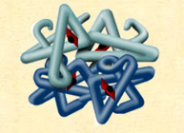
Haemocyanin
Fun Fact
Copper unit
crabs, lobsters, snails, octopus have blue blood.

