Slide 1
Homeostasis and negative feedback

Slide 2
Starter
Remembering back to GCSE what does the term homeostasis mean?
Homeostasis literally means "same state" and it refers to the process of keeping the internal body environment in a steady state.
The importance of this cannot be over-stressed, and a great deal of the hormone system and autonomic nervous system is dedicated to homeostasis.

Slide 3
Homeostasis
Learning objectives
Success criteria
Developing your understanding of homeostasis and feedback mechanisms
Define the terms homeostasis, negative feedback and positive feed back
Explain the principles of homeostasis in terms of receptors, effectors and negative feedback;

Slide 4
Homeostasis
From the textbook p6 write a definition of homeostasis
Homeostasis involves maintenance of the internal environment in a constant state despite external changes.
Examples include:
Blood pH
Blood carbon dioxide levels
Blood glucose concentration
Body temperature
Blood pressure
Water balance

Slide 6
Negative feedback
All homeostatic mechanisms use negative feedback to maintain a constant value.
Negative feedback means that whenever a change occurs in a system, the change automatically causes a corrective mechanism to start, which reverses the original change and brings the system back to normal.
It also means that the bigger then change the bigger the corrective mechanism.

Slide 7
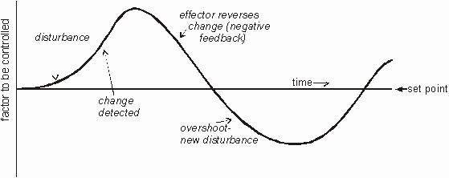
Negative feedback
So in a system controlled by negative feedback the level is never maintained perfectly, but constantly oscillates about the set point. An efficient homeostatic system minimises the size of the oscillations.
Minor changes may not cause a response.

Slide 8
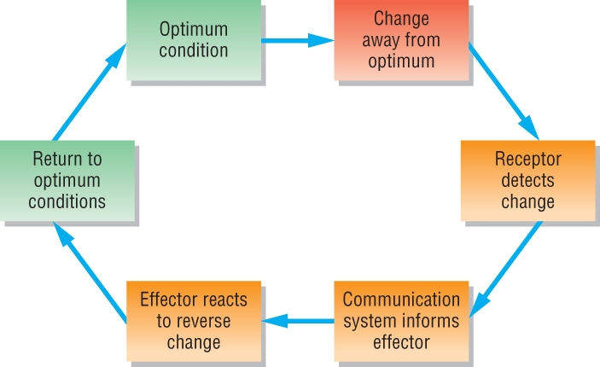
Negative feedback loop
Stimulus
Receptor
Communication pathway
Effector
Response

Slide 9
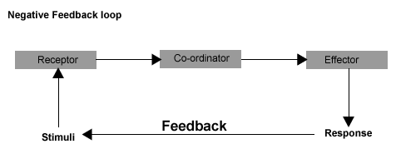
Negative feedback loop
Specialised receptors detect changes within the internal conditions
This information is relayed to a central coordinator that determines the level of response
The coordinator in turn relays such a decision to the effector that is specialised to produce the response behaviour
Notice that this response will modify the internal environment and that these new conditions will in turn become the new stimuli.
The cycle will continue until conditions are reduced back to within narrow acceptable limits.
Notice that system works responding to conditions which are lower than and higher than the fixed regulation point.
Very efficient systems allow very little in the way of undershoot and overshoot.

Slide 10
Positive feedback
Less common
Response is to increase the original change
Effector reacts to increase change

Slide 11
Task
Complete the worksheet (p28 of green book)

Slide 12
Enzyme Action and Temperature Regulation
As core body temperature rises the increase will affect the activity of enzymes. This can lead to heat exhaustion and even death
Describe the effect of increasing temperature on enzyme action
Suggest what actually causes death as the body temperature rises

