Slide 1
Kidney Ultrastructure

Slide 2
Spec
(c) (i) the structure, mechanisms of action and functions of the mammalian kidney (ii) the dissection, examination and drawing of the external and internal structure of the kidney (iii) the examination and drawing of stained sections to show the histology of nephrons
To include the gross structure and histology of the kidney including the detailed structure of a nephron and its associated blood vessels AND the processes of ultrafiltration, selective reabsorption and the production of urine. PAG1, PAG2

Slide 3
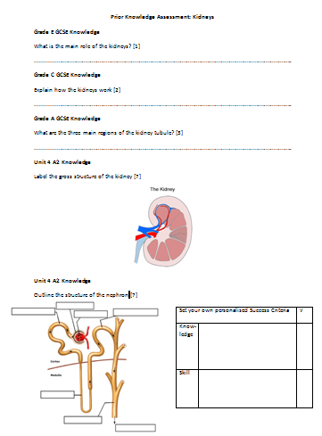
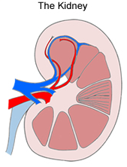
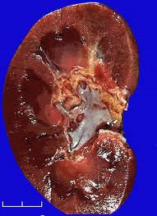
Assess Prior Knowledge

Slide 4
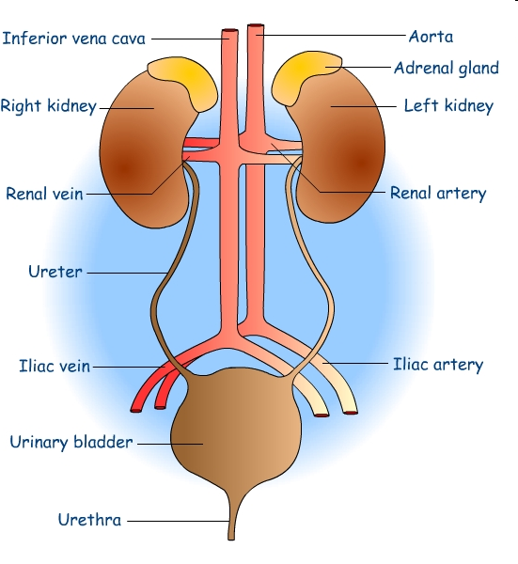
Answers
Grade E GCSE Knowledge
Excretion
Grade C GCSE Knowledge
Filter blood at high pressure
Re-absorb water and useful substances
Grade A GCSE Knowledge
Region for filtering
Region for selective reabsorption
Region to regulate water levels

Slide 5
Answers
Unit 4 A2 Knowledge (Grade E)
Cortex
Renal Vein
Medulla
Renal Artery
Medullary Pyramid
Ureter
Renal Pelvis

Slide 6
Set your own Success Criteria
Set yourself 2 Success Criteria
One knowledge based
E.g. State, Describe, Explain
One skills (drawing based)
Think about how you need to improve high power drawings
Notes:
Exam command words, remember your common errors, look back at your feedback

Slide 7
Learning Objective
To understand about the ultra-structure of the Kidney.
Success Criteria
Describe with the aid of diagrams the detailed structure of the nephron and its associated blood vessels (E-C)
Skill: Develop your high power drawing skills (C-A*)
Analyse with the aid of microscope slides the histology of the kidney (B-A*)

Slide 8
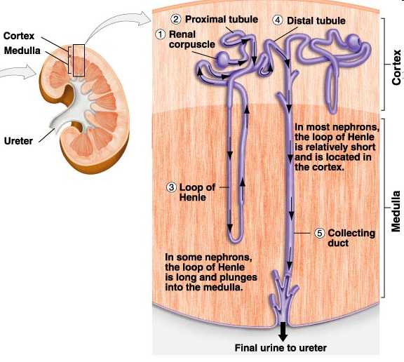
Structure of the Kidney
SC: Describe with the aid of diagrams the detailed structure of the nephron (E-C)
Notes:
Key Question: What is the function of the kidney?

Slide 9
Specialist Groups
Group Number | Specialist | Group Member
1
2
3
4
5
6
7
8

Slide 10
Ultrastructure of the Kidney
You have been given a diagram of the gross and ultrastructure of the kidney
Using the yellow coloured post it notes label on what you parts you already know
Remember if you did triple science at GCSE you are a Specialist! Support the Additional Science students
SC: Describe with the aid of diagrams the detailed structure of the nephron (E-C)

Slide 11
Progress up to A2 standard
Use the sources to add on information about the labels of the structure of the nephron using the different coloured post it notes
You have a choice of three sources it is up to you which sources you use (they increase in difficulty).
It is up to you how much detail you go into (challenge yourselves!) but you must label all parts.
Source 3: the link is http://www.biologymad.com/
resources/kidney.swf
SC: Describe with the aid of diagrams the detailed structure of the nephron (E-C)

Slide 12
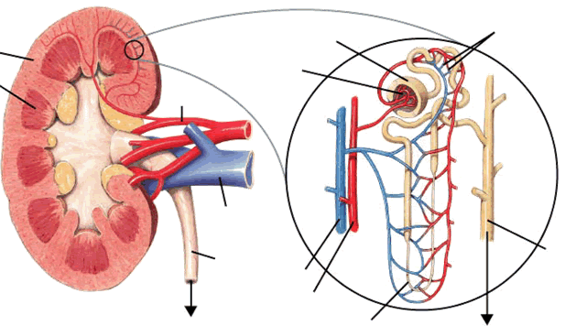
Ultrastructure of the Kidney
SC: Describe with the aid of diagrams the detailed structure of the nephron (E-C)

Slide 13
Answers: Ultrastructure of the Kidney
PCT
Bowman’s Capsule
Capillaries
DCT
Cortex
Pyramid
Renal Artery
Renal Vein
Collecting Duct
Ureter
Venule
Arteriole
Renal Pelvis
Loop of Henle
SC: Describe with the aid of diagrams the detailed structure of the nephron (E-C)

Slide 14
Learning Objective
To understand about the ultra-structure of the Kidney.
Success Criteria
Describe with the aid of diagrams the detailed structure of the nephron (E-C)
Skill: Develop your high power drawing skills (C-A*)
Analyse with the aid of microscope slides the histology of the kidney (B-A*)

Slide 15
PAG 1
Success Criteria
Use of a light microscope at high power and low power
Production of scientific drawings from observations with annotations
What your drawings are being assessed on:
Annotations including descriptive comments
Correctly labelled & label lines drawn with a ruler
Cells drawn to correct proportions
Clear lines, with no shading, showing a few adjacent cells only

Slide 16
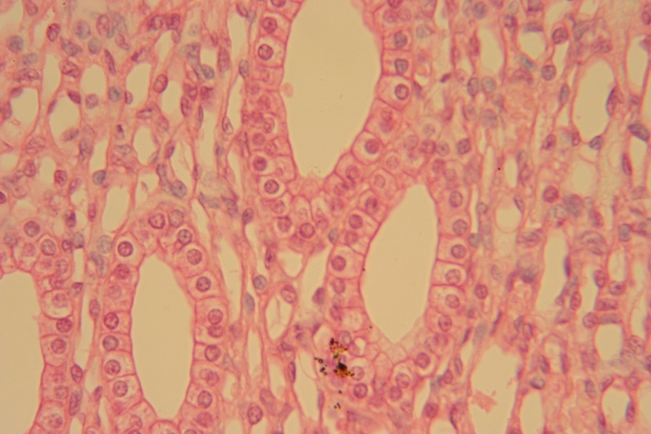
Medulla Micrograph

Slide 17
High Power Drawings
Each group has 3 examples of microscope drawings
Circle any mistakes
Make corrections
Decide which is grade E, C or A
SC: SKILL: Develop your high power drawing skills (C-A*)

Slide 18
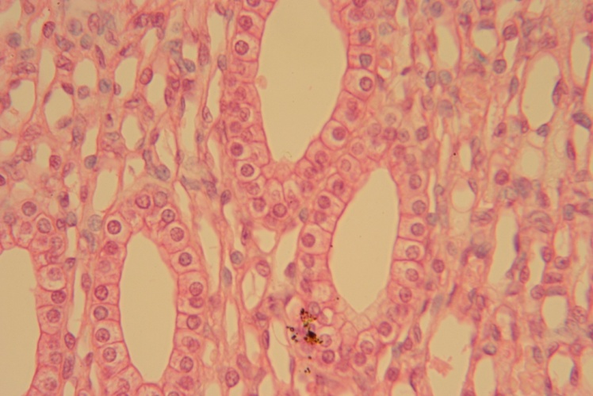
High Power Mark Scheme [10]
Drawn in pencil, no shading
For plant cells: cell walls drawn as single line OR double line, NOT mixing of the two or thick lines drawn
15-20 cells drawn
All cells drawn are complete
Drawing takes up at least 50% of the space
Proportionate
Informative Title
Scale given
Label lines drawn with ruler in pencil
Label lines pointing to correct section
Annotations included written in pen
SC: SKILL: Develop your high power drawing skills (C-A*)

Slide 19
Learning Objective
To understand about the ultra-structure of the Kidney.
Success Criteria
Describe with the aid of diagrams the detailed structure of the nephron (E-C)
Skill: Develop your high power drawing skills (C-A*)
Analyse with the aid of microscope slides the histology of the kidney (B-A*)

Slide 20
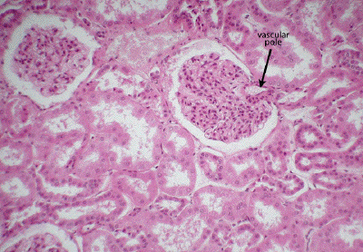
Cortex Micrograph

Slide 21
High Power Drawing Skill
Remind your self of your personalised SC
Look back at your Self/Peer & Teacher assessment and remind yourself of your targets for high power
Complete the past paper style question
SC: SKILL: Develop your high power drawing skills (C-A*)
SC: Analyse with the aid of microscope slides the histology of the kidney (B-A*)

Slide 22
High Power Drawing Skill
Peer Assess!
Give a mark out of 10
State at strength
Set a target for improvement
SC: SKILL: Develop your high power drawing skills (C-A*)
SC: Analyse with the aid of microscope slides the histology of the kidney (B-A*)

Slide 23
Learning Objective
To understand about the ultra-structure of the Kidney.
Success Criteria
Describe with the aid of diagrams the detailed structure of the nephron (E-C)
Skill: Develop your high power drawing skills (C-A*)
Analyse with the aid of microscope slides the histology of the kidney (B-A*)

Slide 24
Plenary
Answer the question on the prior knowledge assessment sheet
Use a green pen to answer
Mark with a red pen
SC: Describe with the aid of diagrams the detailed structure of the nephron (E-C)
SC: SKILL: Develop your high power drawing skills (C-A*)
SC: Analyse with the aid of microscope slides the histology of the kidney (B-A*)

Slide 25
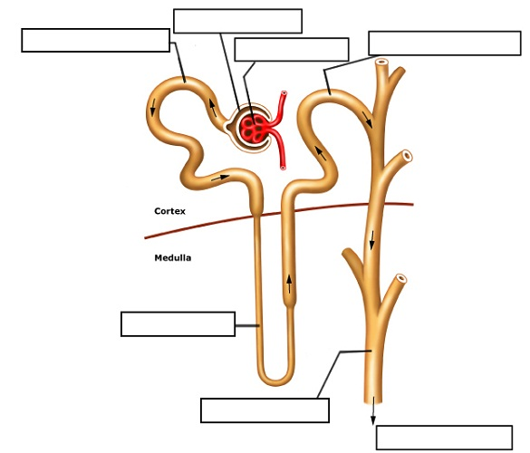
Answers
Bowman’s Capsule
Unit 4 A2 Knowledge
Glomerulus
Distal Convoluted Tubule
Proximal Convoluted Tubule
Loop of Henle
Urine collects in the pelvis
Collecting Duct

Slide 26
Homework
Practice Qualitative Skills and revise kidneys for Qualitative assessment in 2 weeks, you’ll get the aim next week in Seran’s lesson:
Qualitative Assessment: 2nd July

