Slide 1
Natural and Artificial Cloning in Plants
Module 6.4
Cloning & Biotechnology

Slide 2
Learning Objectives
Understand what clones are.
Understand the advantages and disadvantages of natural plant clones.
Understand what natural vegetative propagation in plants is.
Understand what artificial propagation is.
Understand the process of micropropagation.

Slide 3
Clones
Clone:
Genes, cells or whole organisms that carry identical genetic material because they are derived from the same original DNA.
Examples:
Identical twins (when zygote splits).
Plants producing runners.
Binary Fission in bacteria.
Cloning is a natural process for growth/reproduction, but can also be artificial.

Slide 4
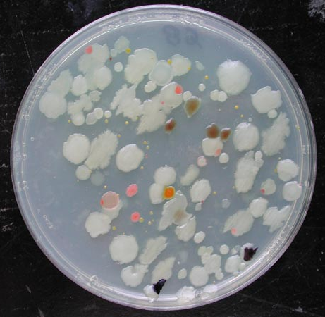
Advantages of Natural Cloning
Quick – allows organisms to reproduce rapidly and take advantages of resources.
All offspring have the genetic information to enable them to survive in their environment.
Can be completed if sexual reproduction fails or is not possible.
Reproduction can happen with only one parent.

Slide 5
Disadvantages of Natural Cloning
The offspring may be crowded.
No genetic diversity – What are the implications of this?
The population shows little variation between individuals.
Selection by environmental problems is not possible.
Detrimental changes in the environment will affect all of the population.

Slide 6
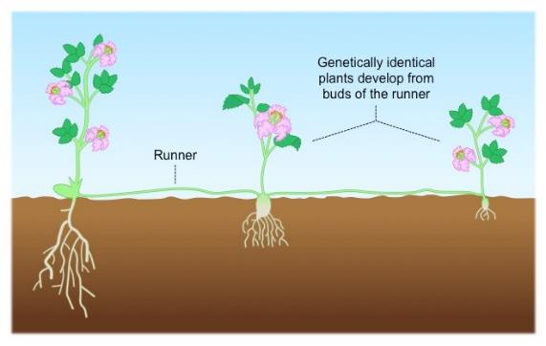
Vegetative Propagation
Many parts of a plant contain cells that retain the ability to divide and differentiate.
This means that plants are able to clone themselves.
Natural cloning in plants is called vegetative propagation.
← Some plants grow horizontal stems called runners or stolens, which can form roots.

Slide 7
Vegetative Propagation
An example of a plant that reproduces asexually is the English elm (Ulmus procera).
If the main trunk is destroyed (disease/burning), growths called root suckers (basal sprouts) appear within 2 months.
The suckers grow from the meristem tissue in the trunk close to the ground.
This is where the least damage is likely to have occurred.
The original plant may even die, but the new stem is a separate individual.

Slide 8
Task
Use page 243 and the vegetative propagation examples sheet to research 4 other methods of vegetative propagation.
Summarise your findings in your notes.

Slide 9
Artificially Cloning Plants

Slide 10
Artificial Vegetative Propagation
The two main methods of artificial vegetative propagation are:
Taking Cuttings
A stem is cut between leaf joints (node) and placed in moist soil. It may require rooting hormone to help it establish new roots.
Tissue Culture / Micropropagation
Involves taking very small pieces of a plant (explants) and using plant growth substances to encourage them to grow into whole new plants.

Slide 11
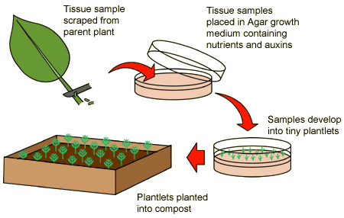
Micropropagation Summary
Only small amounts of a parent plant are required.
Valuable plants can be cloned quickly.
Aseptic techniques required.

Slide 12
Task
Highlight the key points in the process of micropropagation on the handout.
Use page 245 of the textbook to add to the list of disadvantages of micropropagation.

Slide 13
Plenary
Answer the exam question on Tissue Culturing.

Slide 14
Learning Objectives
Understand what clones are.
Understand the advantages and disadvantages of asexual reproduction.
Understand what natural vegetative propagation in plants is.

