Slide 1
Block 1B – Cell division, cell diversity and cellular organisation 2.1.6
Foundations in Biology
Differentiation

Slide 2
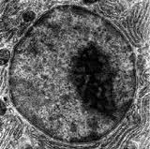
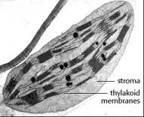
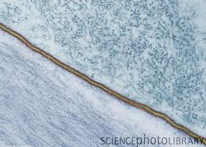
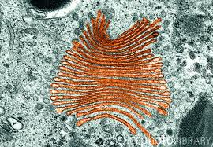
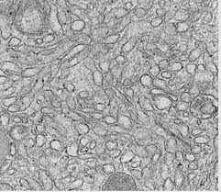
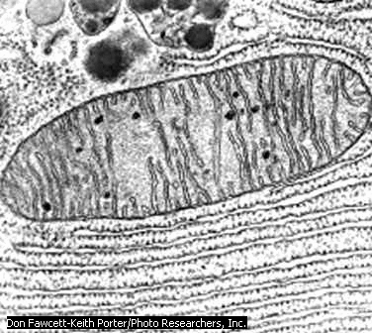
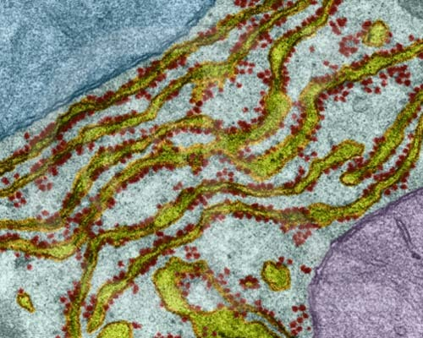
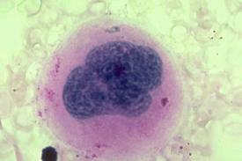
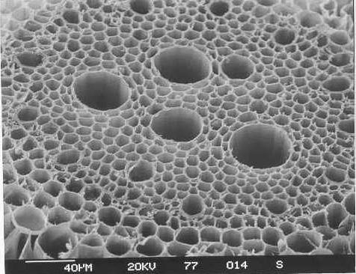
Organelle Quiz
B
D
A
C
H
F
E
G
Notes:
A nucleus; B chloroplast; C plasma membrane; d golgi; e lysosome; F Smooth ER; G mitochondria, H Rough ER; I vascular bundle and xylem;

Slide 3
SPEC

Slide 4
Lesson 7 - Differentiation
Learning Objectives
Success Criteria
How multicellular organisms are specialised for particular functions
define the term differentiation, with reference to erythrocytes, neutrophils (see spec) Grade D-E
describe and explain, how cells of multicellular organisms are specialised for particular functions Grade A-B
explain the meaning of the terms tissue, organ and organ system Grade C

Slide 5
Differentiation
Multicellular organisms have a small SA/V ratio so they need specialised cells to carry out functions.
Differentiation in animal cells
A zygote is not specialised, all of its genes in its genome are able to be expressed. It can divide by mitosis. It is called a stem cell.
This embryonic cell differentiates as certain genes are switched off and others are expressed. This means that the shape, contents and proportion of organelles within it may change.
Differentiation in plant cells
Meristematic cells contain stem cells. It is found at the roots and shoot tips, and in the cambium of vascular bundles. These cells have thin walls, no chloroplasts or a large vacuole. They can divide by mitosis and differentiate into other types of cells
Specialised cells are grouped into tissues, which combine to make organs and organ systems.
Notes:
The following is review purpose only – no notes required. Important to check understanding by answering exam questions

Slide 6
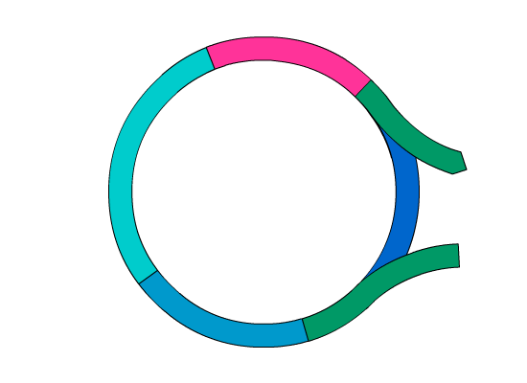

Rest phase
Cells often stop dividing once they are fully differentiated, so where do they fit into the cell cycle?
Specialized cells move from G1 into a resting phase known as G0.
A cell may remain in G0 for the rest of its lifetime, or it may just rest in this state temporarily.
G0
G0 is also the phase in which stem cells wait until their associated body cells need replacing.

Slide 7
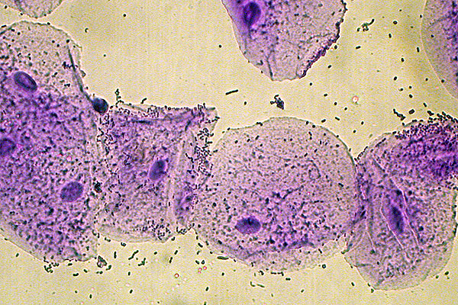
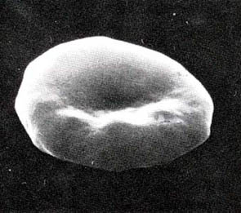
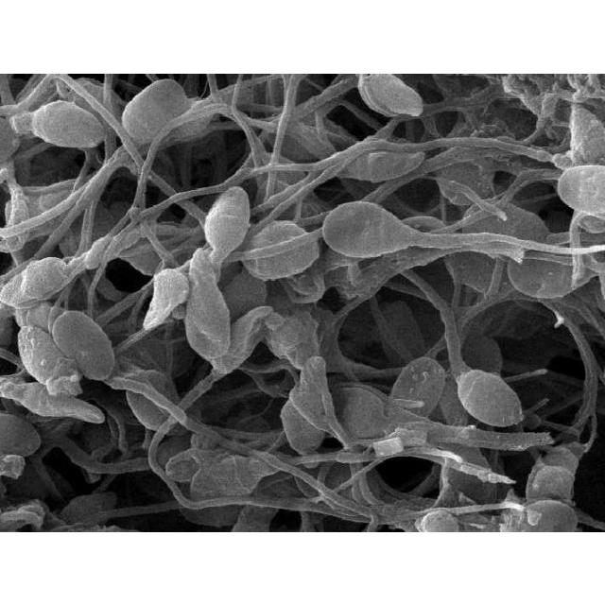
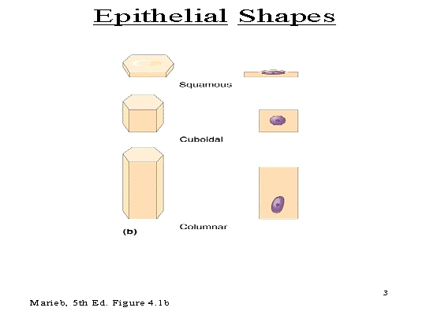
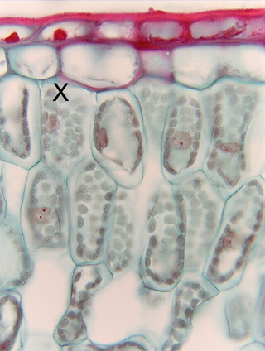
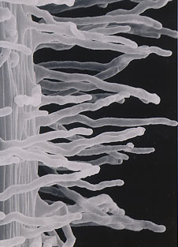
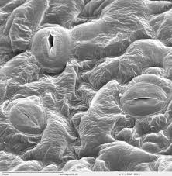
Self assess flip learning task - Feedback

Slide 8
Organisation and specialisation of cells
Cells within a multicellular organism can be specialised.
A tissue is made up of a collection of differentiated cells that have a specialised function or functions. So each tissue is adapted for a particular function.
An organ is a collection of tissues working together to perform the same function
A number of organs working together to carry out an overall life function is called an organ system

Slide 9

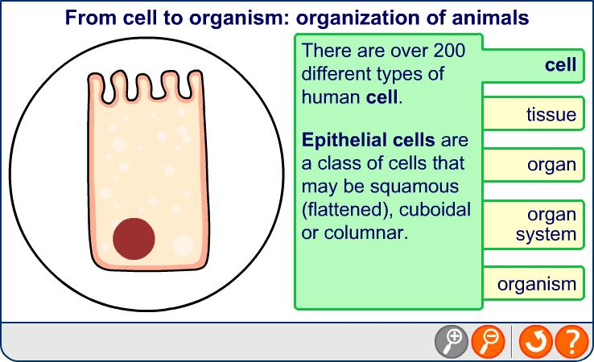
Tissues, organs and organ systems

Slide 10

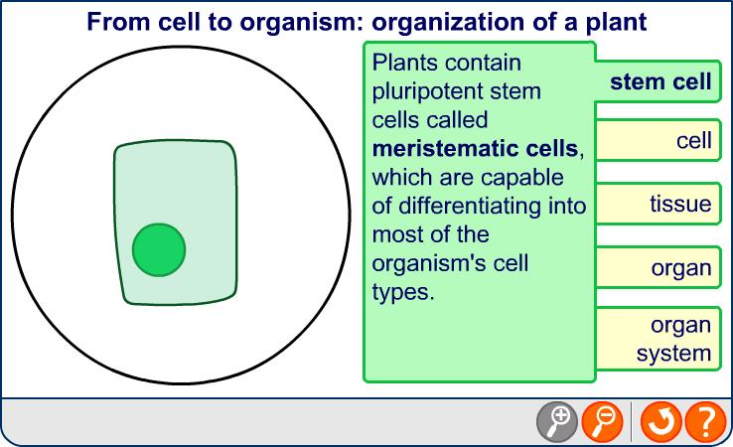
Plant structure
Notes:
Teacher notes
See the ‘Transport in Plants’ presentation for more information about xylem, phloem and the transport of substances.

Slide 11
Task
Complete exam questions

Slide 12
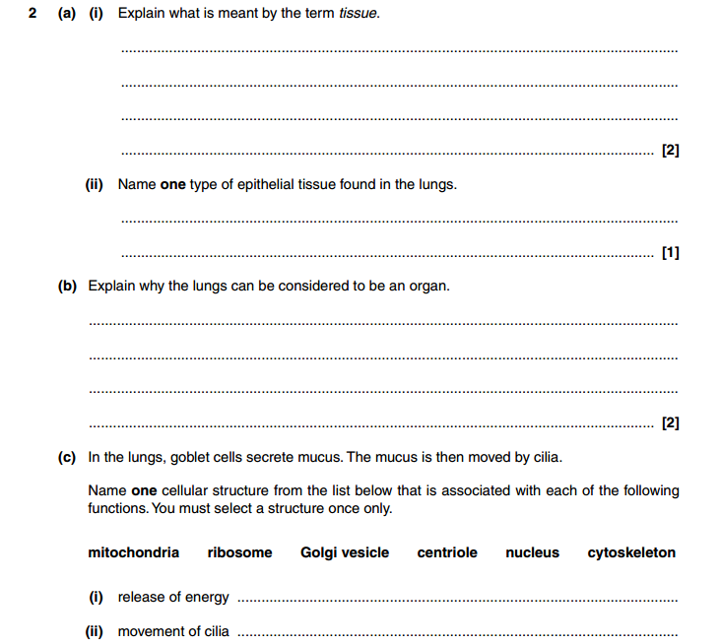


Slide 13
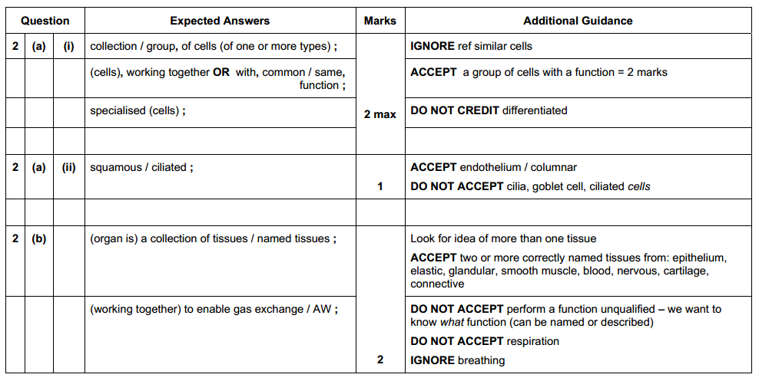
Jan 2010

Slide 14
Plenary – exam questions
Write down 2 examples of organ systems and how the organs that work together in them.
Using the digestive system as an example, explain the relationship between organs in an organ system. (6 marks)
Digestive system is a group of organs working together to carry out a function (1). The pancreas produces digestive enzymes (1) the stomach contains acid for digesting food (1) the liver produces bile to aid digestion of fats (1) the small intestine digests and absorbs soluble food (1) and large intestine absorbs water from undigested food producing faeces (1)

