Slide 1
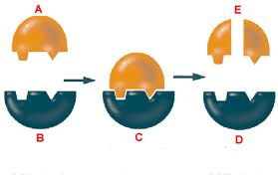
Immobilising Enzymes
6.4 Cloning & Biotechnology

Slide 2
Learning Objectives
Understand the methods used for immobilising enzymes.
Understand the advantages of using immobilised enzymes.

Slide 3
Enzymes as Catalysts
Enzymes are used to speed up chemical (metabolic) reactions e.g. respiration or photosynthesis- so why use enzymes in industry?
They are specific.
Can catalyse reactions between specific chemicals, even in a large mixture .
Form fewer bi-products.
Less purification needed.
Function well at relatively low temperatures saving money on fuel costs.
Enzymes from thermophilic bacteria can be extracted and used at high temperatures.

Slide 4
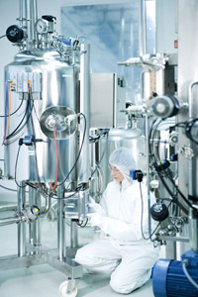
Isolating Enzymes
In some biotechnological processes, whole organisms are cultured to generate products, however when you need a single product, it is more efficient to isolate the enzyme
They can be isolated in large quantities
The extraction of enzymes from a fermentation mixture is known as downstream processing which is the separation and purification of any product of large scale fermentations

Slide 5
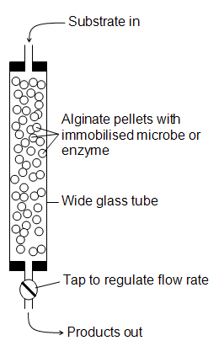
Immobilising Enzymes
Enzyme-substrate complexes must be formed in order to gain the products.
The easiest way is to mix the isolated enzyme with the substrate, however the product must then be separated which can be a costly process.
It is therefore possible to immobilise enzymes so they can catalyse the reaction without mixing freely.

Slide 6
Methods for Immobilising
Covalent Bonding
Adsorption
Membrane Seperation
Entrapment

Slide 7
Covalent Bonding
Enzyme molecules covalently bonded to a support such as clay.
Cross-linking agent such as gluteraldehyde is used.
Binding is very strong.

Slide 8
Adsorption
Enzyme molecules are mixed with immobilising support e.g. glass beads or clay.
Hydrophobic interactions and ionic links form.
Enzymes may become detached, as links are weak

Slide 9
Membrane Separation
Substrate separated from the mixture by a partially permeable membrane.
Enzyme is on one side of the membrane, while the substrate is passed along the other side.
Substrate can pass through the mesh.

Slide 10
Entrapment
Enzymes trapped in their natural state in a gel bead
Reaction rate can be reduced as substrate needs to get through the trapping barrier

Slide 11
Advantages
Immobilised enzymes can be reused.
Product is enzyme free.
Immobilised enzymes are more tolerant to pH and temperature changes.
Enzyme not mixed with products so purification/ downstream processing costs are low.
Enzymes available immediately for re-use which is good for continuous processes.
The enzymes are more stable as the immobilising matrix protects the enzyme molecules – less likely to denature in extreme conditions.

Slide 12
Disadvantages
Additional time, equipment and materials needed, so expensive to set up.
Can be less active as they do not mix freely with the substrate.
Contamination can be costly if it occurs as the whole system needs to be stopped.

Slide 13
Examples of Immobilised Enzymes
Page 263 of the textbook has many examples of enzymes that immobilise for use in industry.
Write about 3 of them and how they are immobilised. Mention what reaction they catalyse.

Slide 14
Plenary
Why might bonding enzymes to a surface reduce their rate of activity?
Suggest why some immobilised enzyme processes can be carried out at temperatures well above the normal optimum for that enzyme.

