Slide 1
Liver histology
Prac - Looking at liver slides

Slide 2
Starter:
Review your FLIP learning, discuss what you learnt with the person next to you

Slide 3
Learning Objective
Success Criteria
Know about liver structure
the structure and functions of the mammalian liver - To include the gross structure and histology of the liver
(ii) the examination and drawing of stained sections to show the histology of liver tissue
Notes:
3

Slide 4
Terms never to confuse!!
Excretion versus egestion
Metabolic waste – substances produced from chemical reaction that may be toxic at high levels in the body
Carbon dioxide
Nitrogenous waste (urea)

Slide 5
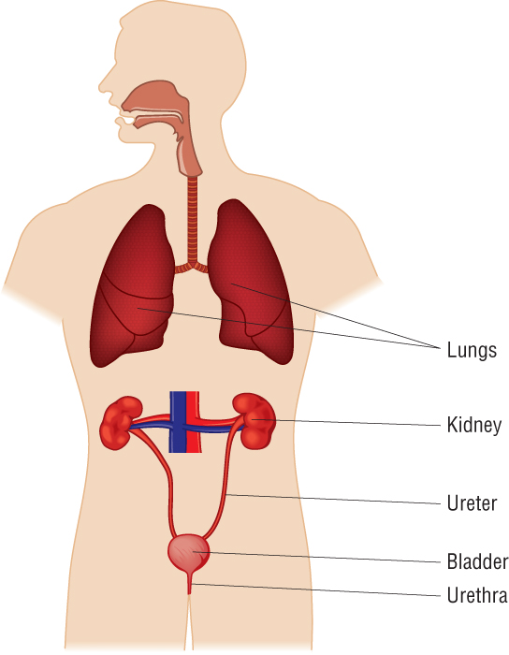
A diagram showing the positions of the main excretory organs
Notes:
5

Slide 6
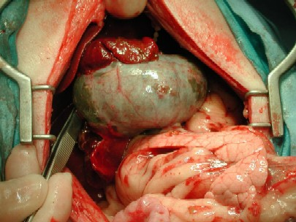
Liver
Gallbladder
Pancreas

Slide 7
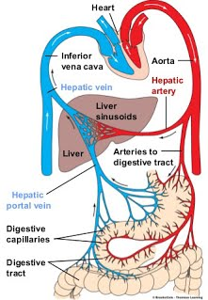
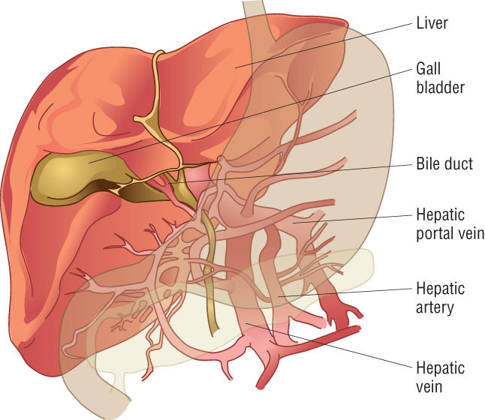
Week 5
The liver and its connections to the blood system
Notes:
7

Slide 8
Blood supply to liver
Hepatic artery – supplies oxygenated blood from heart – providing good supply of oxygen
Hepatic vein – takes deoxygenated blood away from liver
Hepatic portal vein – bring blood from small intestine rich in the products of digestion (meaning harmful substances can be filtered out and broken down immediately)
Bile duct takes bile made in liver to gall bladder for storage
Notes:
8

Slide 9
Liver

Slide 10
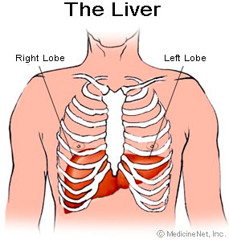
Liver basics
Lies to the right side of body just under diaphragm
Largest internal organ- holds 13% total blood at any one time- can store & release blood acting as a reservoir to compensate for smaller changes in blood volume
Uses up to 20% total energy in body
Made of left & right lobes enclosed by fibrous capsule (Glissons Capsule)
Each lobe formed from hexagonal lobules (100,000)
Dual blood supply: receives blood from 2 blood vessels
Notes:
The liver receives approximately 30% of resting cardiac output and is therefore a very vascular organ.
The hepatic vascular system is dynamic, meaning that it has considerable ability to both store and release blood - it functions as a reservoir within the general circulation.
In the normal situation, 10-15% of the total blood volume is in the liver, with roughly 60% of that in the sinusoids.
When blood is lost, the liver dynamically adjusts its blood volume and can eject enough blood to compensate for a moderate amount of haemorrhage.
Conversely, when vascular volume is increased, as when fluids are rapidly taken up, the hepatic blood volume expands, providing a buffer against increases in blood volume.
The liver receives approximately 30% of resting cardiac output and is therefore a very vascular organ.
The hepatic vascular system is dynamic, meaning that it has considerable ability to both store and release blood - it functions as a reservoir within the general circulation.
In the normal situation, 10-15% of the total blood volume is in the liver, with roughly 60% of that in the sinusoids.
When blood is lost, the liver dynamically adjusts its blood volume and can eject enough blood to compensate for a moderate amount of haemorrhage.
Conversely, when vascular volume is increased, as when fluids are rapidly taken up, the hepatic blood volume expands, providing a buffer against increases in blood volume.

Slide 11
Liver Lobules
Inter-lobular vessel
Liver lobule Intra-lobular vessel

Slide 12
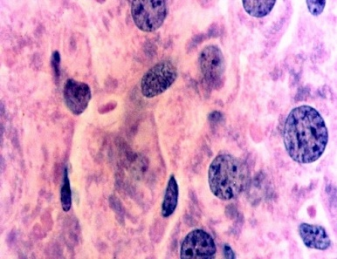
Hepatocytes
Make up roughly 80% of the mass of the liver
Nuclei are distinctly round, most single nucleus, some binucleate cells.
Hepatocytes are exceptionally active in synthesis of protein and lipids for export therefore have large quantities of both rough and smooth endoplasmic reticulum and Golgi membranes.
Glycogen granules and vesicles containing very low density lipoproteins are readily observed.

Slide 13
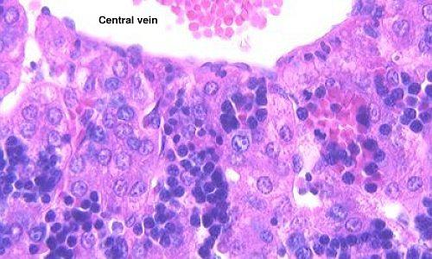
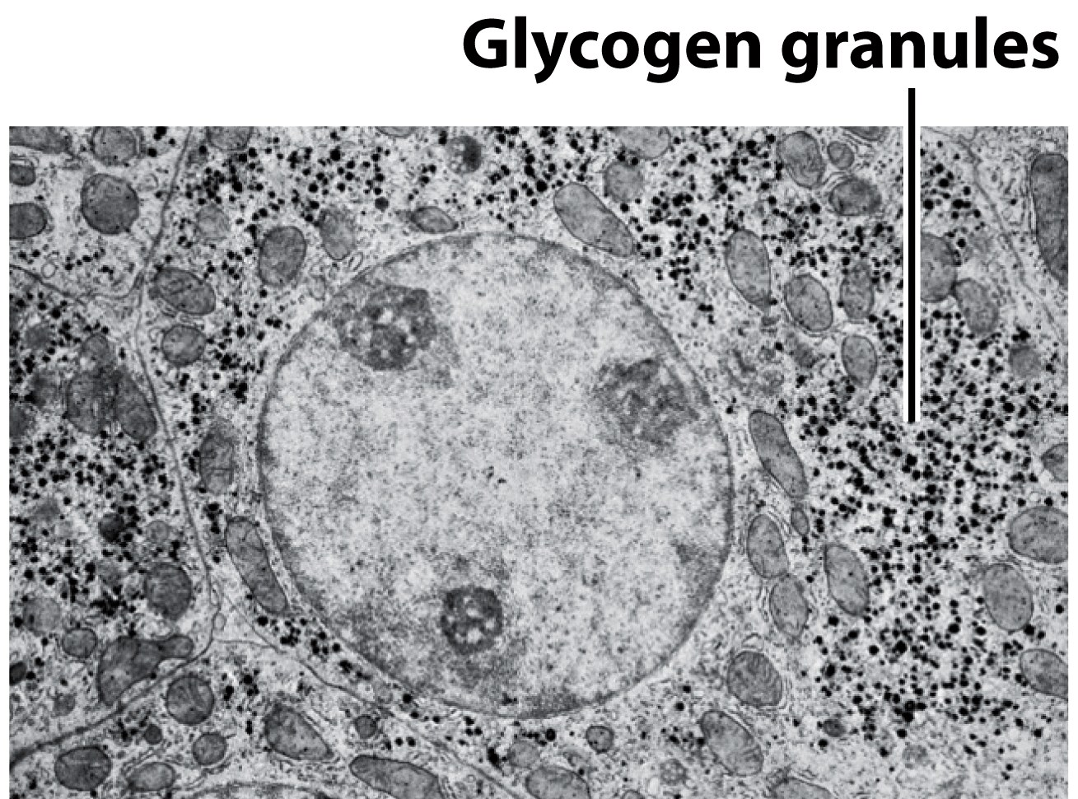
Glycogen granules
within hepatocytes
Notes:
Glycogen granules can make up to 8% mass of cells

Slide 14
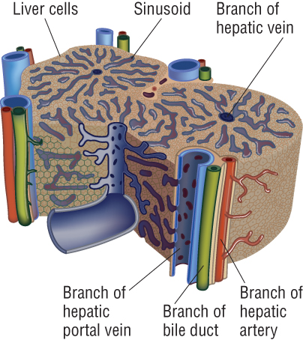
The arrangement of liver cells into cylindrical lobules
Blood moves from outside of lobule from HPV and HA → HV
Blood from HPV and HA mix and enter channels called SINUSOIDS
Hepatocytes lining the SINUSOIDS absorb products in blood and secrete products into the blood as it flows over them.
Interlobular vessels (triad)
Notes:
14
Interlobular vessels: on outside of lobule: triad – three vessels: distinguishable as vein artery + other

Slide 15
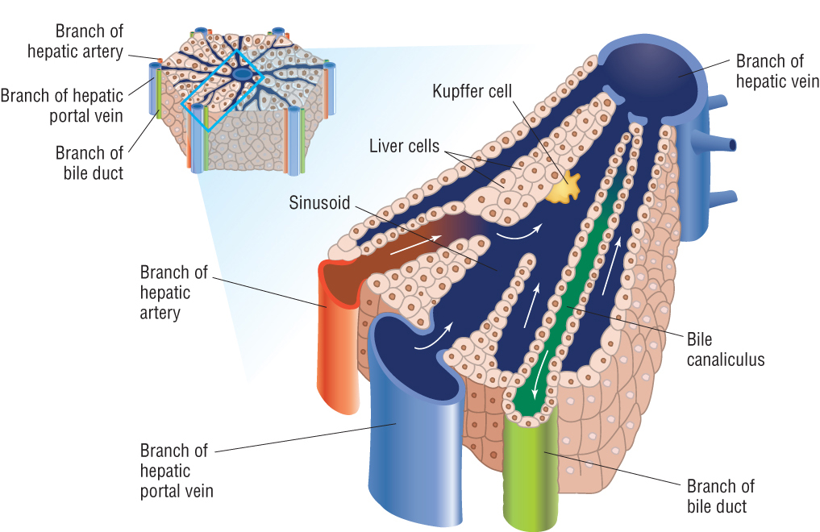
The arrangement of liver cells in a lobule
© Pearson Education Ltd 2009
This document may have been altered from the original
Notes:
15
Stress
Direction of blood flow outside → inside
Sinusoids are dilated capillaires: thin endothelial cells the body fluid filled space in between the hepatocytes and endothelium ois called the PERISINUSOIDAL SPACE or SPACE OF DISSE. Fluid percolate through the endothelial cells and make contact with the uunderlying hepatcytes. Hepatocytes have microvillis x 6 fold increase in surface area.

Slide 16
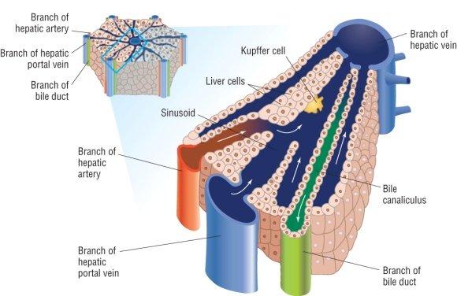
Liver cells
Direction of blood outside → inside lobule through sinusoids
Kupffer cells in SINUSOID: phagocytic cells (derived from monocytes). Ingest bacteria from blood. Breakdown and recycle old red blood cells, bilirubin (product of haemoglobin breakdown) is one of the pigments in bile.
Hepatocytes have microvilli (increase surface area of liver cells: x6). Many metabolic functions:
protein synthesis, formation of glycogen, synthesis of cholesterol and bile salts, detoxification

Slide 17
Bile Canaliculus
Hepatocytes separated by second channel: bile cannuli
Hepatocytes close to bile cannuli rich in Golgi vessels reflecting transport of bile constituents into the channels
Transfers fluid inside → outside of lobule
Contents drained into hepatic bile duct: continuous with the common bile duct, which delivers bile into the duodenum, diverting through the gall bladder
Drains up to 1 litre per day

Slide 18
Key Skill: Drawing Microscope Slides
Looking at liver slides

Slide 19
Low Power Drawing Mark Scheme [10]
Annotations [3]
Whilst a label might be the name of a tissue, an annotation adds a descriptive quality such as shape, size or colour.
Drawings from a microscope [7]
Single, clear lines drawn with a sharp pencil.
No shading or colour on the diagram.
Informative title to be included.
Scale included (e.g. high power, low power, x80, x10) to show approximate magnification.
Low power tissue plans may not include cells.
Tissues should be in correct proportions.
Label lines drawn in pencil using a ruler.

Slide 20
Plenary: PPQ

Slide 21
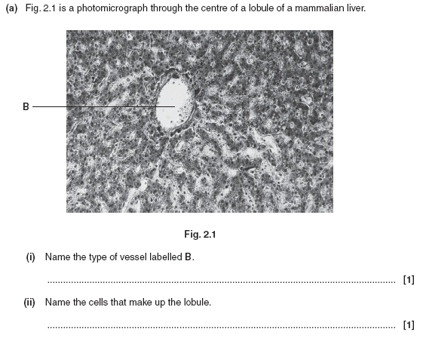

Slide 22
Markscheme

