Slide 1
Settler
Describe and explain the 2 features that make an exchange surface efficient (4 marks)
Notes:
Students to feedback answers – check understanding from previous lesson

Slide 2
Module 3 Exchange and transport
7.2– Mammalian gas exchange system

Slide 3
Starter Activity
In pairs talk for 30 seconds on how to breathe

Slide 4
Learning Objectives
Success Criteria
Label the lungs and each features importance
(Grade E – D)
Describe the features of an efficient exchange surface (Grade C – B)
Outline the mechanism of breathing in mammals, with reference to the function of the ribcage, intercostal muscles and diaphragm (Grade B – A)
Describe how the features of the lung structure that allow it to be an efficient gas exchange surface
Outline the mechanism of breathing

Slide 5
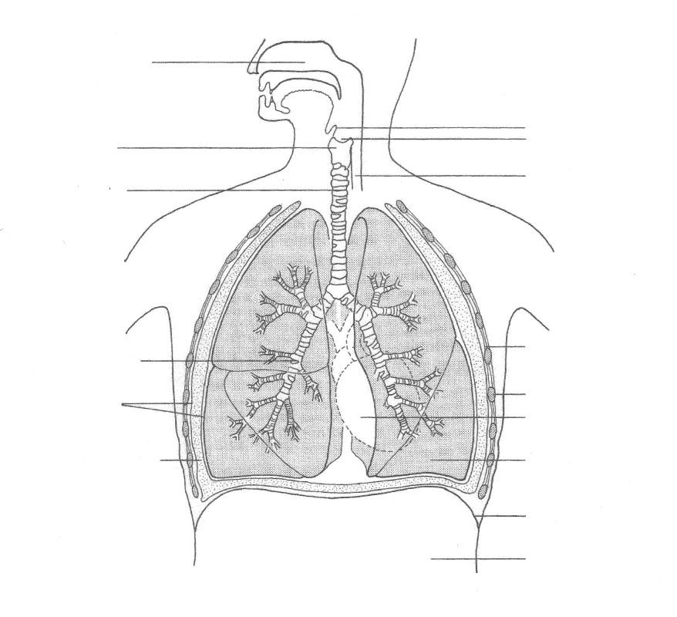
LUNGS
Label the lungs and each features importance
(Grade D – C)
Trachea
Intercostal muscle
Bronchus
Bronchiole
Rib
Pleural membrane
Diaphragm
add onto your diagram briefly the importance of each structure
Notes:
Hand out sheet for students to label

Slide 6
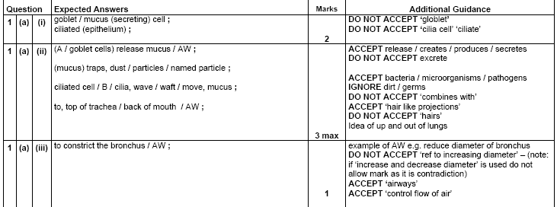
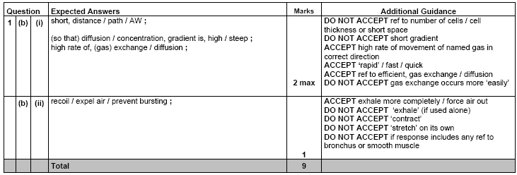
Notes:
Peer mark homework exam questions

Slide 7
Lung dissection
Demonstration
http://www.nuffieldfoundation.org/practical-biology/dissecting-lungs
Discuss worksheet answers

Slide 8
How lungs are adapted for gaseous exchange
Describe the features of an efficient exchange surface (Grade B – C)
Task – Use page 46/47
4 features of a good exchange surface?
1)large surface area
2)thin barrier
3)fresh supply of molecules on one side to keep concentration high
4)Removal of required molecules on the other side to keep concentration low
In pairs,
Person 1 explain how number 1) and 2) would apply to the lungs
Person 2 Explain how number 3) and 4) would apply to the lungs.
Teach each other what you have found

Slide 9
How they are adapted for exchange
Large surface Area = more space for molecules to pass through
Alveoli = 100-300µm
Many of them
Total surface area = 70m²
Permeable to oxygen and Carbon Dioxide
Plasma membrane allows diffusion of both these molecules
Thin barrier to reduce diffusion distance

Slide 10
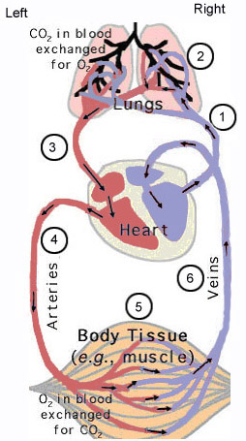
How they are adapted for exchange
Maintaining the diffusion gradient
Steep diffusion gradient is needed
Achieved by the blood transport system and the ventilation movements
Blood Transport System
Blood brings Carbon dioxide to the lungs
Carries oxygen away
Breathing Movements
Replace used air with fresh air
Ensures concentration of oxygen is higher than in the blood
Removes air containing carbon dioxide
Ensure concentration of carbon dioxide is lower than in the blood

Slide 11
A mobile ribcage?
This means that the rib cage must also be able to change position.
Take your hands and place them flat on your chest just above your hips on each side of your body. Now breathe in and out very deeply. Whilst you do this, watch to see what happens to your hands.
You should notice the following things…..

Slide 12
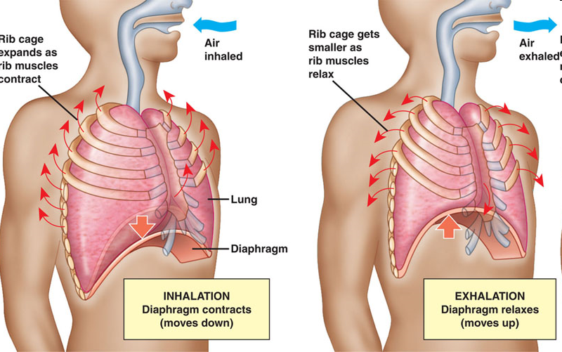
Mechanism of breathing

Slide 13
Make a table like this:
Step | Breathing in (Inspiration) | Breathing out (expiration)
1
2
3
4
5
6
Complete the table by writing the sentences on the next slide in the correct order.
Outline the mechanism of breathing in mammals, with reference to the function of the ribcage, intercostal muscles and diaphragm (Grade A – B)

Slide 14
Breathing in and out
Pressure in lungs decreases.
Volume of chest cavity decreases
Diaphragm relaxes and is pushed upwards by displaced organs underneath
External intercostal muscles relax and ribs fall
Pressure in lungs increases.
Air moves out of the lungs.
Diaphragm contracts to become flatter and pushes digestive organs down
Volume of chest cavity increases
External intercostal muscles contract to raise ribs
Air moves into the lungs.

Slide 15
Breathing in and out
Breathing in Energy using process | Breathing out Passive process
1. External intercostal muscles contract to raise ribs | 1. External intercostal muscles relax and ribs fall
2. Diaphragm contracts to become flatter and pushes digestive organs down | 2. Diaphragm relaxes and is pushed upwards by displaced organs underneath
3. Volume of chest cavity increases | 3. Volume of chest cavity decreases
4. Pressure in lungs decreases. | 4. Pressure in lungs increases.
5. Air moves into the lungs. | 5. Air moves out of the lungs.

Slide 16
Task
Complete questions 1-3 on p47

Slide 17
Plenary Activity
Alveolus
Intercostal muscles
Inspiration
Expiration
Diaphragm
Squamous Tissue
Capillary
Trachea
Bronchi
Bronchioles
Ribs
Lungs
Surfactant
Volume
Pressure

