Slide 1
Stages of the cell cycle
Notes:
Photo credit: Herve Conge, ISM / Science Photo Library
Light micrograph of hyacinth root cells undergoing mitosis (nuclear division). Mitosis is the formation of two daughter nuclei from one parent nucleus. One cell at centre left is in metaphase. The chromosomes, which contain 2 identical chromatids and are made of deoxyribonucleic acid (DNA, red), are lining up along the centre of the cell. the chromatids are then separated during anaphase (upper centre). At left a cell is in telophase, the last stage of mitosis before cytokinesis (cellular division). The chromosomes have been separated and moved to opposite poles of the cell. The chromatids are divided equally between the daughter cells. Magnification: x280 at 10 centimetres wide.

Slide 2
Mitosis and the Cell cycle

Slide 3
Mitosis and Cell Cycle
Learning Objectives
Success Criteria
- Explain the significance of mitosis
- Explain the meaning of the term homologous pair of chromosomes;
- State that mitosis occupies a small amount of the cell cycle
Outline how the cell cycle is regulated
List purpose of mitosis
Draw and annotate the cell cycle from the video resource
Identify the phases of mitosis from EM micrographs
Use of the term ‘checkpoints’

Slide 4
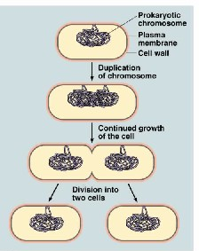
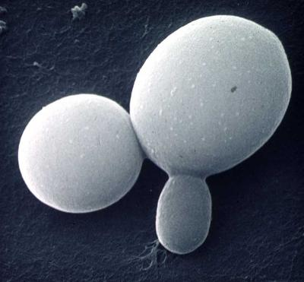
Binary Fision (Bacteria)
Budding (Yeast)
1 A bud is formed at the surface of the cell
2 Interphase – DNA and organelles replicated
3 Set of duplicated chromosomes – each set contained within a nucleus
4 One daughter nucleus migrates into the bud
5 Bud increases in size and eventually separates from parent cell – producing a new, genetically identical yeast cell
http://biolibogy.com/cells.html

Slide 5
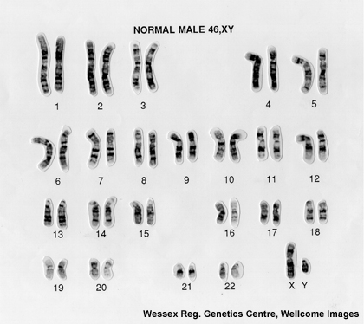
Chromosome number
A human somatic (body) cell contains 46 chromosomes. These consist of 23 pairs of homologous chromosomes.
Each pair contains one chromosome from each parent. Other species have different numbers of these homologous pairs.
Sex cells, or gametes, have only one copy of each chromosome: they are haploid. A somatic cell, containing two of each, is called diploid.
Notes:
Matching pair of chromosomes one inherited from each parent – homologous chromosomes

Slide 6
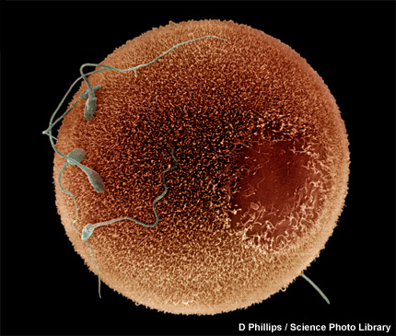
Haploid gametes
All somatic cells in a multicellular organism are genetically identical because they are the result of mitosis.
They are all descended from a single cell – a zygote.
A zygote is formed when two haploid gametes fuse.
These gametes are genetically unique because, unlike somatic cells, they were formed by a special form of cell division called meiosis.
Notes:
Photo credit: D Phillips / Science Photo Library
Human sperm fertilizing an egg.

Slide 7
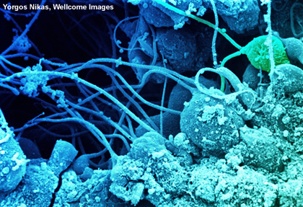
What is the cell cycle?
All cells are formed by division of existing cells. Eukaryotic cells always divide in one of two ways:
Mitosis: division into two daughter cells that are genetically identical to each other and to the parent cell.
Meiosis: division into four unique daughter cells with half the chromosomes of the parent cell.
All cells follow the same sequence of events between mitotic divisions, and this is known as the cell cycle.
Notes:
Photo credit: Yorgos Nikas, Wellcome Images
Sperm develop in the seminiferous tubules of the testis. The spermatids are embedded in the Sertoli cells with their tails projecting into the lumen of the tubule. These spermatids are in the advanced stages of maturation. One of the spermatids has two tails (top right, green).

Slide 8
The cell cycle

Slide 9
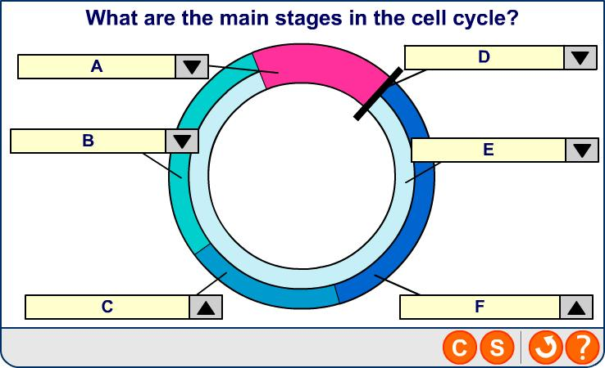
Stages of the cell cycle

Slide 10
Mitosis
Notes:
Teacher notes
For clarity, only one pair of chromosomes is shown here.
Cytokinesis is considered separate from mitosis because they are not always coupled. Cytokinesis usually happens during telophase, but this isn’t necessarily the case: coenocytic cells go through telophase without cytokinesis, sometimes several times, gaining multiple nuclei.

Slide 11
Cell cycle summary

Slide 12
Cytokinesis
In animal cells the cell surface membrane is pulled in wards by the cytoskeleton until its close enough to fuse around the middle forming 2 new cells
Plant cells have walls, so cytokinesis cannot proceed with a cleavage furrow. Instead, during telophase a cell plate forms across the cell in the location of the old metaphase plate.
During telophase, membrane-enclosed vesicles derived from the Golgi apparatus migrate to the centre of the cell and fuse to form a cell plate. The growing cell plate fuses with the existing plasma membrane, producing two daughter cells, each with its own plasma membrane. Then a new cell wall forms.

Slide 13
A. One of the two copies of a chromosome that are joined together by a centromere prior to cell division
B. A type of cell division where the chromosome number is halved
C. One of the different forms of a particular gene
D. A section of DNA that codes for a polypeptide
E. A type of cell division where the daughter cells have the same number of chromosomes as the parent cell
F. A term referring to a nucleus which contains two pairs of chromosomes.
G. A pair of chromosomes (one maternal and one paternal) that have the same gene loci.
H. The position of a gene on a chromosome
Define these words:
Gene
Locus
Allele
Mitosis
Meiosis
Homologous chromosomes
Chromatid
Diploid

Slide 14
Control of the cell cycle
2.1.6b
Cell can only divide to produce two identical daughter cells if:
The cell has grown to the right size.
The replicated DNA is error-free.
Chromosomes are in the correct place ready for mitosis.
Checkpoints are control mechanisms – monitor and verify each phase of cell cycle has occurred correctly before moving on to next one.
3 of them: G₁, G₂ and spindle assembly checkpoints

Slide 15
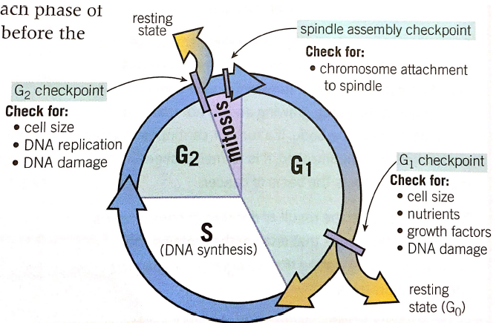
Checkpoints
2.1.6b

Slide 16
Cells can leave the cell cycle
G₀ is the name given to this phase.
Happens when a cell:
Differentiates to carry out a function – cell no longer able to divide.
Has damaged DNA – cannot divide any longer.
Ages – cells can only divide a certain number of times – they become senescent. (Linked to age-related disease).
Lymphocytes can re-enter the cell cycle when stimulated in an immune response.

Slide 17
How do checkpoints work?
2.1.6b
Kinases- enzymes which cause phosphorylation of proteins
This causes a change in the tertiary structure and activates the proteins
Kinases bind to cyclins (CDK complexes) to phosphorylate proteins involved in the cell cycle
Uncontrolled division of cells = cancer and this can be the result of mutations in the genes encoding for checkpoint proteins, eg cyclins.
Treatment for cancer could be targeting mutated cyclin proteins using chemical inhibitors
Notes:
CDK – Cyclin dependent kinases

Slide 18
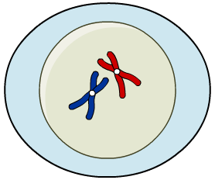
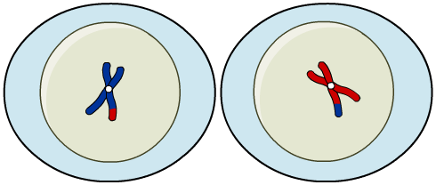
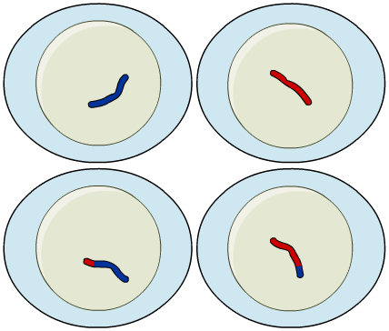
Meiosis I and II
Meiosis is the process of cell division underlying sexual reproduction. It is a two-stage process:
Meiosis I introduces genetic diversity by randomly dividing a cell’s genes in two. It results in two haploid cells.
Meiosis II is similar to mitosis. It splits each chromosome into its two chromatids and places one in each daughter cell. It results in four haploid gametes.

Slide 19
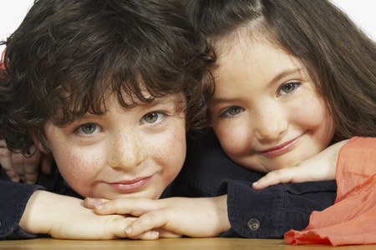
Genetic variation
Sexual reproduction creates genetic diversity within a population, which is vital to a species’ survival.
Two processes during meiosis determine the unique genetic make-up of the four daughter cells:
During meiosis I, homologous pairs of chromosomes swap parts of their genetic material. This is crossing over.
The chromosomes from each pair are randomly allotted to the daughter cells by independent assortment.
Notes:
Photo credit: Jupiterimages Corporation

Slide 20
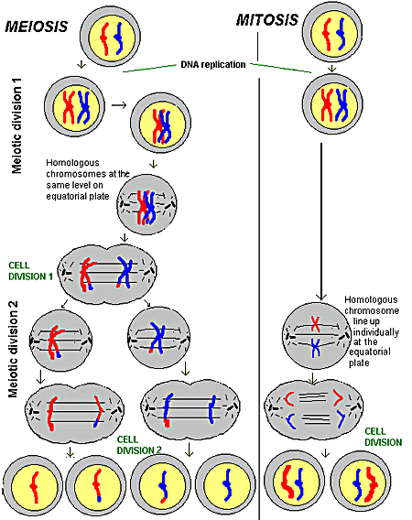

Slide 21
Meiosis: true or false?

Slide 22
Variation from meiosis

Slide 23
Chromosome mutations
Notes:
23
Boardworks AS Biology
Title of presentation
Teacher notes
See the ‘Nucleic Acids and the Genetic Code’ presentation for more information about DNA replication.

Slide 24
Mitosis

