Slide 1
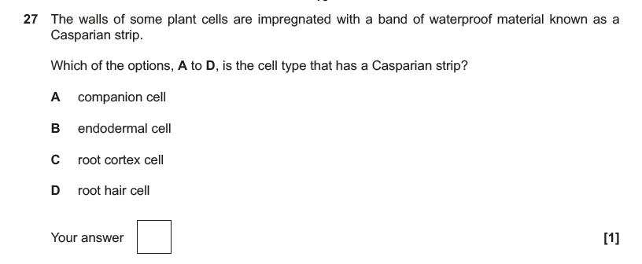
Notes:
H422-01 paper set 2 Dec 2016 from interchange

Slide 2
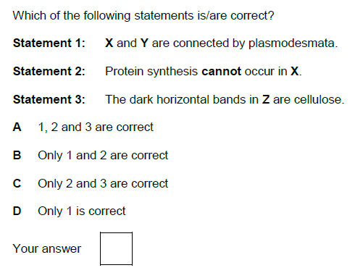
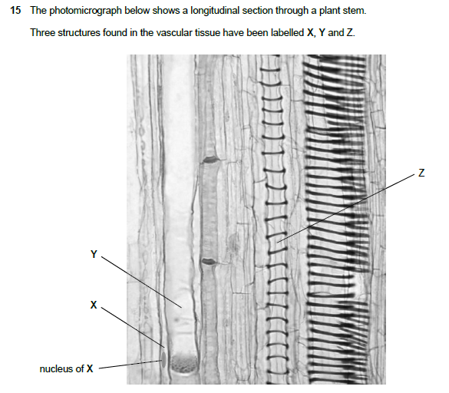
Notes:
H422-01 paper set 1 Aril 2016

Slide 3
Notes:
H422-01 paper set 1 Aril 2016

Slide 4
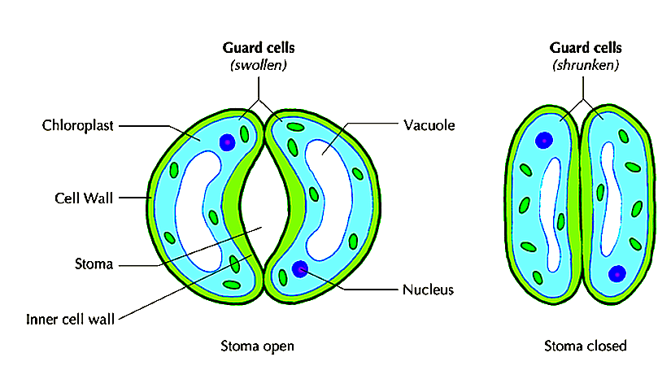
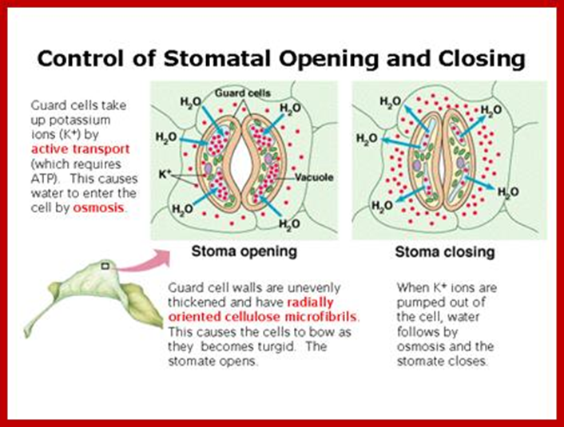

Slide 5
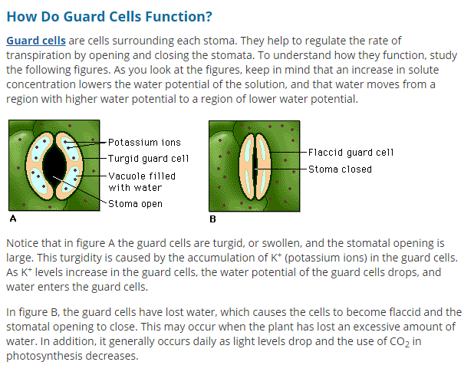

Slide 6
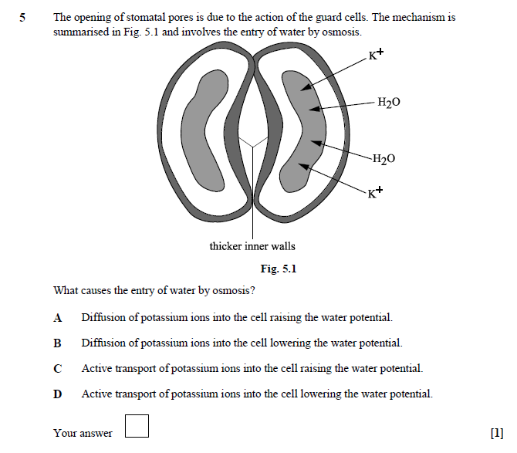

Slide 7
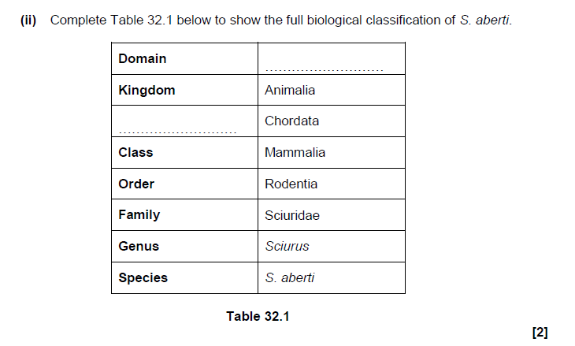
[2]
Notes:
H422-01 paper set 1 Aril 2016

Slide 8
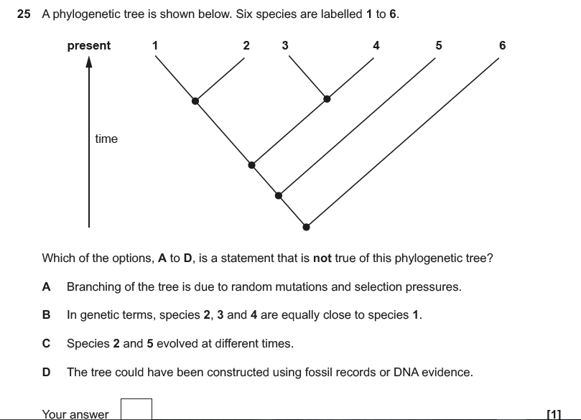
Notes:
H422-01 paper set 2 Dec 2016 from interchange

Slide 9
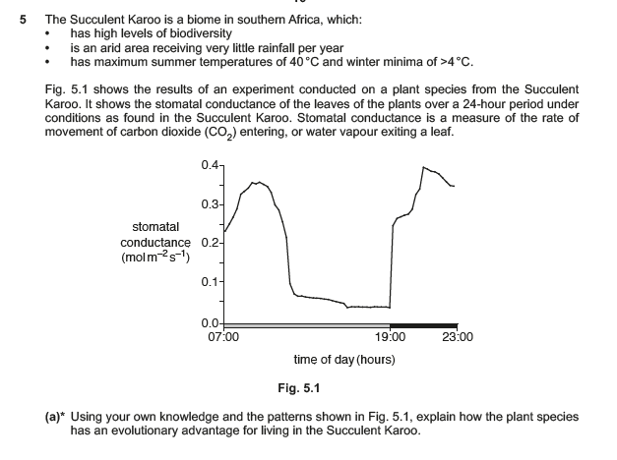
[6]
Notes:
H422-03 paper set 2 Dec 2016 from interchange

Slide 10
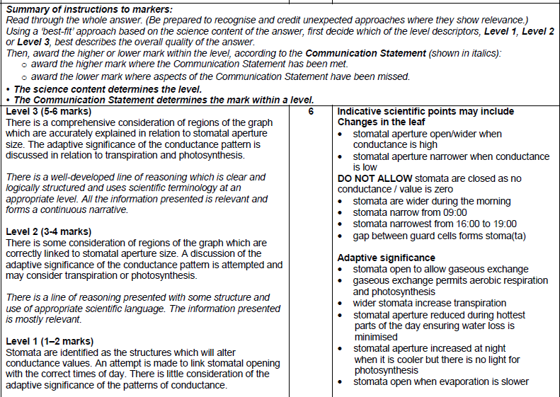
Technical Terms

