Slide 1
Plant Growth

Slide 2
Learning outcomes
Evaluate the experimental evidence for the role of auxins in the control of apical dominance and gibberellin in the control of stem elongation.

Slide 3
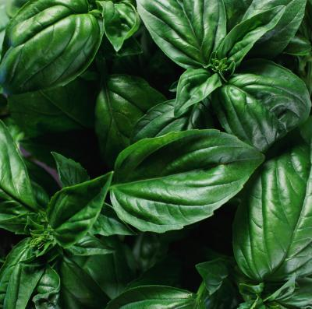
Starter
Where does plant growth originate?
How do plants get ‘bushier’?
Why does this technique work?
“Prune or pinch off the ends of stems as the plant develops, leaving only two to four leaves, going back to just above a leaf node -- the swelling between the stem and the leaf's stem. The plant will branch out from this point on each stem you pinch into two to four new branches that can be harvested in about three weeks”

Slide 4
Plant growth
Plant growth occurs at meristems
Apical meristem
Lateral bud meristems
Lateral meristems
Intercalary meristems

Slide 5
Why “plant growth regulators”?
Exert influence by affecting growth – How?!?
Produced in a region of plant structure by unspecialised cells
Some are active at the site of production
Not specific – can have different effects on different tissues

Slide 6
The Plant growth regulators
There are five main groups
Auxins
Gibberellins
Cytokinins
Abscisic acid
Ethene

Slide 7
Plant growth regulators
Produced in small quantities
Are active at site of production, or move by diffusion, active transport or mass flow.
Effects are different depending on concentration, tissues they act on and whether there is another substance present as well.

Slide 8
Interaction of plant growth regulators
Synergism
2 or more act together to reinforce an effect
Antagonism
Have opposing actions and inhibit (diminish) each others effects.

Slide 9
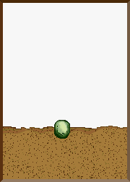
Life of a plant - hormones involved at all stages.
Seed Germination:
Seed absorbs water which stimulates the production of gibberellin
This activates the production of enzymes (how?) (amylase/protease) which break down food stores
Effects of gibb. are opposed by abscissic acid (ABA) – so time of germination is determined by the balance of these two hormones.
Evidence: Mutant seeds without gibb. gene are unable to germinate unless gibb. is externally applied.
Gibb. Inhibitors have the same effect and effect can be reversed by adding external gibb or removing inhibitor chemical

Slide 10
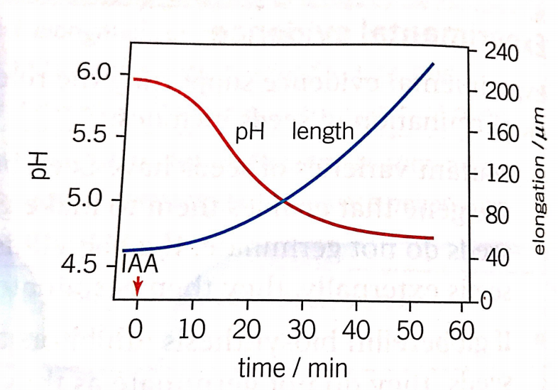
Life of a plant - hormones involved at all stages.
Growth of main apical stem
Auxin stimulates growth of main shoot (effects on cell wall causing H⁺ build up and enzyme activation followed by water ingress by osmosis)
High auxin concentrations inhibit lateral shoot growth
This is apical dominance.

Slide 11
Auxins
Synthesised in shoot or root tips.
Most common form is IAA (indole-3-acetic acid a.k.a. indoleacetic acid)
Main effects of auxins include:
Promote stem elongation
Stimulate cell division
Prevent leaf fall
Maintain apical dominance.

Slide 12
Auxins and Apical Dominance
Auxins produced by the apical meristem
Auxin travels down the stem by diffusion or active transport
Inhibits the sideways growth from the lateral buds

Slide 13
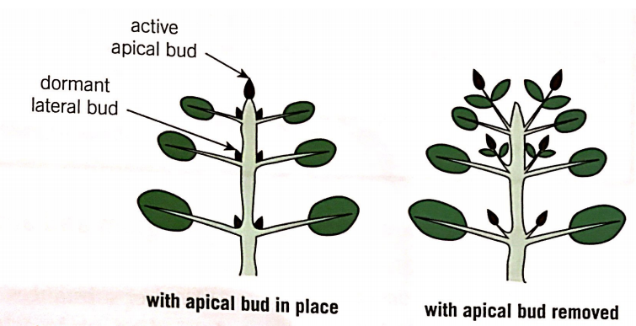
Apical Dominance

Slide 14
Apical Dominance

Slide 15
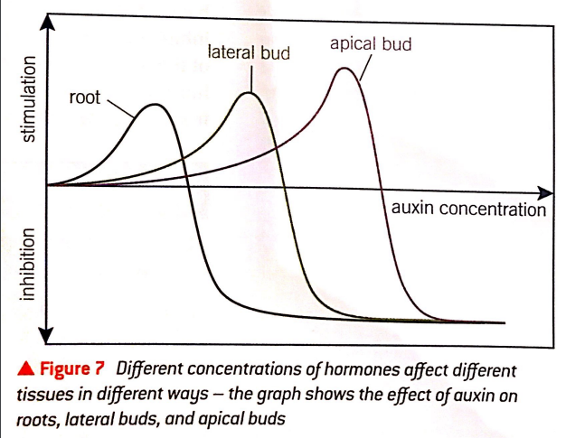
Mechanism for apical dominance
Auxin made by cells in the shoot tip
Auxin transported downwards cell to cell
Auxin accumulates in the nodes beside the lateral buds
Presence inhibits their activity
Apical Dominance worksheet

Slide 16
Evidence for mechanism (1)
If the tip is cut off two shoots
Indole-3-acetic-acid (IAA) is applied to one of them, it continues to show apical dominance
The untreated shoot will branch out sideways

Slide 17
Evidence for mechanism (2)
If a growing shoot is tipped upside down
Apical dominance is prevented
Lateral buds start to grow out sideways
This supports the theory
Auxins are transported downwards, and can not be transported upwards against gravity

Slide 18
Question?
Suggest how apical dominance could be an advantage to a plant!

Slide 19
Suggest!!

Slide 20
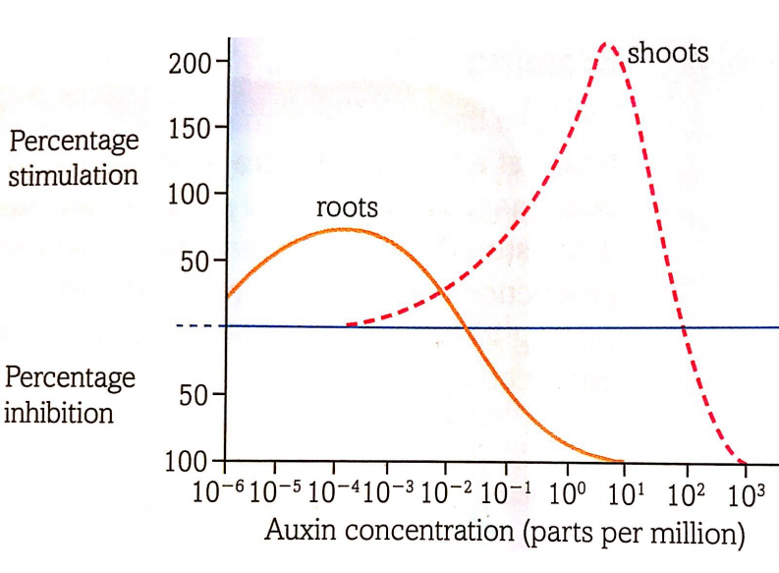
Root growth
Promoted by low concentrations of auxin – too high inhibits growth.
Removing apical bud slows or stops root growth

Slide 21
Life of a plant - hormones involved at all stages.
Elongation of plant stem – role of gibberellin
Affects the length of internodes
Short stemmed plants have low/no gibb production.
Useful for plant survival

Slide 22
Gibberellins and stem elongation
Gibberellin (GA) increases stem length
Increases the lengths of the internodes
Stimulating cell division
Stimulating cell elongation
Gibberellins and stem elongation homework

Slide 23
Evidence for GA and stem elongation
Dwarf beans are dwarf because they lack the gene of producing GA
Mendel’s short pea plants lacked the dominant allele that encodes for GA
Plants with higher GA concentrations are taller

Slide 24
Action of GA
Affects gene expression
Moves through plasma membrane into cell
Binds to a receptor protein, which binds to other receptor proteins eventually breaking down DELLA protein.
DELLA proteins bind to transcription factors
If DELLA protein is broken down, transcription factor is released and transcription of the gene can begin

Slide 25
Investigating role of gibberellins
Use p221 green book – read through the information.
Remember for control experiments the following are important:
Serial dilutions of hormone being studied
Large sample size
Randomly assign individuals to groups
Repeat the measurements
When drawing conclusions – remember that a correlation between two variables does not mean that a change in one causes a change in the other.
Standard Deviation
How did the experiment satisfy the conditions above?

Slide 26
Life of a plant - hormones involved at all stages. – Response to abiotic stress.
Plants have a variety of adaptations to abiotic stress – (eg?)
Seasonal change brings about leaf loss in some plants.
Abscission – leaf loss
Lack of light leads to decreased auxin production (aux. inhibits abscission)
Leaves produce ethene in response
Base of leaves have an ‘abscission zone’ – cells in this area produce enzymes in response to ethene production.
Cell walls are digested and water enters the cells causing swelling – causes leaf to fall off.

Slide 27
Other responses to abiotic conditions
Lack of water:
Stomatal opening and closing due to ABA released by leaves in times of abiotic stress caused by low water availability.
Also thought that ABA could be released by roots and is transported to leaves
ABA presence in leaves causes altered ionic levels in guard cells leading to decreased WP followed by decreased turgor and therefore closing of stomata.

Slide 28
Other responses to abiotic conditions
Photoperiodism:
Thought to be due to changes in the ratio of two light sensitive phytochrome pigments.
Causes leaf loss - other responses to shorter daylight hours

Slide 29
Plenary
Q4 p251 Purple book

