Slide 1
Do Now (in rough)
Without looking at your notes, draw the structure of alpha and beta glucose, highlighting the difference between the two
Can you please leave your homework Qs on your desk so I can collect them

Slide 2
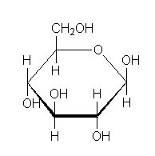
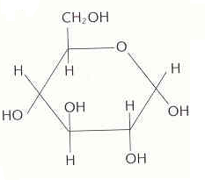
Alpha – below
Beta - above
Beta-glucose
Alpha-glucose
Notes:
How do they differ?
Pnemonic on how to remember which is alpha and which is beta

Slide 3
Polysaccharides
Learning objective
To know about polysaccharides
Success Criteria
I can describe the structure of starch (amylose and amylopectin), glycogen and cellulose
I can explain how the structure and properties of starch, glycogen and cellulose relate to their function in living organisms

Slide 4
Condensation or hydrolysis?
CONDENSATION
Forms glycosidic bonds
Breaks glycosidic bonds
Releases water
Requires addition of water
Used in the synthesis of polysaccharides
Used in the synthesis of disaccharides
Used in digestion of starch
Has 3 reactants and 2 products
Has 2 reactants and 3 products
HYDROLYSIS
CONDENSATION
HYDROLYSIS
CONDENSATION
CONDENSATION
HYDROLYSIS
CONDENSATION
HYDROLYSIS
Notes:
Mwb quiz

Slide 5
You need to be able to explain how molecules are adapted to their function…
Let’s look at glucose as an example..

Slide 6
Relating structure to function example: glucose
Function
To release energy in respiration
Structure and how it relates to function
Small so can be transported
Soluble in water so can be transported
Can be broken into smaller molecules to produce ATP so can release energy
Lots of H atoms so can produce lots of ATP

Slide 7
Polysaccharides
You need to explain how 4 polysaccharides are adapted to their function :-
Amylose (part of starch)
Amylopectin (part of starch)
Glycogen
Cellulose
You have to relate their structure to their function:
State location
State function
Describe structure
List the properties
Relate properties to function

Slide 8
Polysaccharides
Polymers of monosaccharides joined by glycosidic bonds
Polysaccharides act as a store of energy
Glucose is the source of energy.
Lots of glucose molecules joined together into polysaccharides form a store of energy. Polysaccharides are arranged in chains so that glucose can be easily ‘snipped off’ when it is needed via hydrolysis reaction
In plants, it is stored as starch (amylose and amylopectin)
In humans, it is stored as glycogen
Notes:
Ask what all the individual molecules are?

Slide 9
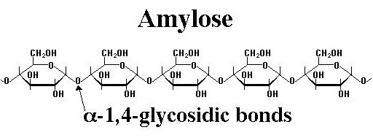
Amylose
Store of energy in plants
Made up of α-glucose monomers, with a 1-4 glycosidic bond
Forms an unbranched chain that then coils into spiral shape with H-bonds holding it’s structure
Notes:
Explain why we call it a 1-4 glycosidic bond

Slide 10
Amylopectin
Store of energy in plants
Similar to amylose, with monomers of α-glucose bonded together through a 1-4 glycosidic bond
In addition to this, it is a branched molecule. These branches are formed by a 1-6 glycosidic bond
Coils in a similar way to amylose, but with branches
These branches make hydrolysis of glucose easier
Also makes energy store more compact

Slide 11
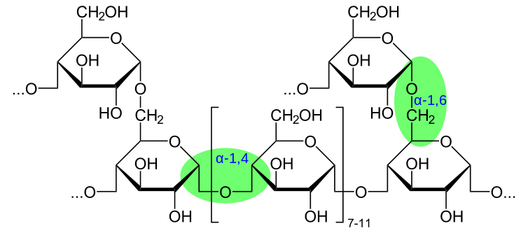

Slide 12
Glycogen
Store of energy in humans
Similar to amylopectin in that it has both 1-4 glycosidic bonds and 1-6 glycosidic bonds that form branches
Smaller length chains
Less coils because of this, but more branches so is more compact and easier to hydrolise

Slide 13
Cellulose
Found in all plants, forming plant cell walls
Made up of β-glucose monomers, with a 1-4 glyosidic bond
Every 2nd β-glucose molecule is rotated 180º
Long, unbranched chains
They from hydrogen bonds within the chain to stop it spiralling, giving cellulose it’s strength

Slide 15
Polysaccharide and function | Structure | How structure relates to function
AMYLOSE:
AMYLOPECTIN
GLYCOGEN
CELLULOSE:

Slide 16
Polysaccharide and function | Structure | How structure relates to function
AMYLOSE: Store of glucose and energy in plants | Made up of alpha-glucose monomers 1-4 glycosidic bond Straight chains Coils into spiral shape, held by H-bonds | Coiled means it is insoluble in water, so doesn’t affect water potential Straight chains means glucose molecules can be easily hydrolysed from ends of chains to provide glucose when needed Compact so can store lots of energy in a small volume
AMYLOPECTIN Store of glucose and energy in plants | Made up of alpha-glucose monomers 1-4 glycosidic bonds AND 1-6 glycodic bonds that form branched chains Coiled into spiral shape, held by H-bonds

Slide 17
Polysaccharide and function | Structure | How structure relates to function
GLYCOGEN Store of glucose and energy in animals | Made up of alpha-glucose monomers Shorter chains so NOT coiled 1-4 glycosidic bonds AND 1-6 glycosidic bonds that form branched chains | Insoluble in water so water potential not affected Branched means lots of ends, so easy to hydrolyse glucose monomers for energy Compact so can store lots of energy in a small volume
CELLULOSE: Forms plant cell walls | Beta glucose monomers Second molecule is rotated forwards 180° Chains held by many H bonds | Insoluble so will not dissolve in water Strong to prevent the cell from bursting Spaces between the chains so water can move in the cell wall

Slide 18
1. Which polysaccharide/s….
Is found in plants?
Notes:
Cellulose, starch

Slide 19
2. Which polysaccharide/s….
Is found in animals?
Notes:
Glycogen

Slide 20
4. Which polysaccharide/s….
Is made of alpha glucose?
Notes:
Amylose, amylopectin and glycogen

Slide 21
5. Which polysaccharide/s….
Is made of beta glucose?
Notes:
cellulose

Slide 22
6. Which polysaccharide/s….
Has branches in its structure?
Notes:
The starches

Slide 23
7. Which polysaccharide/s….
Has no branches?
Notes:
Cellulose amylose

Slide 24
8. Which polysaccharide/s….
Is insoluble in water?
Notes:
all

Slide 25
9. Which polysaccharide/s….
Is a store of glucose?
Notes:
all

Slide 26
10. Which polysaccharide/s….
Is quick to hydrolyse?
Notes:
Starch and glycogen NOT cellulose

Slide 27
11. Which polysaccharide/s….
Contains lots of hydrogen bonds?
Notes:
Cellulose

Slide 28
12. Which polysaccharide/s….
Prevents a plant cell from bursting?
Notes:
cellulose

Slide 29
Compare and Contrast the Polysaccharides
How are the following similar? 1. Amylose and glycogen
2. Amylose and cellulose
3. Glycogen and cellulose
How are the following different? 1. Amylose and glycogen
2. Amylose and cellulose
3. Glycogen and cellulose

Slide 30
Explain how the structure of glycogen relates to its function in living organisms
You should include:-
The function of glycogen
Description of the structure
Link the structure to the property
Explain how the property allows the molecule to perform its function

Slide 31
Describe the formation of a starch (4 marks)
Award 1 mark for each bullet point
Formation of polysaccharide
Made of glucose molecules
Glucose molecules joined by glycosidic bonds
Glycosidic bonds formed in condensation reactions
1 molecule of water is released for each glycosidic bond

Slide 32
Describe the breakdown of a glycogen (4 marks)
Award 1 mark for each bullet point
Breakdown of polysaccharide
Made of glucose molecules
Glucose molecules joined by glycosidic bonds
Glycosidic bonds broken in hydrolysis reactions
Water is added in hydroylsis reactions

