Slide 1
Revision
Loop of henle, animal responses, nerve

Slide 2
Loop of Henle

Slide 3
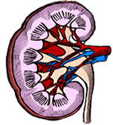
Loop Of Henle
Important Facts:
In the descending limb the water potential of the fluid is decreased by the addition of mineral ions and the removal of water
In the ascending limb the water potential is increased as mineral ions are removed by active transport

Slide 4
Stage 1
Na⁺ and Cl⁻ are actively transported out of the ascending limb

Slide 5
Stage 2
This raises the Na+ and Cl- concentration in the tissue fluid
(lowering the water potential)

Slide 6
Stage 3
Water is drawn out of the descending limb by OSMOSIS………
And Na⁺ and Cl⁻ diffuse in down a concentration gradient

Slide 7
Stage 4
Removing Water from the limb concentrates the Na⁺ and Cl⁻ in the descending limb…..

Slide 8
Stage 5
So as you go down the limb - Na⁺ and Cl⁻ diffuses out into the medulla
This concentration of the salt in the medulla is called the “Counter-Current Multiplier”
Decrease the water potential in the medulla

Slide 9
Nerves

Slide 10
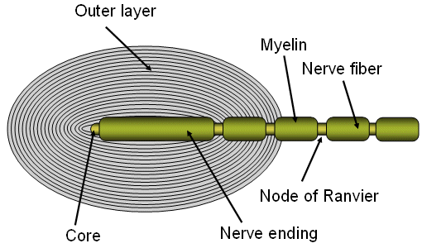
Roles of sensory receptors
Convert different form of energy in to nerve impulses (transducer)
For Example
Pacinian corpuscle
Pressure is stimulus
Stretch mediated sodium ion channels
Closed in resting potential
Pressure stretches the membrane
Opens the sodium ion channels
Depolarises the membrane
Generator potential

Slide 11
Sensory Neurone: Structure & Function
Transmit from a receptor to the CNS

Slide 12
Motor Neurone: Structure & Function
Transmit impulses from CNS to effector

Slide 13
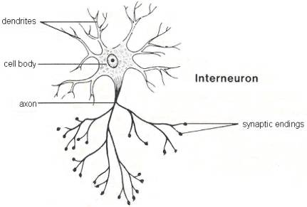
Relay Neurone
Transmits from sensory neurone to motor neurone
In the CNS

Slide 14
Compare and contrast structure and function
Myelinated Neurones | Non-myelinated neurones
CNS & Somatic nervous system Faster due to saltatory conduction Sped up by myelin sheath (Schwann Cells containing high amount of myelin wrapped around axon) | Autonomic nervous system Slower Sped up by increasing diameter of axon

Slide 15
Resting Potential
Potential Difference across the membrane:
Inside has charge of -70mV compared to outside
Sodium Potassium Ion Pump
2 K+ ions in
3 Na+ ions out
Membrane is impermeable to Na+ but some K+ ions leak out

Slide 16
Action Potential
When membrane is depolarised and pd across the membrane reaches -40mV (generator potential)
Voltage gated Na+ channels open
Sodium ions move in (DEPOLARISATION)
Changes pd to +40mV
Na+ channels close & voltage gated K+ channels open (REPOLARISATION)
Changes pd to about -75 to -90mV (HYPERPOLARISATION)
Most of K+ channels close and Na+/K+ pump restores resting potential

Slide 17
Action Potential: Transmitted in a Myelinated neurone
Nerve impulse jumps from one Node of Ranvier to the next
Saltatory Conduction
Presence of action potential at one node sets up depolarisation at the next (local circuit)
Refractory Period
When membrane is hyperpolarised another action potential can’t form: action potential can only go one way

Slide 18
Action Potential: Voltage Graph

Slide 19
Structure of the Cholinergic Synapse

Slide 20
Role of Neurotransmitters: How a synapse works
Action potential reaches axon terminal
Calcium ion channels open and calcium ions move in
Synaptic vesicles fuse with presynaptic membrane (requires ATP)
Acetylcholine (ACh) diffuses across gap and binds to receptors on postsynaptic membrane
Na+ channels open and action potential occurs
Acetylcholinesterase breaks down ACh and choline is absorbed through presynaptic membrane

Slide 21
Roles of the Synapse in the Nervous System
One direction of transmission
May be excitatory or inhibitory
Spatial summation
When two synapses on the same neurone get action potentials at same time depolarisation of postsynaptic membrane is greater
Temporal summation
When two action potentials arrive one after the other the depolarisation of the postsynaptic membrane is greater

Slide 22
Animal Responses

Slide 23
Organisation of Nervous System
Central
Brain and spinal cord
Grey (non myelinated) and white (myelinated) matter
Peripheral
Neurones that carry impulses in and out of CNS
Sensory neurones carry impulses from receptors to CNS
Motor neurones carry impulses from CNS to effectors
Somatic: voluntary (conscious) control
Autonomic: not under voluntary control e.g. to heart, gut

Slide 24
Peripheral Nervous System
Somatic Nervous System
Concious control
Used when you decide to do something
Autonomic Nervous System
Non-myelinated neurones
Connect to the effectors with at least two neurones (which join at a ganglion)
Two Types antagonistic to each other
Sympathetic
Most active in times of stress
Neurotransmitter is noradrenaline
Pre ganglionic neurones are very short as ganglion is near the CNS
Parasympatheric
Most active in sleep and relaxation
Neurotransmitter is acetyl choline
Pre ganglionic neurones are longer as ganglion is within target tissue

Slide 25
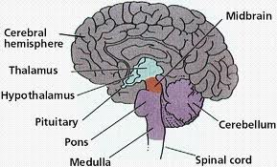
Gross Structure of the Brain

Slide 26
Functions
Cerebrum
Largest part, 2 hemispheres connected by corpus callosum, controls higher brain functions
Conscious thought & emotions
Override some reflexes
Reasoning and judgement
Cerebellum
Coordinates motor responses
Processes sensory information from eye, ear, spindle fibres & joints
Medulla oblongata
Controls non-skeletal muscles (e.g. heart and lung)
Controls autonomic nervous system
Hypothalamus
Controls homeostatic mechanisms e.g. Osmoregulation
Regulates pituitary gland (so controls endocrine function)
Pituitary Gland
Controls most glands in the body
Anterior makes hormones
Posterior stores and releases hormones

Slide 27
Reflex Arcs
Reflex arc
Receptor→ Sensory neurone → Relay neurone → Motor neurone → Effector
Knee Jerk
Stretching of the patella tendon causes the extensor muscle to contract and the hamstring muscle to relax, causing the leg to kick
Spinal reflex
Blinking
Corneal stimulus causes the eye lids to close
Enables survival
Born with, involuntary, very fast
Avoid hurt

Slide 28
First and Second Messengers: adrenaline & cAMP
Adrenaline doesn’t enter the target tissue
Adrenaline is the first messenger
Adrenaline binds to receptor on cell surface, activating adenyl cyclase inside the cell
Adenyl cyclase increases concentration of cAMP
cAMP is the second messenger
cAMP activates cascade of enzymes

Slide 29
Control of Heart Rate in Humans
Hormonal | Nervous
Adrenaline (increase) | Accelerator Nerve (increase) - Stretch receptors in muscles - Low blood pH Vagus Nerve (decrease) - High bp detected by carotid sinus

Slide 30
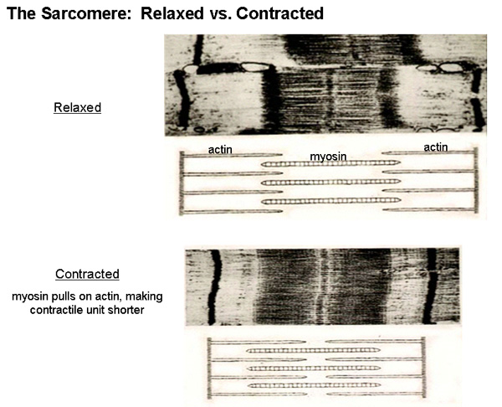
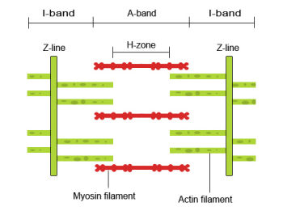
Sliding Filament Model of Muscle Contraction

Slide 31
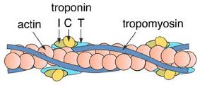
Sliding Filament Model of Muscle Contraction
Two types of protein involved
Thick filament
Bundles of myosin
One tail, two heads
Thin filament
2 strands of actin coiled round each other
Tropomyosin coiled round the actin
Troponin has 3 binding sites: binds to tropomyosin, actin and a free one for calcium ions

Slide 32
Sliding Filament Model of Muscle Contraction
Calcium ions bind to troponin changing its shape so myosin can bind to the actin
Myosin head attaches to actin (forming a cross bridge)
Myosin head bends pulling thin filament along (more overlap)
Uses ATP, so making ADP and inorganic P
Cross bridge broken as ATP binds to myosin head
Head group moves back as ATP is broken down and then forms new crossbridge with actin

Slide 33
Role of ATP in muscle contraction
Energy required to break crossbridge
Supply only sufficient for 1-2 secs contraction
ATP supply maintained by
Aerobic respiration
Anaerobic respiration
Phosphate group from creatnine phosphate used to turn ADP into ATP

Slide 34
Compare & contrast synapses and neuromuscular junctions
Compare | Contrast
Neurotransmitter in vesicles Action potential causes neurotransmitter to be released into cleft Neurotransmitter diffuses across gap and binds to receptors Binding of neurotransmitter results in depolarisation Enzymes degrade neurotransmitter | Synapse | Neuromuscular junction
 | Neurone to neurone Action potential caused in post synaptic neurone Synaptic knob is smooth | Neurone to sarcomere Depolarisation in sarcolemma caused End plate has microvilli

Slide 35
Outline structural and functional differences between voluntary, involuntary and cardiac muscle
Voluntary | Involuntary | Cardiac
Cells form long fibres Contracts and fatigues quickly Under voluntary nervous control Involved in voluntary movements of bones Striated appearance | Short spindle shaped cells Contracts and fatigues slowly Under autonomic nervous control Involved in involuntary movement of tubes e.g gut Un-striated appearance | Cells form branched fibres Contracts quickly and doesn’t fatigue Contraction in myogenic but autonomic controls rate Involved in pumping blood around body Striated appearance

Slide 36
Mammals
Responses to environmental stimuli are coordinated by nervous and endocrine systems

Slide 37
‘Fight or Flight’
Balance between sympathetic and parasympathtic nervous system being changed
Hypothalamus stimulates both nervous system and endocrine system
Nervous system
Activates glands in smooth muscle
Activates adrenal medulla
Releasing both noradrenaline and adrenaline
Endocrine system
Anterior pituitary releases Corticosteroid Releasing Factor
Pituitary gland secretes ACTH
ACTH causes release of many hormones from adrenal cortex

