Slide 1
Module 3 Exchange Surfaces
7.1 Special surfaces for exchange

Slide 3
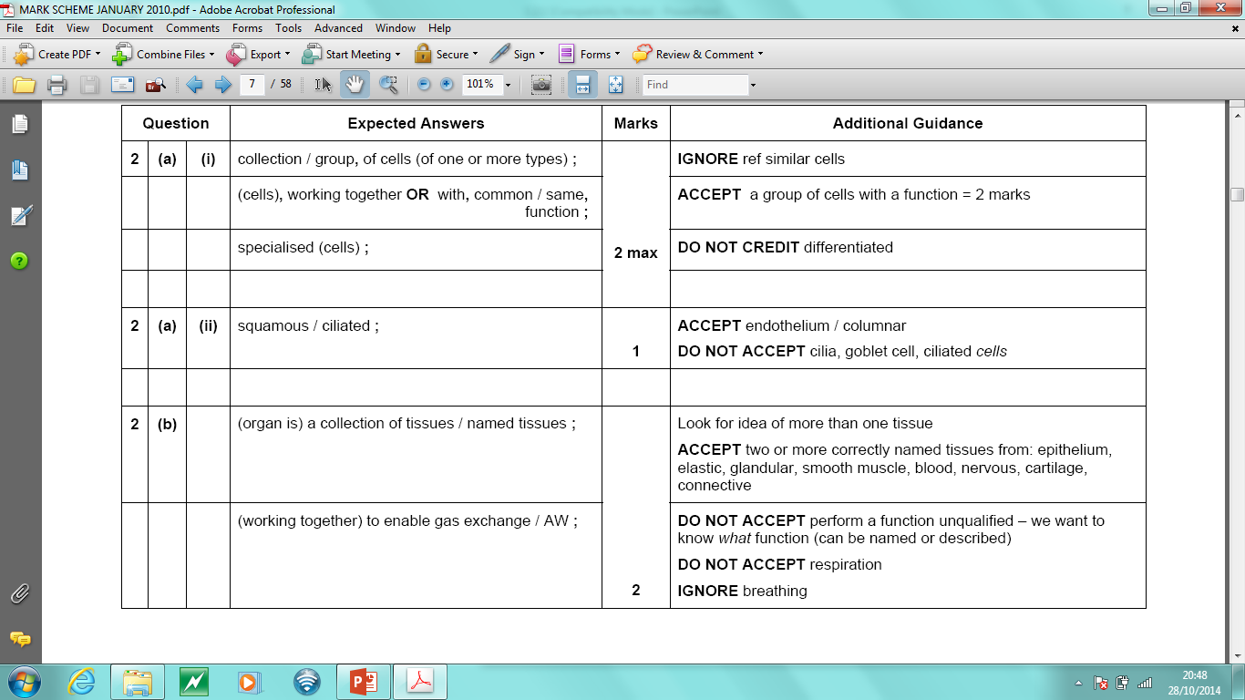

Slide 4
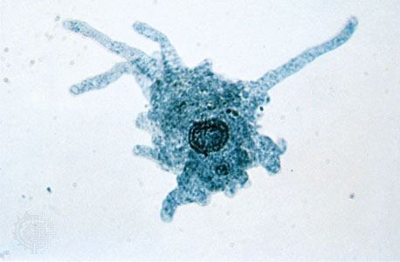
Amoeba
Mouse
Build a amoeba!
e.g. A cube measuring
1cm x 1cm x 1cm
Build a mouse!
e.g. A block measuring
3cm x 3cm x 3cm
What is the surface area of each ‘organism’?
What is the volume of each ‘organism’?
Calculate and compare the surface area to volume ratio for the ‘amoeba’ and ‘mouse’
What do you notice about the relationship between the size of the organism and it’s surface-area-to-volume-ratio
https://www.youtube.com/watch?v=xuG4ZZ1GbzI
Notes:
STARTER ACTIVITY – need card and scissors and rulers and pencils
- could be done using plasticine models and rough guide to measurements?

Slide 5
Learning Objectives
Success Criteria
Explain in terms of surface-area-to-volume-ratio, why multicellular organisms have specialised exchange surfaces and single celled organisms do not
List why organisms need special exchange surfaces
(Grade E - D)
Describe and explain the features that make an exchange surface efficient
(Grade C –B)
Explain in terms of surface area to volume ratio how multicellular organisms are different to unicellular organisms
(Grade B – A)

Slide 6
Why organisms need special exchange surfaces
Living cells must be able to take up simple substances from their environment.
They also need to remove waste products from metabolic activities.
Task
- On your post it write down one of these substances /products
- Stick your post it on the board and explain why it is important
Looking at your model of a single-celled and multicellular organism describe how they exchange these important substances/products use keyword surface-area-volume-ratio
List why organisms need special exchange surfaces
(Grade D – C)

Slide 7
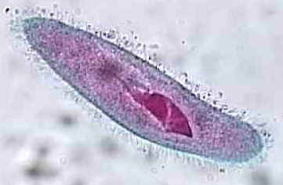
Single Celled Organisms
Exchange gases, nutrients and wastes can diffuse directly in and out of the cell across the cell surface membrane. They have a large surface-area-volume-ratio.
Diffusion rate is quick as substances only have to travel small distances

Slide 8
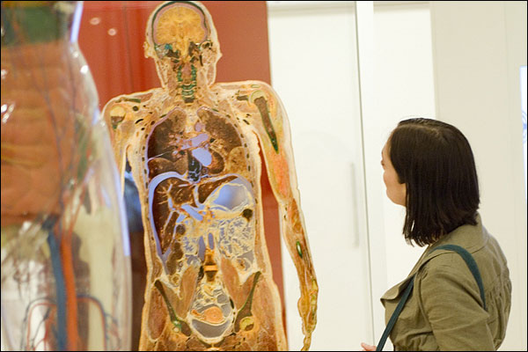
Multicellular Organisms need special exchange surfaces
Diffusion across the outer membrane is too slow for 3 reasons
1) some cells are deep within the body→ there is a big distance between them and the outside environment

Slide 9
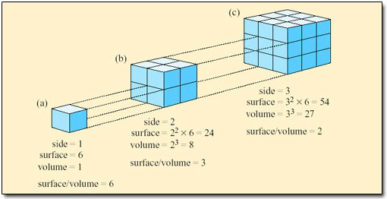
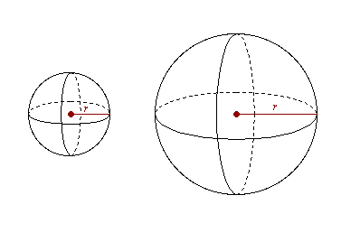
2) low surface area to volume ratio
It is difficult to exchange enough substances to supply a large volume of oxygen through a small outer surface
Notes:
When 𝜋=3.14

Slide 10
3) Multicellular organisms are often very active which means a lot of cells are respiring very quickly → need a constant, rapid supply of glucose and O₂
Molecules such as hormones or enzymes are made in one place but needed in another
Food will be digested in one organ system and need to be transported to every cell for use in respiration and other aspects of cell metabolism
Waste products of metabolism need to be removed and transported to excretory systems

Slide 11
Job Advert
Create a job advert for an exchange surface. Include all the feature necessary to make a good exchange surface.
Describe and explain the features that make an exchange surface efficient
(Grade C –B)

Slide 12
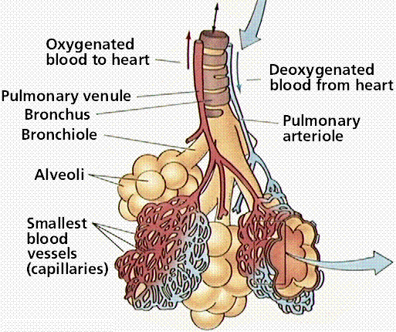
Examples of specialised exchange surfaces
Alveoli of the lungs
Notes:
Students to discuss in pairs and feedback why each of the following require specialised exchange surfaces

Slide 13
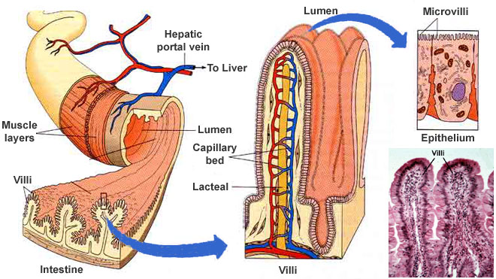
Examples of specialised exchange surfaces
Small intestine

Slide 14
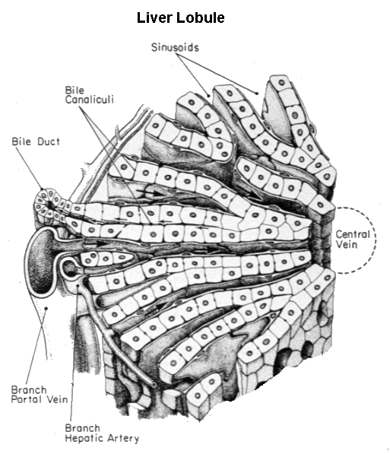
Examples of specialised exchange surfaces
Liver- blood sugar

Slide 15
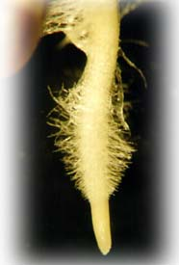
Examples of specialised exchange surfaces
Root Hair Cells in Plants

Slide 16
Plenary
Explain why large, active organisms need specialised surfaces for exchange.
(3 marks)
Large mammals have a high demand for oxygen for respiration, which can’t be met by diffusion alone as their surface area : volume ratio is too low. A specialised exchange surface gives a greater area, so more oxygen can be absorbed and more carbon dioxide can be removed.
Explain in terms of surface area to volume ratio how multicellular organisms are different to unicellular organisms
(Grade B – A)

