Slide 1
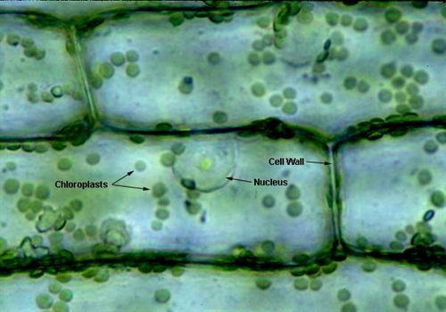
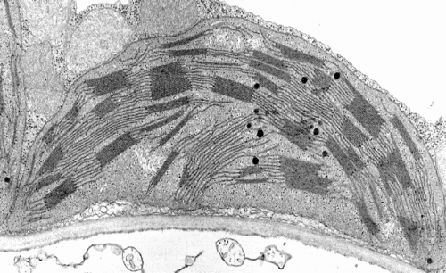
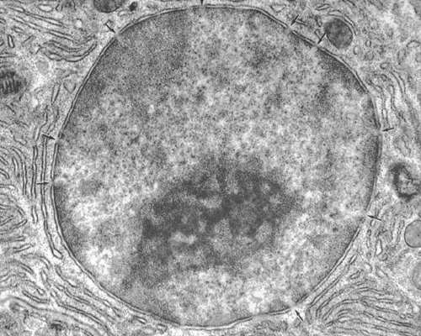
Starter: Microscopes
Notes:
Which image is from the light microsope? How do you know?

Slide 2
Block 1A - Cell structure 2.1.1
Foundations in Biology
Microscopy

Slide 3
SPEC

Slide 4
Objectives and Success Criteria
Objectives
Success criteria
Compare and contrast different types of microscopes
Describe the preparation of specimens for observation using microscopes
Identify the differences between Optical, Electron and Laser scanning microscope (grade E)
Describe how a specimen can be prepared for observation and used to identify structures (grade C)
Compare a light microscope with an electron microscope (grade A)

Slide 5
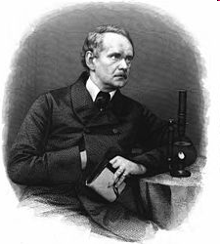
Cell Theory
All living things consist of cells
New cells are formed only by the division of pre-existing cells
The cell contains information that acts as the instructions for growth. This information can be passed to new cells

Slide 6
Use the table to complete the notes comparing microscopes
 | Light microscope | Laser scanning microscope | Electron microscope
 |  |  | TEM | SEM
How do they work?
Magnification
Resolution
Advantages
Disadvantage
Compare a light microscope with an electron microscope (grade A)

Slide 7
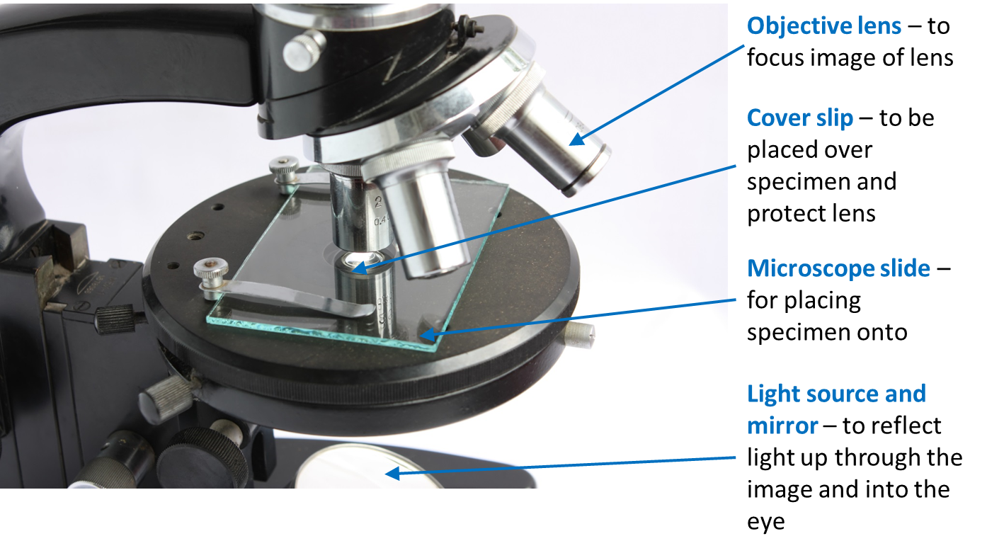
The light microscope
Uses a number of lenses to view an image through the eye piece
Light passes through the condenser lens and then through the specimen
Beam of light is focused through the objective lens and then through the eye piece lens
Magnification: How many times a structure is enlarged
Resolution: The ability to see two objects that are close together as separate objects. Objects that are close together can only be distinguished if light waves can pass through them, allowing you to see detail

Slide 8
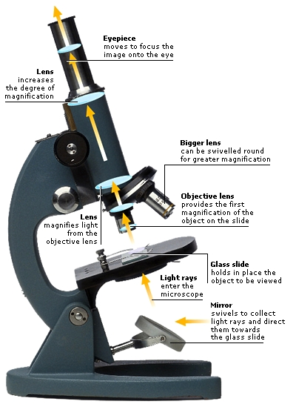
Optical (Light)
Microscope
Relatively cheap
Easy to use
Portable
Can study whole living specimens

Slide 9
Key Terms
Resolution: the ability to distinguish two separate points as distinct from each other.
Increases the clarity of the image.
Magnification: the number of times greater an image is than the original object
x 100 = 100 times wider and 100 times longer

Slide 10
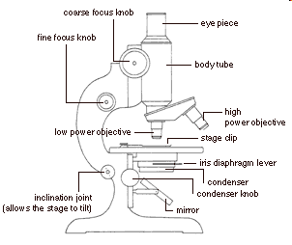
Optical (Light) Microscope
Hint: In optical microscopy objects that are closer than half the wavelength of light cannot be seen separately.
Magnification available on light microscope
  x40
  x100
  x400
  x1500 or x2000
Resolution – (limited) maximum of 200nm. (0.2μm)
This is due to the wavelength of visible light (400-700nm)
TASK – Label microscopes on worksheet
Ribosomes have a diameter of 20nm
Can you see them using an optical microscope?
Notes:
Structures less than 200nm appear as one object Label Light Microscope Sheet. Ribosomes are too small to see in light microscope.

Slide 11
Laser scanning (confocal) microscopes
Laser light used to scan the image point by point. It can focus at specific depths. Computer assembles information into one image.
High resolution, high contrast, depth sensitivity
Fluorescent dye can be used to allow more specific targeting of features to be studied.
Can be used for whole cells and living organisms
Use in diagnosis of disease (eg eye diseases) and in medical research

Slide 12
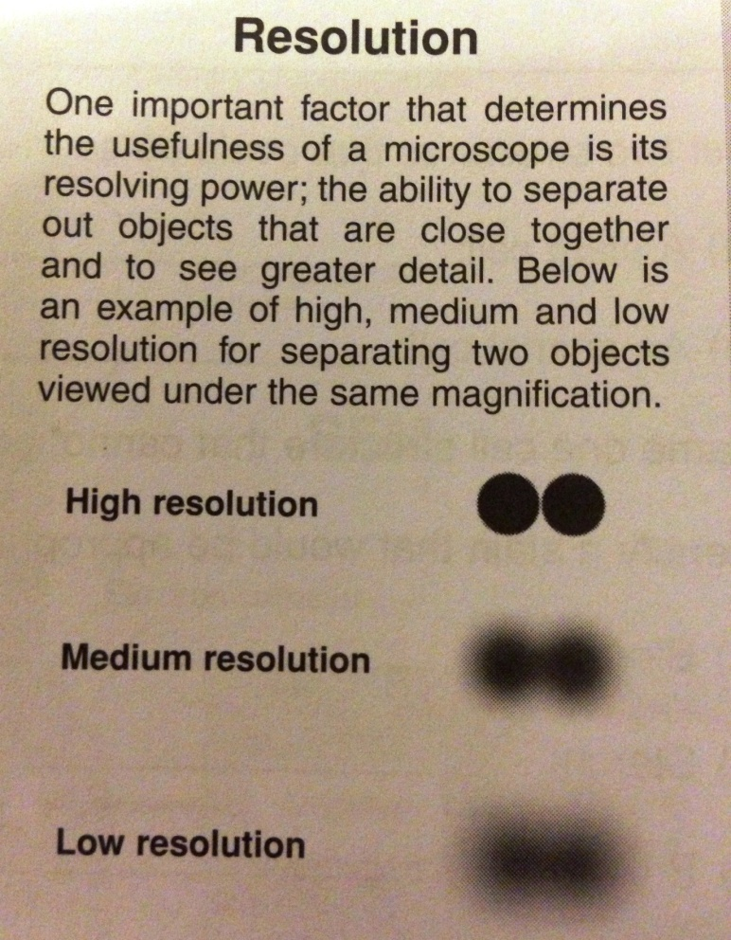
Electron Microscope
EM generates beam of electrons (0.004nm width)
Wavelength is 125 000x shorter than visual light so increases resolution.
Electron beam passes through very thin prepared sample.
Resolution is 0.5nm
Magnification can be up to 500 000x
Expensive, can only be used in
a controlled environment
Vacuum needed for sample preparation
large
Preparing slides is complex
Skill and training needed

Slide 13
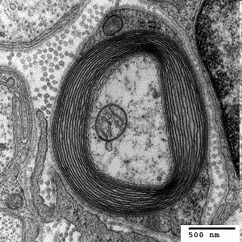
Transmission Electron Microscope
Electrons pass through thin part of sample less easily so create contrast.
Sample dehydrated and stained with metal salts
Electrons focused on photographic plate (or screen)
Resulting 2D grey-scale image is an Electron micrograph
Magnification up to 2 million times so smaller organelles can be seen, such as ribosomes
(future- 50 million x)
What might be a disadvantage of
Electron microscopy?
Notes:
Samples are dehydrated and stained – not alive and can be damaged. Can produce artefacts. = ELECTRON MICROGRAPH

Slide 14
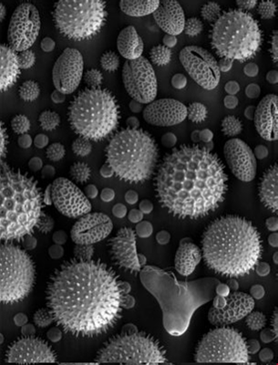

Scanning Electron Microscope
Electrons are reflected off the surface of a metal-salt-stained sample
3D shape can be seen so greater field of view, grayscale, but computer programmes can add false colour
You can see surface features in detail
Magnification x 15-200 000

Slide 15
EM
Advantages of EM | Disadvantages of EM
Resolution is x2000 more than LM | Samples have to be placed in a vacuum
Produces detailed images | Very expensive
SEM produces 3D images | Need to be highly skilled to create samples

Slide 16
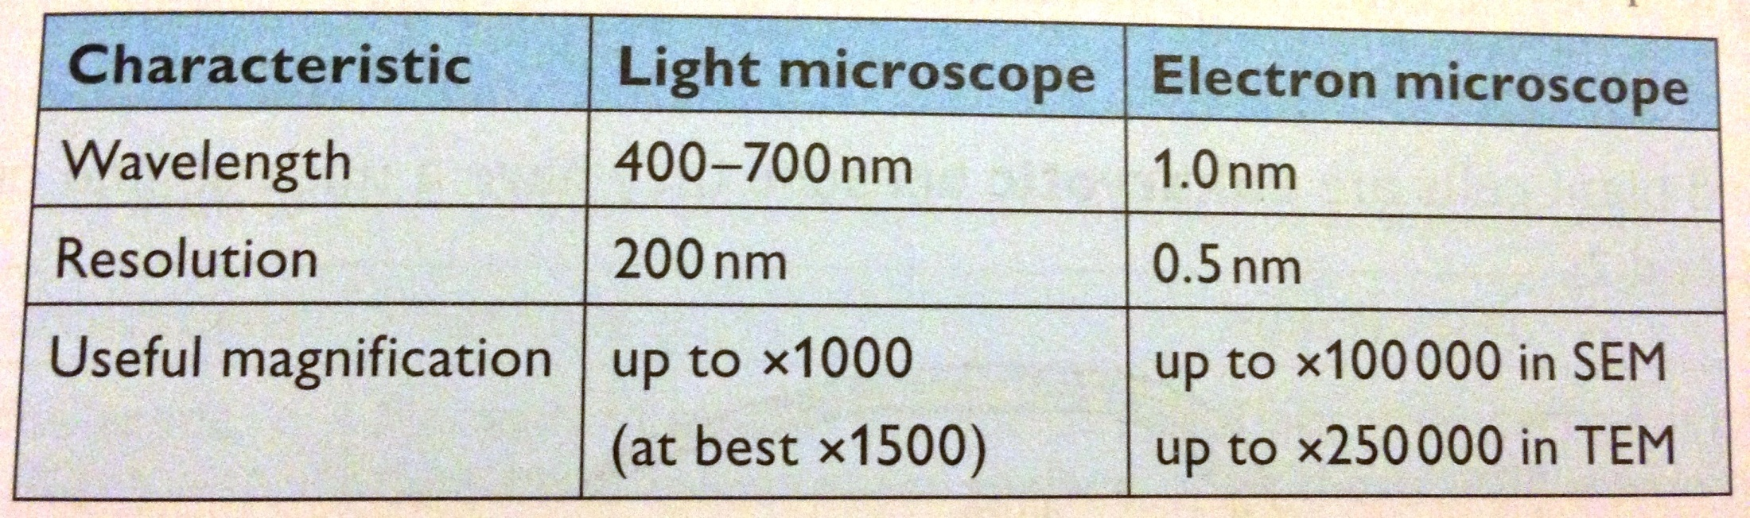
Comparing LM and EM
1500
x 200 000
2000)
x 2 000 000
Identify the differences between Optical, Electron and Laser scanning microscope (grade E)
Notes:
Table a bit out of date now – have put newer figures on top.

