Slide 1
Structure of DNA

Slide 2
Need to book
Mini whiteboards
Sweets for DNA model (see link to sheet on slide)
Speakers
Practical ‘DNA your onions’: blender, knife, white tile, water bath (60ºC), ice, thermometer, beakers, funnel, filter paper, syringe, boiling tube, glass rod, pipette, protease, washing up liquid, salt, 95% ice cold ethanol
Repro
Chagraff’s Ratios worksheet
Either sweet model (see link on slide) sheet or exam board diagram sheet
Practical Sheet (see link on slide)

Slide 3
Flip Learning: DNA Timeline
http://www.hhmi.org/biointeractive/great-discoveries-science-double-helix
http://www.dnai.org/timeline/index.html
Complete worksheet Famous Scientists

Slide 4
Starter: 5 W’s

Slide 5
Starter Answers
Who
James Watson, Francis Crick & Rosalind Franklin
What
W&C used F’s X rays of DNA
Double Helix structure of DNA & it’s replication
When
April 25th 1953 (published article in Nature)
Where
University of Cambridge
Why
Explained how genetic information was passed on

Slide 6
Learning Objective
Know about the structure of DNA
Success Criteria
Describe the structure of DNA
Explain a practical investigation of the purification of DNA by precipitation

Slide 7
Experiment: DNA your ONIONS
Set up onion extract as it has to go in water bath for 15 min
http://www.ncbe.reading.ac.uk/NCBE/PROTOCOLS/PRACBIOTECH/PDF/onion.pdf
Print for students

Slide 8
Starter: Prior Knowledge Assessment
In pairs draw and label the structure of DNA on whiteboards
https://www.dnalc.org/resources/3d/09-5-dna-has-4-units.html

Slide 9
Task: Chagraff’s Ratios
Evidence for the structure of DNA

Slide 10
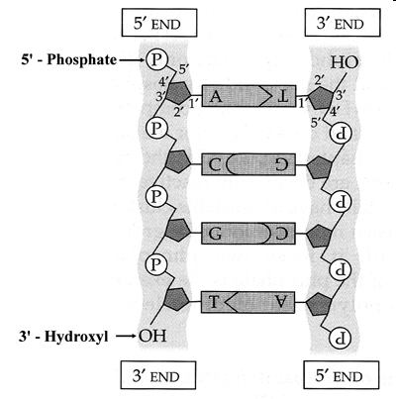
Antiparallel DNA Strands
Two antiparallel DNA polynucleotides leas to the formation of a DNA molecule
Twisting produces the double helix shape

Slide 11
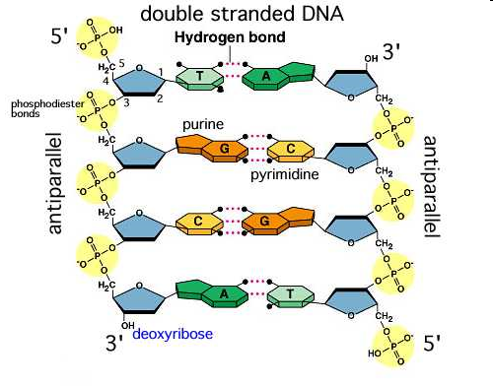
Bases bond with Hydrogen Bonds
A pyrimidine base (T or C) always binds to a purine base (A or G)
Complementary base pairing
G & C bind with 3 H bonds
A & T bind with 2 H bonds

Slide 12
Plenary Task
Make a model of DNA from sweets
http://www.andersononline.org/ourpages/auto/2015/1/21/52509287/Twizzler%20Lab.pdf

