Slide 1
Glucose

Slide 2
Need to book
Molymods (C,H,O, each group will need 6 carbon, 12 hydrogen & 6 oxygen)
Practical Activity 19 (PAG 9)
Repro sheet for Practical Activity 19

Slide 3
Success Criteria
Learning Objective
Know about monosaccharides
Compare alpha and beta glucose molecules
Describe the ring structure and properties of glucose and ribose
Compare hexose and pentose monosaccharides
Explain the formation and breakage of glycosidic bonds
Carry out benedict’s test for reducing sugars

Slide 4
What is the Formulae of Glucose?
C₆H₁₂O₆

Slide 5
Starter
A3 Memory Game

Slide 6
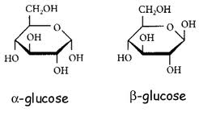
Answers
- Compare alpha and beta glucose molecules
What are the differences?

Slide 7
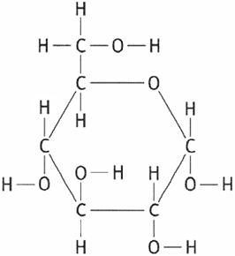
Hexose Monosaccharide: Glucose
- Compare alpha and beta glucose molecules
Remember you can check you’ve done it right by counting the number of C,H,Os and that they all have the right number of bonds

Slide 8
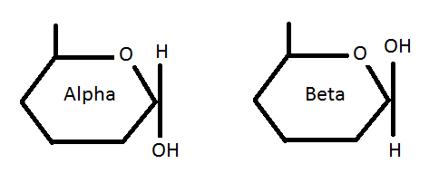
Molecular Diagram
- Compare alpha and beta glucose molecules

Slide 9
Group Task
- Compare alpha and beta glucose molecules
Make model of alpha glucose and beta glucose using page 93 of the textbook and the molymods

Slide 10
Ribose
- Describe the ring structure and properties of glucose and ribose
- Compare hexose and pentose monosaccharides

Slide 11
What are the differences between a Pentose & Hexose Monosaccharides?
- Describe the ring structure and properties of glucose and ribose
- Compare hexose and pentose monosaccharides
Hexose = 6 carbon atoms
Pentose = 5 carbon atoms

Slide 12
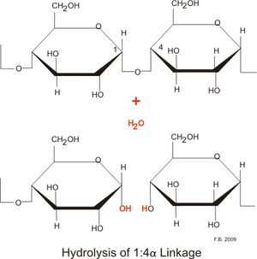
Glycosidic Bonds
- Explain the formation and breakage of glycosidic bonds
Alpha glucose → Maltose → Amylose
Monosaccharide → Disaccharide → Polysaccharide
Glycosidic bonds form between two glucose molecules by a condensation reaction

Slide 13
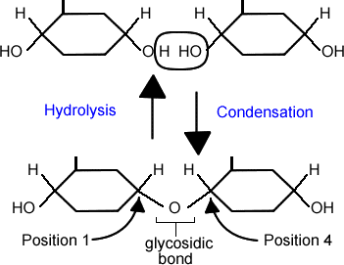
1-4 GlYCosidic Bond Formation
- Explain the formation and breakage of glycosidic bonds

Slide 14
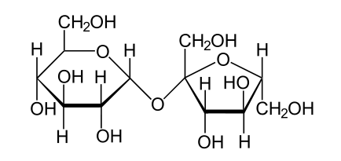
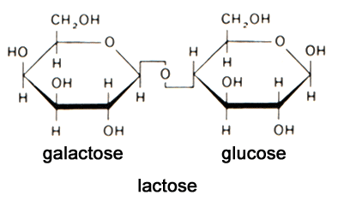
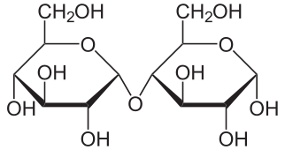
Making Disaccharides
- Explain the formation and breakage of glycosidic bonds
Sucrose
Fructose + Glucose
Lactose
Glucose + Galactose
Maltose
Glucose + Glucose
Sucrose
Maltose

Slide 15
PAG9
Qualitative Testing: Food Tests
You will need in your lab book:
A method for one of the food tests
Results tables for all the food tests
Photos of all the food tests
To be completed by the end of lesson 6 biological molecules

Slide 16
PRACTICAL: Activity 19
- Carry out benedict’s test for reducing sugars
What is the colours of the positive and negative test for:
Starch?
Glucose?
Practical Skills: Evaluative
Analysing experiment

Slide 17
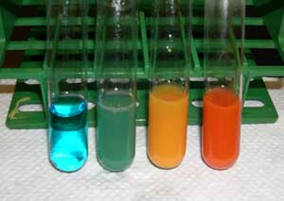
Reducing sugars (Benedict’s test) PAG9
- Carry out benedict’s test for reducing sugars
Add sample to a test tube
Add Benedict’s solution and put in a water bath, heat sample.
Positive test will show a brick red and a range of colours between depending on amount.

Slide 18
NON-Reducing sugars (Benedict’s test) PAG9
- Carry out benedict’s test for reducing sugars
Add sample to a test tube
Add HCl, heat for 5 mins
Sodium hydrogen carbonate to neutralise
Add Benedict’s solution and put in a water bath, heat sample.
Positive test will show a brick red and a range of colours between depending on amount.

Slide 19
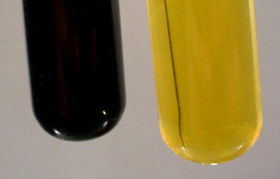
Starch (iodine solution) PAG9
- Carry out benedict’s test for reducing sugars
Add sample to a well in a spotting tile
Add iodine solution to the well
Positive result will show a colour change from orange/brown to blue/black

Slide 20
Testing for | Description | Negative Result | Positive Results
Starch | Add iodine | Brown | Blue/black
Reducing Sugar | Add Benedict’s Heat to 80ºC | Blue | Orange/Red
Non-reducing sugar | Negative to RS Boil in acid Neutralise Add Benedict’s Heat to 80ºC | Blue | Orange/Red

Slide 21
Plenary: Quick Quiz
- Compare alpha and beta glucose molecules
- Describe the ring structure and properties of glucose and ribose
- Compare hexose and pentose monosaccharides
- Explain the formation and breakage of glycosidic bonds
- Carry out benedict’s test for reducing sugars
Sketch alpha and beta glucose in their simplest form to show their structural differences
What type of reaction forms a glycosidic bond?
Condensation

Slide 22
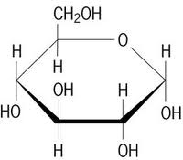
Plenary: Quick Quiz
- Compare alpha and beta glucose molecules
- Describe the ring structure and properties of glucose and ribose
- Compare hexose and pentose monosaccharides
- Explain the formation and breakage of glycosidic bonds
- Carry out benedict’s test for reducing sugars
Sketch in full the alpha glucose structure
What is lactose an example of?
Disaccharide
What monosaccharides are sucrose made from?
Glucose & Fructose

Slide 23
Homework
Write up practical in lab book, must include:
method for Reducing Sugar
Results for reducing sugar and iodine test
Photos of results

Slide 24
Extension: Group TasK
Make 2 alpha glucose molecule and join them together by a glycosidic bond to make maltose
Get your teacher to check your model
Join your maltose model with another groups’ to make amylose

