Slide 1
Microorganisms & Biotechnology
Unit 2
Module 2 – Biotechnology and Gene Technologies

Slide 2
Learning Objectives
Understand what serial dilutions are.
Understand the ‘growth curve’ of microorganisms placed in a closed culture environment.

Slide 3
Success Criteria
Describe how serial dilutions are made.
Describe and explain what is happening at each stage of the growth curve.

Slide 4
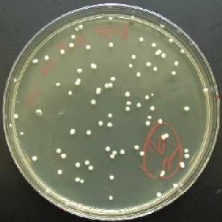
Measuring Bacterial Growth
Scientists may want to measure the growth of a microorganism population.
A sterile broth is inoculated with microorganism, and then small samples are transferred to agar plates at intervals.
The colonies can then be counted.
However, the number of microorganisms in the initial broth can be very high.
There may be too many colonies, which merge and then cannot be seen.

Slide 5
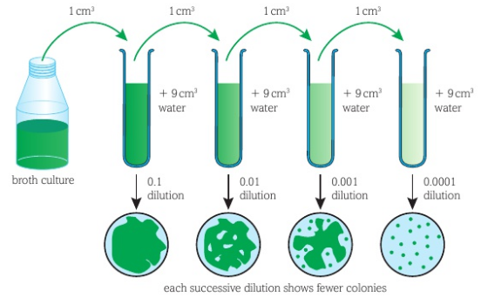
Serial Dilutions
The population density of a liquid broth can be reduced by diluting it.
A step-wise dilution method is used – serial dilution.
At each step, the broth is diluted by a factor of 10 (see diagram).

Slide 6
A drop of each solution can be used to inoculate an agar plate.
One will eventually produce a plate where the colonies can be counted.
Example:
A 10⁻³ strength (0.001 dilution) has been diluted to form a 1 in 1000 ratio of broth to water.
The number of colonies on the agar must be multiplied by 1000.
An accurate population density can only be known if the volume of the drop is also known.

Slide 7
Large-Scale Culture of Bacteria & The Growth Curve

Slide 8
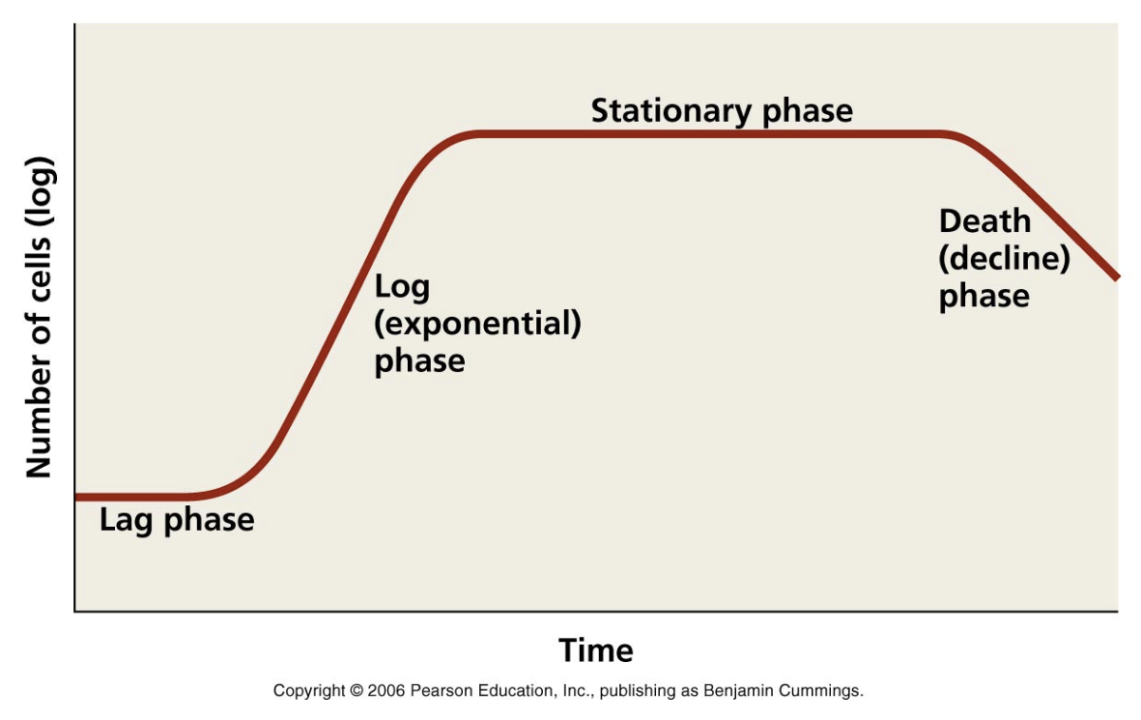
The Growth Curve
We refer to conditions when microorganisms grow in an environment where all conditions are fixed and contained, as closed culture.
No new materials are added and no waste products are removed.
In this kind of environment, the population dynamics follow a predictable and standard route.
The four stages of the growth curve describe what happens to the population of microorganisms in a closed culture.

Slide 9
The Lag Phase
Organisms are still getting used to the environment – taking in water, activating genes and synthesising enzymes.
The cells are not yet reproducing, so the populations remains fairly constant.
The length of this period depends on the growing conditions – nutrient type/quality etc.

Slide 10
Log Phase
Also known as the exponential phase.
Population doubles every generation as there are no limiting factors.
The length of this phase depends on speed of reproduction and rate of uptake of available nutrients and space.

Slide 11
Stationary Phase
Nutrient levels decrease and waste product levels increase.
Carbon dioxide and other metabolites build up.
The rate of death is the same as the rate at which new individuals are being produced.
This keeps the population constant.

Slide 12
Decline or Death Phase
Previously available nutrients have now been exhausted.
Levels of toxic waste products and metabolites lead to the death rate increase above the reproduction rate.
In a closed system, eventually all of the organisms will die.
What could be done to keep the population constant?

Slide 13
Metabolites
Metabolites are substances produced by organisms as part of their normal metabolic reactions.
Primary Metabolites
Substances produced as part of normal growth – amino acids, proteins, enzymes etc.
Production matches the growth in population size.
Secondary Metabolites
Substances produced that are not required for normal growth, such as antibiotics.
The production of these usually begins after the main growth period and does not match the growth in population.

Slide 14
Secondary metabolite production
Primary metabolite production
Note: Only a relatively small number of microorganisms produce secondary metabolites.

Slide 15
Homework
Complete the summary questions on page 261

Slide 16
Learning Objectives
Understand what serial dilutions are.
Understand the ‘growth curve’ of microorganisms placed in a closed culture environment.

Slide 17
Success Criteria
Describe how serial dilutions are made.
Describe and explain what is happening at each stage of the growth curve.

