Slide 1
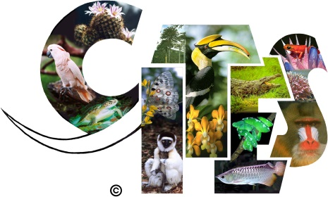
Protection of species and habitats
CITES (The Convention on International Trade in Endangered Species)
Main Aims:
Regulate and monitor international trade in selected species of plants and animals
Ensure that international trade does not endanger the survival of populations in the wild
Ensure that trade in wild plants for commercial purposes is prohibited
Ensure that trade in artificially propagated plants is allowed, subject to permit
Ensure that some slightly less endangered wild species may be traded subject to a permit, as agreed between the exporting and importing countries.

Slide 2
Rio Convention on Biological Diversity (CBD)
It is signed by 150 government leaders in 1992 at the Rio Earth Summit.
It aims to develop international strategies on the conservation of biodiversity and how to use animal and plant resources in a sustainable way.
The convention made it part of international law that conserving biodiversity is everyone's responsibility.
It also provides guidance to governments on how to conserve biodiversity,
And appropriate shared access to genetic resources and scientific knowledge and techniques.

Slide 3
The Countryside Stewardship Scheme (CSS)
The Countryside Stewardship Scheme was introduced in 1991. Some of its aims were to conserve wildlife and biodiversity, restore and re-create targeted landscapes and to improve and extend wildlife habitats by promoting specific management techniques to landowners.
The Government offered 10 year agreements to pay landowners who followed the management techniques they were suggesting. For example, to regenerate hedgerows, to leave grassy margins around the edges of fields where wildflowers could grow, and to graze upland areas to keep down bracken.
This was all to increase the diversity of the countryside by maintaining habitats.
The scheme was replaced by the Environmental Stewardship Scheme in 2005 which aims were to look after wildlife, protect historical features and provide opportunities for people to visit and learn about the countryside.

