Slide 1
Block 1B – Cell division, cell diversity and cellular organisation 2.1.6
Foundations in Biology
Mitosis and the cell cycle – 2 lessons

Slide 2
Starter – Exam questions
Name the 2 different types of integral proteins and explain their roles (2 marks)
Describe the role of cholesterol in the plasma membrane
(2 marks)
3) Describe how the plasma membranes allows hormones to affect the cell (3 marks)
Channel proteins allow substances to diffuse across the plasma membrane (such as ions – polar molecules that are insoluble in lipids)
Carrier proteins actively transports substances across the plasma membrane (such as glucose – to large to pass across)
- cholesterol partially immobilises nearby phospholipids in the plasma membrane (1) This decrease the permeability and maintains mechanical stability of the plasma membrane (1)
Hormones bind to receptor proteins (1) in a complementary way (1) This causes a series of reactions inside the cell (1) Cell signalling

Slide 3
SPEC

Slide 4
Mitosis and Cell Cycle
Learning Objectives
Success Criteria
To understand the cell cycle and how its regulated
To describe the main stages of mitosis and its significance in life cycles
Explain the significance of mitosis (Grade D-E)
Explain the importance of checkpoints in the cell cycle
(Grade C)
Explain the stages of mitosis to include the changes in key parts (see spec) (Grade A-B)

Slide 5
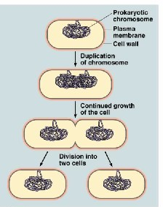
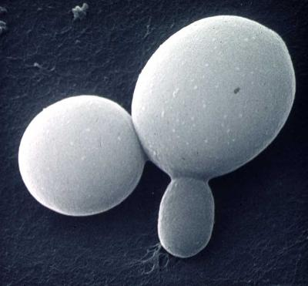
Binary Fision (Bacteria)
Binary fission (Prokaryotes)
Do not have a nucleus, so there are no linear chromosomes
Before they divide DNA is replicated
The 2 new loops of DNA are pulled to opposite ends of the cell. The cell wall forms which begins to separate the bacterial cell.
Each new cell contains plasmids and synthesised ribosomes
How does Yeast divide?
Budding (Yeast)
http://biolibogy.com/cells.html
Notes:
EUKARYOTIC – MITOCHONDRA/CHLOROPLASTS DIVIDE BY BINARY FISSION
Yeast replication not required but worth a discussion
1 A bud is formed at the surface of the cell
2 Interphase – DNA and organelles replicated
3 Set of duplicated chromosomes – each set contained within a nucleus
4 One daughter nucleus migrates into the bud
5 Bud increases in size and eventually separates from parent cell – producing a new, genetically identical yeast cell

Slide 6
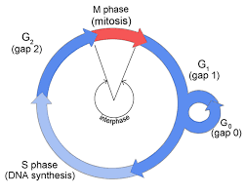
The cell cycle
Challenge – Link to next lesson – Flip learning
Mitosis and cytoplasmic division occupy only a small part of the cell cycle.
M indicates the division phase and interphase is divided into G₁, S and G₂.
Why do you think these stages are important and what could happen at each stage?

Slide 7
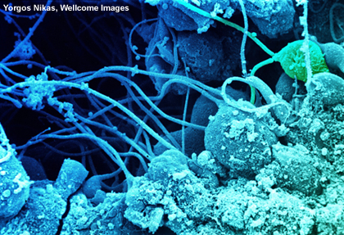
What is the cell cycle?
All cells are formed by division of existing cells. Eukaryotic cells always divide in one of two ways:
Mitosis: division into two daughter cells that are genetically identical to each other and to the parent cell.
Meiosis: division into four unique daughter cells with half the chromosomes of the parent cell.
All cells follow the same sequence of events between mitotic divisions, and this is known as the cell cycle. The length of the cycle varies (from minutes to hours, or , longer) ending with mitosis.
Notes:
New cells can only be made when existing cells divide. All cells have the ability to divide – but some cells lose this ability.
Intestinal epithelial lining - replaced every five days by cell division
Liver cells - divide only to repair damage, and then stop dividing
Bone marrow cells - divide repeatedly to produce red and white blood cells
Meristem cells (tips of roots and shoots) – divide to produce new growth
Cambium cells (plants) – divide to form vascular tissue (xylem and phloem)

Slide 8
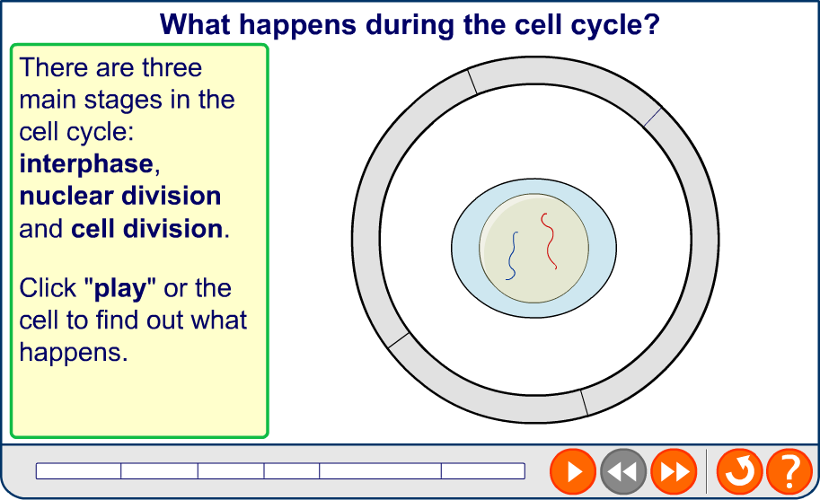
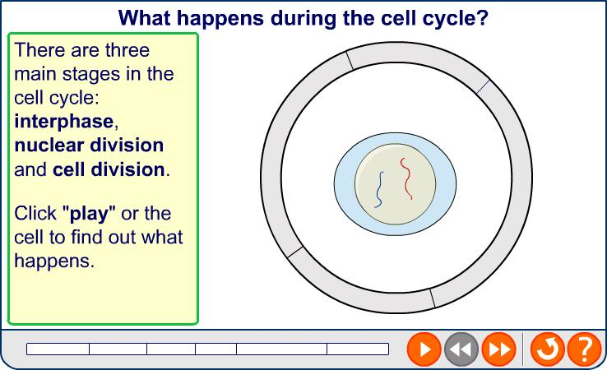
The cell cycle
Refer the worksheet 2 - add notes (read through page 145 in your own time)
Notes:
G1 – Growth phase – organelles duplicate/cell grows, increase in size/transcription of genes to make RNA/ Biosynthesis (making enzymes for next stage) p53 (tumour suppressor gene) helps control this phase
S phase – DNA replicates quickly – each one consists of a pair of sister chromatids
G2 – Cells grow, stimulates proteins that help with the next stage (release chemicals)
M phase - mitosis (chemical triggers condensation of chromatin)
Go - - cells may undergo apoptosis (programmed cell death) differentiation or senescence. NEURONES remain in this stage for a long time or indefintely

Slide 9
The Cell Cycle
The cell cycle can be divided into stages:
G1 (“growth phase” 1) – Cells grow, increase in size. Cells prepare for DNA replication
S (“synthesis”) - DNA replication occurs
G2 (“growth phase” 2)- Short gap before mitosis. Cells grow.
M Mitosis (relatively short)
Cells should undergo approx. 50 cell divisions this is known as the Hayflick constant.
Between each stage the cell “checks” to see if it is OK to proceed to the next stage.
G1/S checkpoint = restriction point, this is to ensure the cell is ready to enter the S phase and begin DNA replication
G2/M checkpoint, uses special chemicals to ensure proteins required for making chromosomes condense are stimulated
These check points ensure genetically identical information is passed to daughter cells, detect and repair damage to DNA, prevent uncontrolled cell division.
“Proof-reading” enzymes check the copied chromosomes for mistakes (mutations) – the cell may kill itself (undergo “suicide”) if harmful mutations are – a process known as apoptosis.
Uncontrolled and repeated cell division by mitosis results in cancer (tumours)
Notes:
P53 – Tumour suppressor gene – it triggers the 2 main check points in regulating the cell cycle. Cyclins and CDKs (cyclin-dependent kinases) and also regulatory chemicals. Complete check point notes on worksheet 1

Slide 10
Control of the cell cycle
2.1.6b
Cell can only divide to produce two identical daughter cells if:
The cell has grown to the right size.
The replicated DNA is error-free.
Chromosomes are in the correct place ready for mitosis.
Checkpoints are control mechanisms – monitor and verify each phase of cell cycle has occurred correctly before moving on to next one.
3 of them: G₁, G₂ and spindle assembly checkpoints

Slide 11
A resting stage
G₀ triggered during G1 at restriction check point by a checkpoint chemical. The cell may leave the cell cycle at this point.
Happens when a cell:
Differentiates to carry out a function – cell no longer able to divide. Neurones can remain in this stage indefinitely
Has damaged DNA – cannot divide any longer. Results in programmed cell death (apoptosis).
Ages – cells can only divide a certain number of times – they become senescent. (Linked to age-related disease).
Lymphocytes can re-enter the cell cycle when stimulated in an immune response.
Epithelial cells lining the gut do not have this stage
Notes:
If proto-oncogenes (these regulate cell division by coding for proteins that regulate cell growth/differentiation ) mutate they become oncogenes and these cells fail to undergo apoptosis, so keep dividing uncontrollably

Slide 12
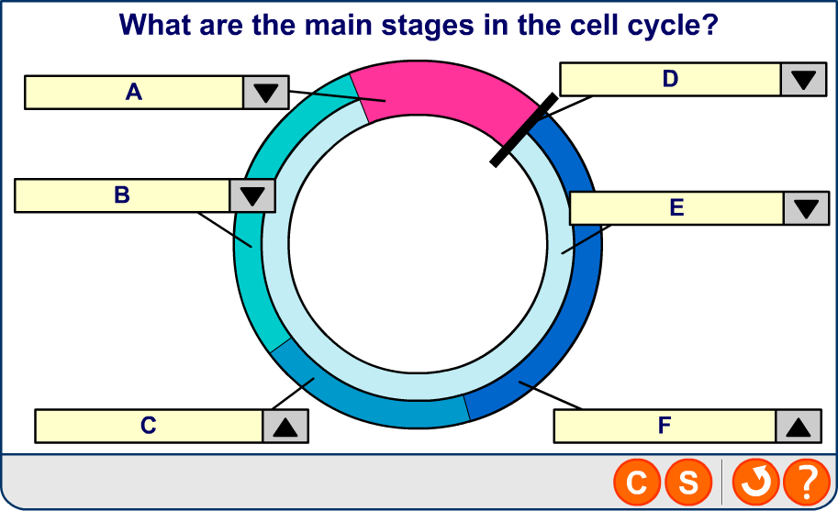
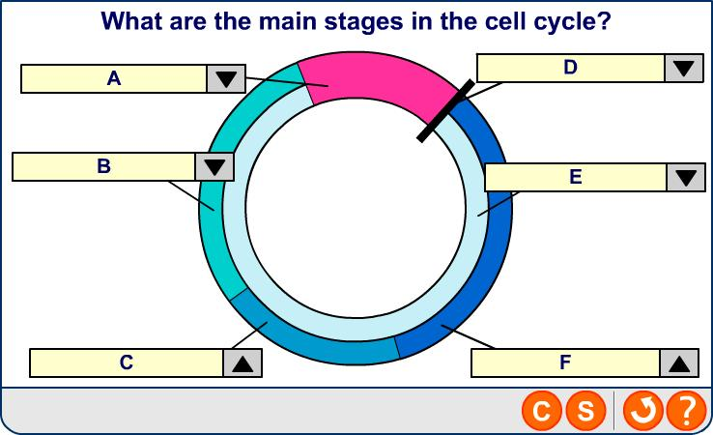
Stages of the cell cycle

Slide 13
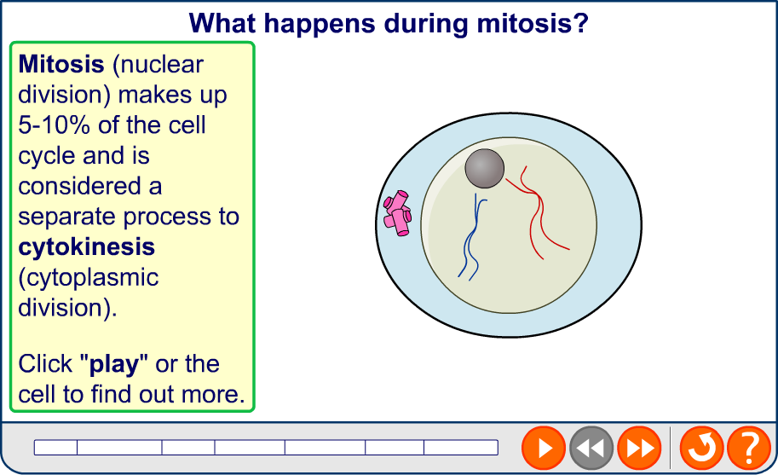
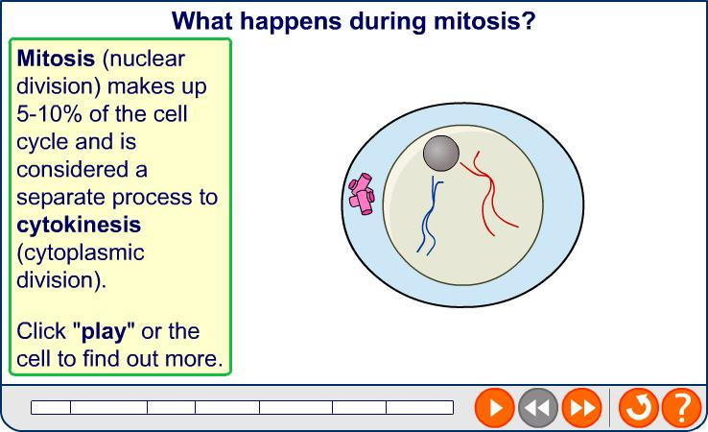
Mitosis
Use the textbook page 148-149 to annotate your worksheet with the events at each stage
Notes:
Teacher notes
For clarity, only one pair of chromosomes is shown here.
Cytokinesis is considered separate from mitosis because they are not always coupled. Cytokinesis usually happens during telophase, but this isn’t necessarily the case: coenocytic cells go through telophase without cytokinesis, sometimes several times, gaining multiple nuclei.

Slide 14
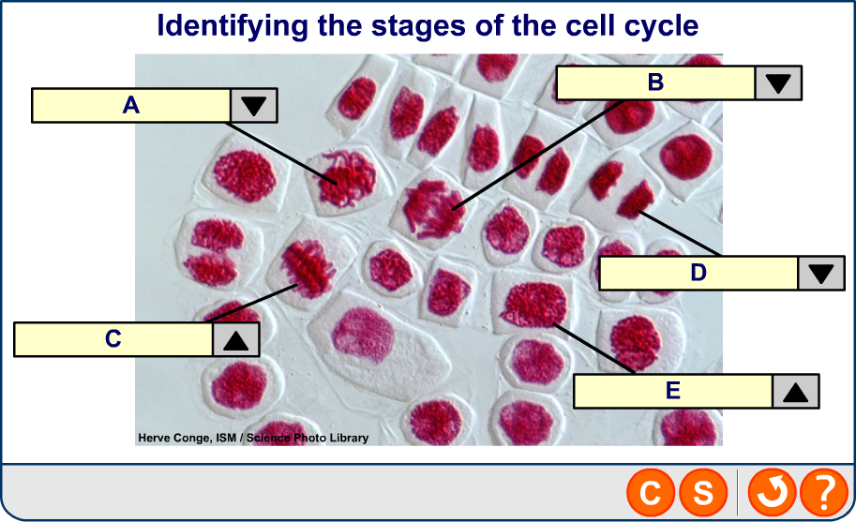

Stages of the cell cycle
Notes:
Photo credit: Herve Conge, ISM / Science Photo Library
Light micrograph of hyacinth root cells undergoing mitosis (nuclear division). Mitosis is the formation of two daughter nuclei from one parent nucleus. One cell at centre left is in metaphase. The chromosomes, which contain 2 identical chromatids and are made of deoxyribonucleic acid (DNA, red), are lining up along the centre of the cell. the chromatids are then separated during anaphase (upper centre). At left a cell is in telophase, the last stage of mitosis before cytokinesis (cellular division). The chromosomes have been separated and moved to opposite poles of the cell. The chromatids are divided equally between the daughter cells. Magnification: x280 at 10 centimetres wide.

Slide 15
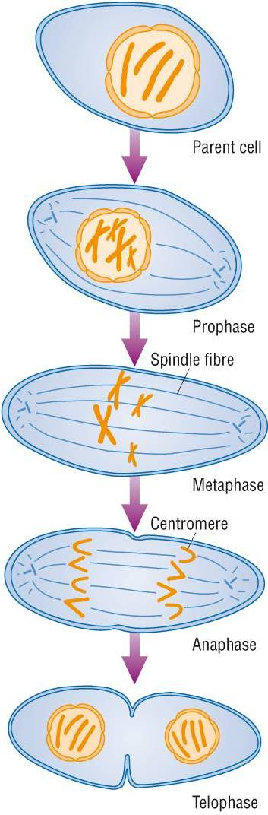
Before a cell divides, its chromosomes are copied exactly in INTERPHASE. This process is called replication; ATP is synthesised – provides energy for cell division; organelles are replicated and proteins are made
PROPHASE
The DNA of each chromosome is copied to form two chromatids (“sister” chromosomes); chromosomes condense – becoming shorter and fatter – visible under LM; nuclear envelope breaks down; chromosomes lie freely in cytoplasm; centrioles move to opposite ends of the cell, forming protein (tubulin) fibres across it called a spindle – fibres extend to the equator of the cell
METAPHASE
Chromosomes line up at the equator; the spindle fibres from each pole become attached to the centromere of the chromosomes
ANAPHASE
The spindle fibres contract; the centromeres are split and the pairs of sister chromatids are separated and dragged to opposite poles assuming a “V” shape – the centromeres lead; a complete set of chromosomes is therefore found at each pole; energy (ATP) is required
TELOPHASE
Chromatids reach their respective poles and uncoil – become thin and long again – now called chromosomes again – no longer visible under LM; spindle fibres break down; nuclear envelope forms around each group of chromosomes – forming two nuclei; cytokinesis follows – cytoplasm divides and a plasma membrane forms two form two individual cells; cell enters interphase once again

Slide 16
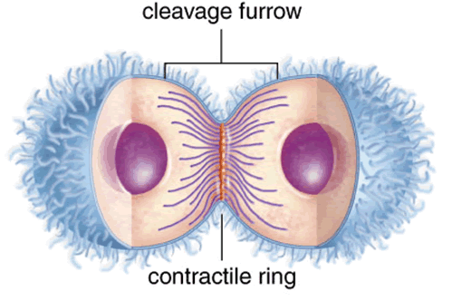
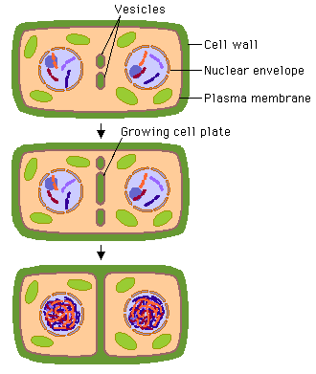
Cytokinesis
In animal cells the cell surface membrane is pulled in wards by the cytoskeleton until its close enough to fuse around the middle forming 2 new cells
Plant cells have walls, so cytokinesis cannot proceed with a cleavage furrow. Instead, during telophase a cell plate forms across the cell in the location of the old metaphase plate.
During telophase, membrane-enclosed vesicles derived from the Golgi apparatus migrate to the centre of the cell and fuse to form a cell plate. The growing cell plate fuses with the existing plasma membrane, producing two daughter cells, each with its own plasma membrane. Then a new cell wall forms.
Complete exam questions - SA

Slide 17
Task
Challenge – complete application question
Complete exam questions
SA
(a) Metaphase (1 mark)
(ii) Chromosomes line up at the equator; (1) the spindle fibres from each pole become attached to the centromere of the chromosomes (1) (2 marks)
(b) Chromatids uncoil and are called chromosomes again (1) spindle fibres break down (1) nuclear envelope forms around each group of chromosomes – forming two nuclei (1) the cell surface membrane is pulled inwards to form 2 new cells, this is called cytokinesis (1) (4 marks)
Plant cells have cell walls so cytokinesis can’t proceed by a cleavage furrow (1) , instead a cell plate is formed (1) (2 marks)
(a) X = Metaphase (1) Y = Anaphase (1) (2 marks)
Total = /11
Notes:
Concentration gradient breaks down because the nuclear envelope breaks down to allow the formation of chromosomes. Concentration gradients are dependent upon the impermeability of the membrane, the concentration gradient weakens and disappears.

Slide 18
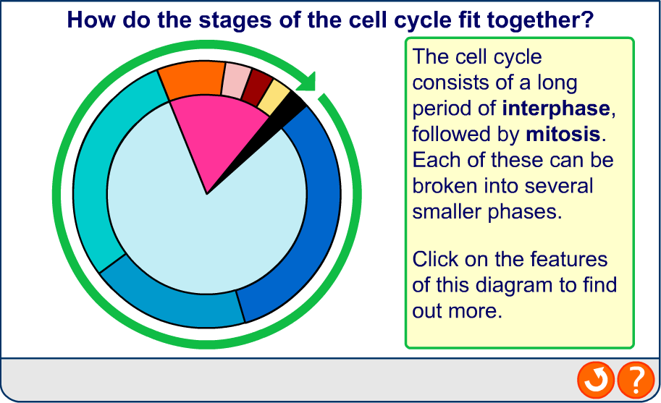

Cell cycle summary

Slide 19
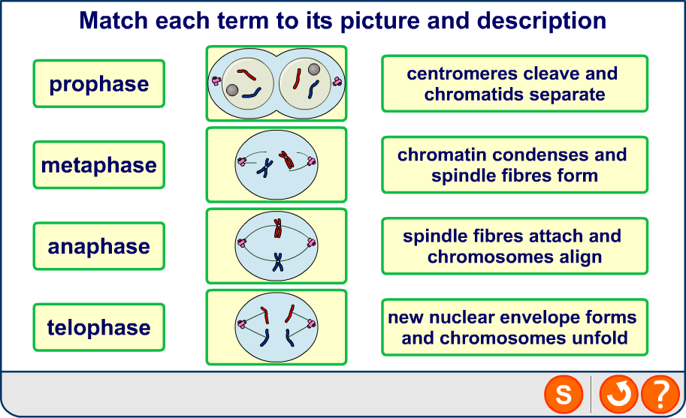
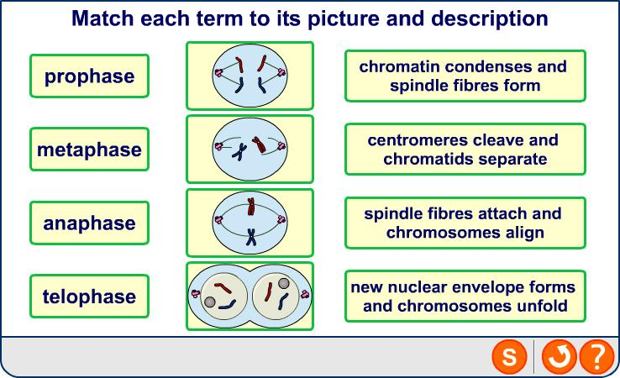
Phases of mitosis - Plenary

