Slide 1
Monohybrid crosses and codominance
Patterns of Inheritance

Slide 2
Learning outcomes
(i) genetic diagrams to show patterns of inheritance
To include monogenic inheritance, dihybrid inheritance, multiple alleles, sex linkage and codominance.

Slide 4
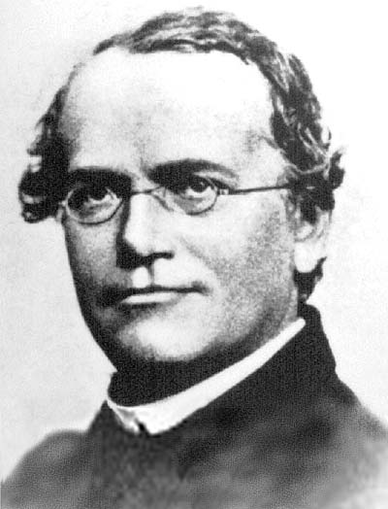
Inheritance
Gregor Mendel (often called the father of genetics).
He investigated inheritance by crossing varieties of pea plants that had different characteristics. He used true-breeding strains, where the characteristic had appeared unchanged for many generations
Monohybrid crosses – involving one gene

Slide 5
Monohybrid Crosses
Mendel was looking at one characteristic
P₁ (parental generation) True- breeding for a particular characteristic
All the offspring from this cross, the first generation are known as the F₁ generation.
Crossing this first generation gives the second generation known as the F₂ generation.

Slide 6
Steps to take when drawing a monohybrid cross
T Tall-stemmed t – short stemmed
Parents P1 TT x tt
genotypes
Gametes
Genotypes for F1
generation Tt Tt Tt Tt
Gametes
Genotypes for F2
generation TT Tt Tt tt
Phenotypes Tall Tall Tall small
Ratio of F2 generation 3 : 1
Choose one letter to represent dominant and recessive alleles
Work out what the parental genotypes are and then what gametes they might produce
Work out what the offspring could be
Look at what the phenotypes are in the F₁ generation
(ALL tall)
Second cross of offspring
Show gametes of F1 generation
Work out what the offspring could be
Look at what the phenotypes are in the F2 generation
Work out ratios
T
T
t
t
T
t
T
t

Slide 7
Same thing using punnett squares
T Tall-stemmed t – short stemmed
Parents TT x tt
genotypes
Gametes
Genotypes for F1
generation
Tt x Tt
Genotypes for F2
Generation
Ratio of F2 generation 3 tall : 1 short
Choose one letter to represent dominant and recessive alleles
Work out what the parental genotypes are and then what gametes they might produce
Using a punnett square work out what the offspring of the F1 generation could be
Look at what the phenotypes are in the F₁ generation
(All tall)
Second cross of offspring
Using a punnett square work out what the offspring of the F2 generation could be
Look at what the phenotypes are in the F2 generation
Work out ratios
T
T
t
t
T
T
t
Tt | Tt
Tt | Tt
t
T
t
T
TT | Tt
Tt | tt
t

Slide 8
Exam question
1.The ability to taste the chemical PTC is determined by a single gene in humans with the ability to taste given by the dominant allele T and inability to taste by the recessive allele t. Suppose two heterozygous tasters (Tt) have a large family.
a. Predict the proportion of their children who will be tasters and non-tasters. Use a Punnett square to illustrate how you make these predictions.
b. What is the likelihood that their first child will be a taster?
c. What is the likelihood that their fourth child will be a taster?

Slide 9
1.The ability to taste the chemical PTC is determined by a single gene in humans with the ability to taste given by the dominant allele T and inability to taste by the recessive allele t. Suppose two heterozygous tasters (Tt) have a large family.
a. Predict the proportion of their children who will be tasters and non-tasters. Use a Punnett square to illustrate how you make these predictions.
Heterozygous tasters
Tt X Tt
75 % Taster and 25% non-tasters
b. What is the likelihood that their first child will be a taster?
75 %
c. What is the likelihood that their fourth child will be a taster?
75%
 | T | t
T | TT | Tt
t | Tt | tt

Slide 10
EXAM QUESTION
Q2. In certain trees, smooth bark is dominant over wrinkled.
a. Cross two trees that are heterozygous for smooth bark. b. If there are 100 offspring produced, how many will have wrinkled bark.
Trees : Allele Key B = Smooth and b = wrinkled
Heterozygote X Heterozygote
Phenotype: Smooth X Smooth
Genotype: Bb X Bb
Offspring Genotype: BB :2Bb : bb
Phenotype Ratio: 3 Smooth: 1 Wrinkled
Offspring : 75 Smooth : 25 Wrinkled
 | B | b
B | BB | Bb
b | Bb | bb

Slide 11
Monohybrid Crosses – try these situations. What will the offspring be?
Unattached and attached ear lobes. Unattached is dominant. Heterozygous female and homozygous recessive male.
E – attached earlobe
e – unattached earlobe
Heterozygous female Ee
Homozygous recessive male ee
Tall and short plants. Tall is dominant. Homozygous dominant female and heterozygous male.
T – tall t – short
Homozygous dominant female TT
Heterozygous male Tt
 | E | e
e | Ee | ee
e | Ee | ee
50% attached earlobe (Ee)
50% unattached (ee)
 | T | T
T | TT | TT
t | Tt | Tt
All tall

Slide 12
GOLDEN RULES
Homozygous dominant x homozygous recessive = all heterozygous.
Heterozygous x heterozygous = 3 : 1 ratio
Heterozygous x homozygous recessive (test cross) = 1 : 1

Slide 13
Test cross
This is used to determine the genotype of an individual showing the dominant characteristic.
In our example of tall and short stemmed plants, a plant with the phenotype tall could have the following genotypes
homozygous TT
or
heterozygous Tt
Both plants would look the same, a test cross can be used to identify the genotype.

Slide 14
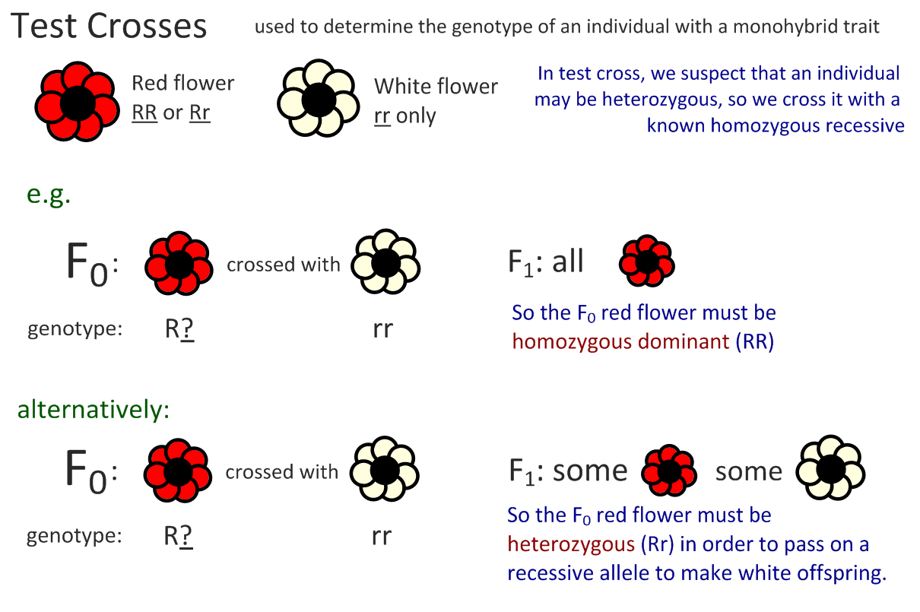

Slide 15
Codominance
What is codominance?
When both alleles are present they both affect the phenotype (equally dominant)

Slide 16
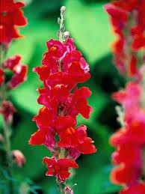
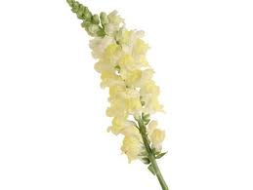
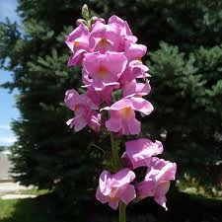
Snapdragon Flowers
An example of codominance: both alleles are expressed in the phenotype when the plant is heterozygous
Alleles code for red or white
When one of each allele is present then the flower is pink (some flowers could be red and white spotted)

Slide 17
Snapdragon Flowers – more detail
Homozygous Red
The 2 alleles for red flowers code for an enzyme which catalyses red pigment formation, hence the flowers are red
Homozygous White
The 2 alleles for white flowers do not code for the enzyme, so no pigment is produced, hence the flowers are white
Heterozygous
The one red allele codes for some pigment, but only enough to make the flower pink, not red

Slide 18
Codominance: Punnet Squares
Do not use one upper and one lower case letter, as we are not talking about recessive and dominant alleles
Use 2 different letters as superscripts
Snapdragon Flowers
Red flowers = C^{R}C^{R}
White flowers = C^{W}C^{W}
Pink flowers = C^{R}C^{W}
TASK:
Draw a punnett square for crossing a red flower with a white flower.
Once you find out the F₁ generation, draw a punnett square for crossing 2 of these plants to find out the F₂ generation

Slide 19
Codominance
Crossing a red flower with a white flower
Male gametes
C^{R}
C^{R}
All offspring are pink
Female gametes
C^{W}
C^{R}C^{W}
C^{R}C^{W}
C^{W}
C^{R}C^{W}
C^{R}C^{W}

Slide 20
Codominance
Crossing the F₁ to find the F₂ (Crossing 2 pink flowers)
Male gametes
C^{R}
C^{W}
Offspring :
50% pink,
25% red,
25% white
Female gametes
C^{R}
C^{R}C^{R}
C^{R}C^{W}
C^{W}
C^{R}C^{W}
C^{W}C^{W}

Slide 21
Homework
Research and prepare a leaflet on sickle cell anaemia. It should include
Symptoms in tissues (2)
Causes at the genetic level (2)
Affect on protein structure (1)
Codominance (2)
Worldwide distribution and the link to malaria (2)
Why does the sickle cell allele persist? (1)
REMEMBER to review your notes and practice
exam questions from the textbook!!!

Slide 22
Learning outcomes
(i) genetic diagrams to show patterns of inheritance
To include monogenic inheritance, dihybrid inheritance, multiple alleles, sex linkage and codominance.

