Slide 1
Transcription

Slide 2
Need to book
Plasticene
Repro
Transcription Translation video questions for flip learning task
Standard Homework & Feedback sheet
Past paper questions
Could also use hwk sheet

Slide 3
Intro
http://www.hhmi.org/biointeractive/central-dogma-song
Play whilst students settle

Slide 4
What is the genetic code?
The genetic code of an organism is the sequence of bases along its DNA. It contains thousands of sections called genes or cistrons. Each gene codes for a specific polypeptide.
one gene
thousands more bases in gene (not shown)
All polypeptides are made from amino acids, so the sequence of bases in a gene must code for amino acids.
The genetic code is almost universal – the same sequence of bases codes for the same amino acids in all organisms.
Eg TCT codes for serine in any organism.
Notes:
Teacher notes
The genetic code in mitochondria and chloroplasts (which both contain their own DNA) is slightly different to genomic DNA.
The size of genes varies enormously. In humans, the average gene contains 10,000–15,000 bases (10–15 kb).

Slide 5
Learning Objective
Know about protein synthesis
Success Criteria
Describe transcription
Describe the nature of the genetic code

Slide 6
Think, Pair, Share
Describe transcription
Definition of a gene

Slide 7
Key Definition: Gene
Describe transcription
A sequence of DNA nucleotides that codes for a polypeptide

Slide 8
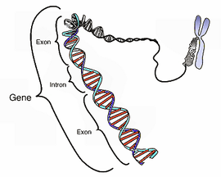
DNA
Describe transcription
DNA molecules consist of 2 polynucleotide strands linked together
The sequence of bases enables the DNA to store information
Introns (junk DNA) are regions of DNA that enable several different proteins that share some sections in common to be produced from a single gene
At some loci there are multiple repeats of certain triple letters
e.g. CAGCAGCAG

Slide 9
Protein synthesis
Describe transcription
3 organelles are needed to create a functioning protein:
Nucleus
Ribosome
Golgi Apparatus

Slide 10
A Problem
DNA is in the nucleus
Protein synthesis takes place in the cytoplasm
How does the code get transferred to the cytoplasm?

Slide 11
Protein Synthesis Overview
Describe transcription
Consists of two stages:
Transcription: making mRNA from DNA in the nucleus
Translation: using the mRNA template to make a polypeptide chain in the cytoplasm
tRNA and ribosomes are also needed
The polypeptide chain can then be sent to the Golgi for modification
Transcription Translation

Slide 12
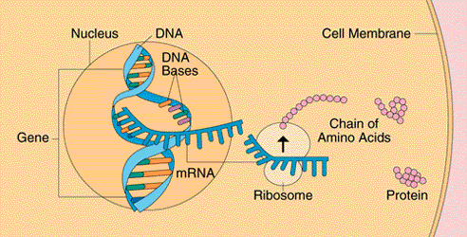
Describe transcription

Slide 13
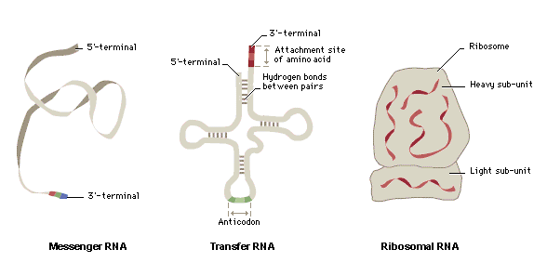
RNA
There are 3 types of RNA all involved in protein synthesis.
Messenger RNA (mRNA) – has a role in transcription
Transfer RNA (tRNA) – has a role in translation
Ribosomal RNA (rRNA) structural and functional role in ribosomes

Slide 14
Gene expression
When a gene is ‘switched on’ or expressed, it is transcribed into
an mRNA strand which is then translated into a protein.
Proteins, such as enzymes, can control chemical reactions and therefore determine how an organism grows, develops and functions.
Only some of the many genes in a cell will be expressed at any one time. This is key to controlling development and cell differentiation.

Slide 15
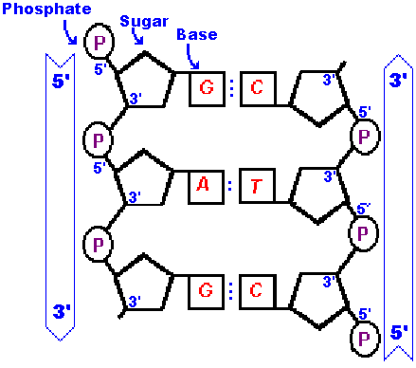
Template Strand
Describe transcription
2 Strands of DNA
Sense strand (5’-3’)
Code for the protein
Antisense strand (3’-5’)
Template strand
Complementary RNA strand will then be the same as the sense strand

Slide 16
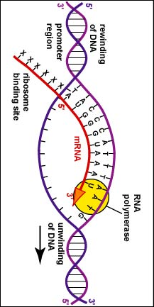
Transcription: making messenger RNA
Describe transcription
DNA unwinds and unzips at the required gene
DNA Helicase breaks the hydrogen bonds
Free RNA nucleotides pair up with the complementary bases on the antisense strand
Remember RNA has no thymine, so uracil pairs up with adenine
Phosphodiester bonds form between the RNA nucleotides
By RNA Polymerase
mRNA leaves the nucleus via the nuclear pore

Slide 17
Task: Model Transcription
Describe transcription
Use plasticene to model transcription

Slide 18
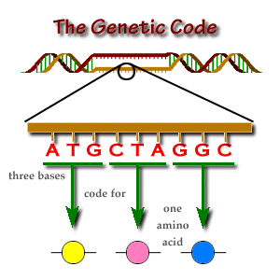
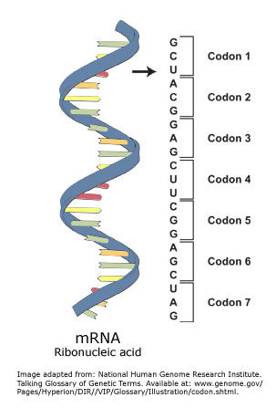
Codons
mRNA moves out of the nucleus through the pores in the nuclear membrane and into the cytoplasm.
The base sequence in the mRNA is used as a guide for assembling the sequence of amino acids that will be a polypeptide.
The sequence of 3 bases on the mRNA is called a codon.
Each codon codes for a specific amino acid to be added to a polypeptide.

Slide 19
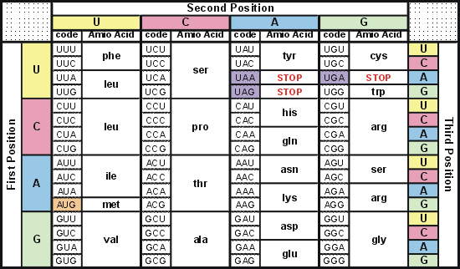
Using the table we can find the correct amino acid from looking at the mRNA codon.
Different codons can code for the same amino acid. The code is said to be degenerate.

Slide 20
Nature of Genetic Code
Describe the nature of the genetic code
Triplet Code
Non-overlapping
Degenerate
Universal
Think, Pair, Share:
What does this mean?

Slide 21
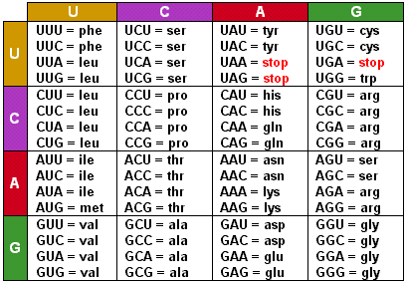
Nature of Genetic Code
Describe the nature of the genetic code
Triplet Code: Every 3 bases codes for 1 amino acid
Non-overlapping
Each triplet is a separate code
Degenerate
3rd base changes and the amino
acid coded for stays the same
Universal
Code is the same for all organisms

Slide 22
Task: Translation
Describe transcription
Describe the nature of the genetic code
DNA | TAC | CGG | AGT | GCA | TTC | GCT
mRNA

Slide 23
Task: Translation Answers
Describe transcription
Describe the nature of the genetic code
DNA | TAC | CGG | AGT | GCA | TTC | GCT
mRNA | AUG | GCC | UCA | CGU | AAG | CGA

Slide 24
Flip Learning Task: Video Clip
http://www.youtube.com/watch?v=itsb2SqR-R0
Watch video and answer the questions

